Slide 1
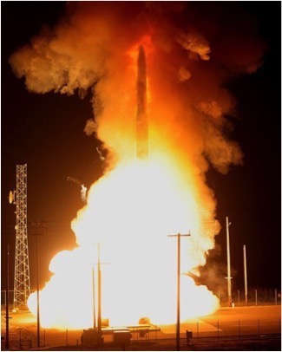
Predictively Effective Planetary Defense Systems
Planetary Defense
Redondo Beach
Charlie Vono
Notes:
“Boulder-Size” Asteroid Disintegrates Over Botswana.
The AP (6/4) reports that a boulder-size asteroid “disintegrated harmlessly over Africa, just hours after its weekend discovery.” The 2018 LA asteroid was discovered “near the moon’s orbit early Saturday morning,” only the “third time scientists have spotted an incoming asteroid on a direct collision course with Earth.” Asteroid trackers quickly determined that the asteroid was “too small to pose any danger.” NASA officials used the object’s approach as a training exercise, as the agency’s “ability to zoom in on likely impact areas bodes well for the future, if and when a bigger object heads our way.” In a statement, NASA Planetary Defense Officer Lindley Johnson explained that the “real-world event allows us to exercise our capabilities and gives some confidence our impact prediction models are adequate to respond to the potential impact of a larger object.”
The Washington (DC) Post (6/4) hosts video of the asteroid taken as it entered the atmosphere.

Slide 2
Overview
Keeping highly complex ICBMs viable since the 1950’s yields lessons in how to design a planetary defense system

Slide 3
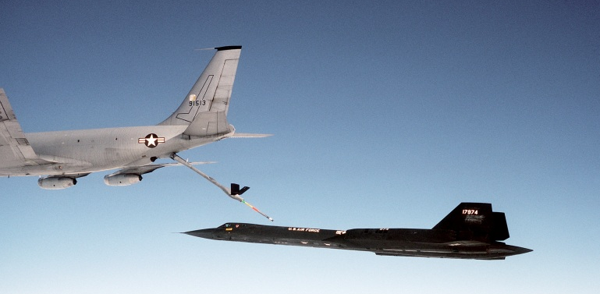
Charlie Vono
charlesvono.com
EDUCATION
B.S. Astronautical Engineering, USAF Academy, 1976
M.S. Systems Management, USC, 1985
Crawford Slip Method under Dr. C.C. Crawford
M.S. Mechanical Engineering, USU, 1995
Air University, 1996
US AIR FORCE Retired Colonel
KC-135 Aircraft Commander
Inertial Upper Stage Software Systems Chief
F-16 Structural Engineer
Ogden Air Logistics Center Staff (sustainment)
Pacific Command Reserve Forces Division Chief (ops)
TRW & NORTHROP GRUMMAN Retired
ICBM Engineer and Technical Manager, propulsion & guidance
Weapon system sustainment expert
Other Interests
AIAA Associate Fellow, SAME, INCOSE
AIAA Distinguished Lecturer
Utah Engineers Council
Husband of the Turtle Lady
Author
Notes:
That is my key contribution, I think. To imagine a future where the Planetary Defense System must continuously justify its existence to decision-makers who hold the purse strings. Does the system provide the required insurance against attack? To what level of probability? To what level of confidence?

Slide 4
My Web Site
Notes:
Go here for these charts, the video, information on my other presentations and writings leave comments

Slide 5
Overview
Keeping highly complex ICBMs viable since the 1950’s yields lessons in how to design a planetary defense system
Notes:
The theme of my talk today

Slide 6
Overview
Keeping highly complex ICBMs viable since the 1950’s…
yields lessons in how to design a planetary defense system
Notes:
Transition chart

Slide 7
Overview
Keeping highly complex ICBMs viable since the 1950’s (SUSTAINMENT)
yields lessons in how to design a planetary defense system (SUSTAINABILITY)
Notes:
Make the distinction between sustainment, which happens after deployment, and sustainability, which happens during design

Slide 8
Sustainability vs. Sustainment
Sustainment is what the poor bastard realizes he has to do when someone else drops a system in his lap and tells him to keep it working
Sustainability is the first design criteria to be ignored when money is short; no one is sure what doing it entails since it hasn’t happened yet
Notes:
Joke, but funny because it have so much truth to it.
But also takes a lot of liberties with definitions, which is usually not a good thing

Slide 9
Sustainment, Sustainability, Supportability
Sustainability: Designing for energy efficiency in operations, retirement, demilitarization, reclamation, materiel disposition, and disposal planning and execution
System Specific: ESOH, PESHE, and National Environmental Policy Act Executive Order 12114
Universal: The need to preserve Earth’s natural resource base for use in the future
Supportability: A key component of availability
Generally related to the design characteristics of a system with overlap in reliability and maintainability
“The degree to which a system can be supported, both in terms of the inherent design characteristics of the prime mission-oriented components of the system and characteristics of the various elements of support…”
Design, tech support data, maint procedures to facilitate detection, isolation, timely repair/replacement of anomalies
Diagnostics, prognostics, real time maintenance data collection, and Human System Integration (HSI)
Standardization, interchangeability, accessibility, diagnostics, compatibility among the elements of logistic support
Sustainment: Tailored product support to achieve specified and evolving life cycle product support availability, reliability, and affordability parameters.
Supply; maintenance; transportation; sustainment engineering; data management; configuration management; human systems integration (HSI); environment, safety (including explosives), and occupational health; protection of critical program information and anti-tamper provisions, supportability, and interoperability.
Begins at Materiel Solution Analysis, matured during Technology Maturation and Risk Reduction, ends at disposal
Too Legalistic To Be Universally Helpful
Notes:
Actual Defense Acquisition University Definitions.
Helpful, but always a bit too legalistics due to DAU’s charter to train professional acquisition experts.
Environment, Safety, and Occupational Health (ESOH) planning and execution, Programmatic Environment, Safety, and Occupational Health Evaluation (PESHE), and National Environmental Policy Act Executive Order 12114

Slide 10
Fundamental Theorem of Sustainment
“An effective sustainment organization will always find ways to affordably detect threats to the system in time to correct them before the mission is impacted.”
Notes:
A fundamental theorem helps establish a domain of knowledge. For instance, the Fundamental Theorem of Calculus links differentiation and integration. Or the first fundamental theorem of welfare economics (also known as the “Invisible Hand Theorem”):
any competitive equilibrium leads to a Pareto efficient allocation of resources.

Slide 11
The Complex System Sustainment Management Model
Readiness Factors
Reliable
Available
Accurate
…
Sustaining Your System
Observe: Assessment Program
Identify: Risk Management
Fix: Long-Range Planning
Enablers
People: Everyone a Leader
IT: Handling Big Data
Processes: Disciplined Approaches
Notes:
“An effective sustainment organization will always find ways to affordably detect threats to the system in time to correct them before the mission is impacted.”
Discuss the “Observe – Identify – Fix” part and more if time permits. Lead into next chart: predicting the future. “in time to correct them”

Slide 12
Predicting the Future
SUSTAINMENT:
Good sustainment predicts the future.
Predicting the future is, of course, impossible.
“It's tough to make predictions, especially about the future.” – Yogi Berra
Notes:
“It's tough to make predictions, especially about the future.” – Yogi Berra

Slide 13
How to Predict the Future
Restrict the act of Prediction:
Search diligently for emerging failure modes
Characterize the physical properties of the degradation as thoroughly as possible
Assume these physical properties continue down some logical path.
Control for Errors:
bad physical model, environmental conditions change in the future, unforeseen interactions of chemical processes, data we used turns out to be defective in some way, unexpected additional emerging failure modes that interact with the first one, etc., etc.
Attain benefits from having many, many copies of a similar system
Aggregate data to predict that, as a group, those multiple copies will have a predictable reliability, within definable confidence bounds.
Additional tests or operational data can help refine the math.
Notes:
“It's tough to make predictions, especially about the future.” – Yogi Berra

Slide 14
Overview
Keeping highly complex ICBMs viable since the 1950’s yields lessons in how to design a planetary defense system
Notes:
Transition to classic 3 point overview chart

Slide 15
Overview
Sustainment
Highly Complex ICBMs
Viable
Since the 1950’s
How to design a planetary defense system

Slide 16
Overview
Sustainment
Viable Highly Complex ICBMs Since the 1950’s
How to design a planetary defense system
Notes:
We’ve already discussed a lot about sustainment. Now we need to explain bullet two. A short history lesson is needed here.

Slide 17
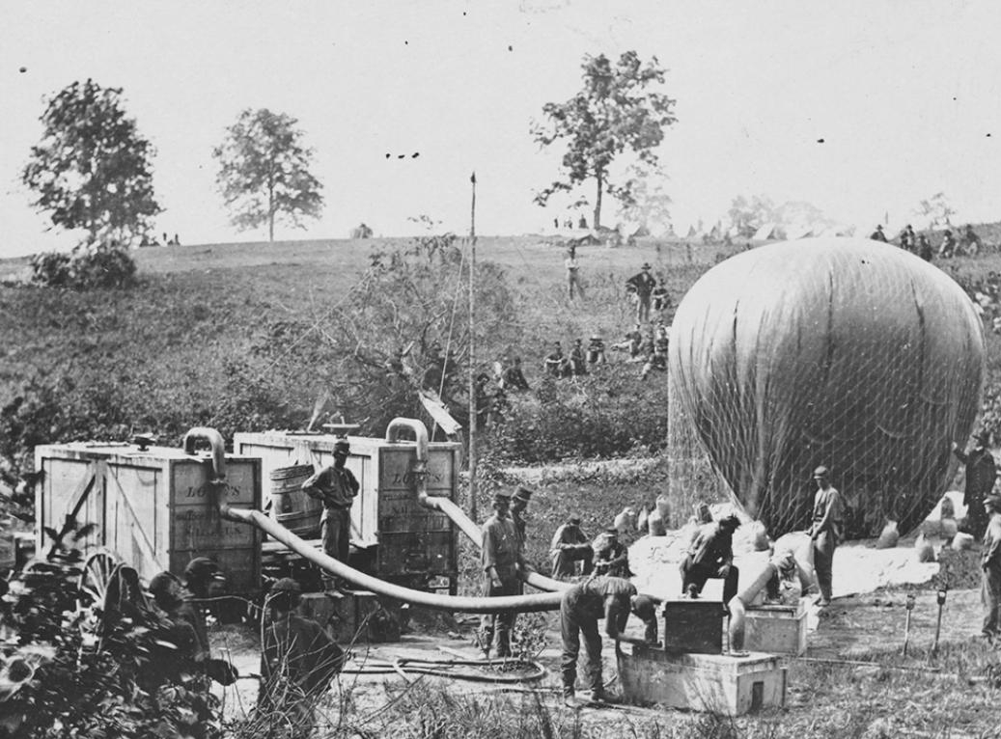
A Brief History of Strategic Bombardment
1775
1st Industrial Revolution
Birth of “Systems”
-- From hand production to
machines
- New chemical manufacturing
- New iron production processes
- Increasing use of steam power
- Development of machine tools
- Rise of factory system
1800
1825
1850
American Civil War: Industrialized Warfare Begins
1875
2nd Industrial Revolution
“Systems” Mature
- New steel making processes
- Large-scale tool manufacture
- Advanced machinery / Steam-power
1900
Notes:
Thaddius Lowe

Slide 18
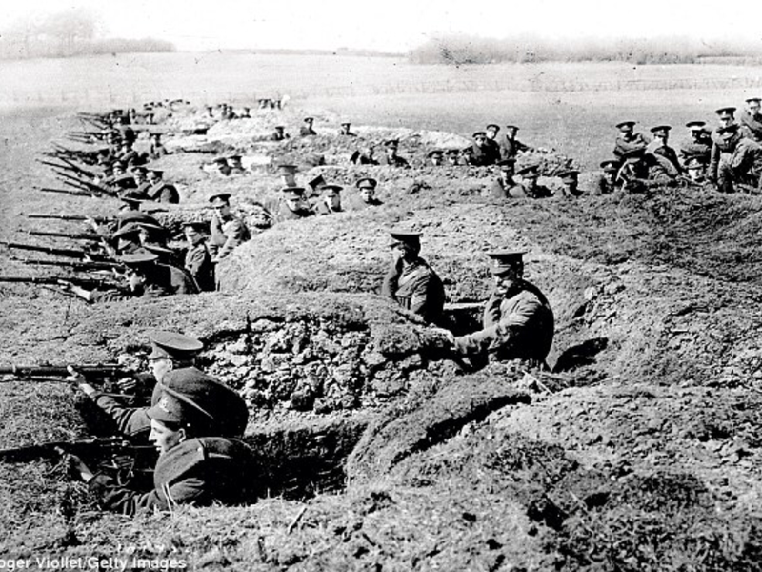
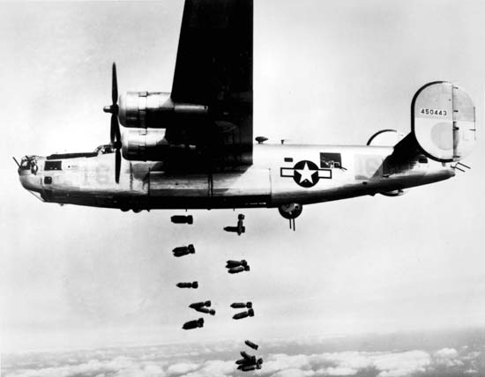
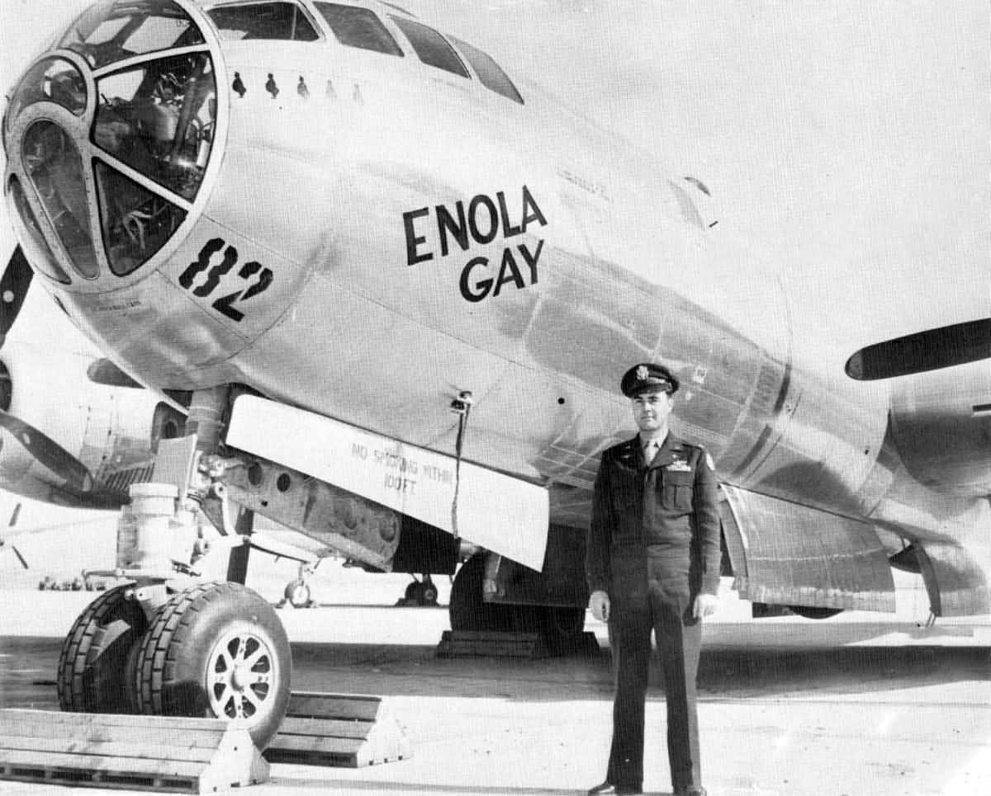
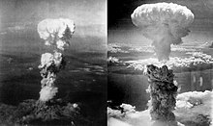
A Brief History of Strategic Bombardment
1900
WWI
1925
Spanish Civil War
WWII
Signal Corps Aviation Section
britannica.com
Notes:
GUERNICA – Picasso goo - air -- nika
Signal Corps Aviation Section looked back on Civil War, WWI, Spanish Civil War “On War” Von Clausswiss

Slide 19
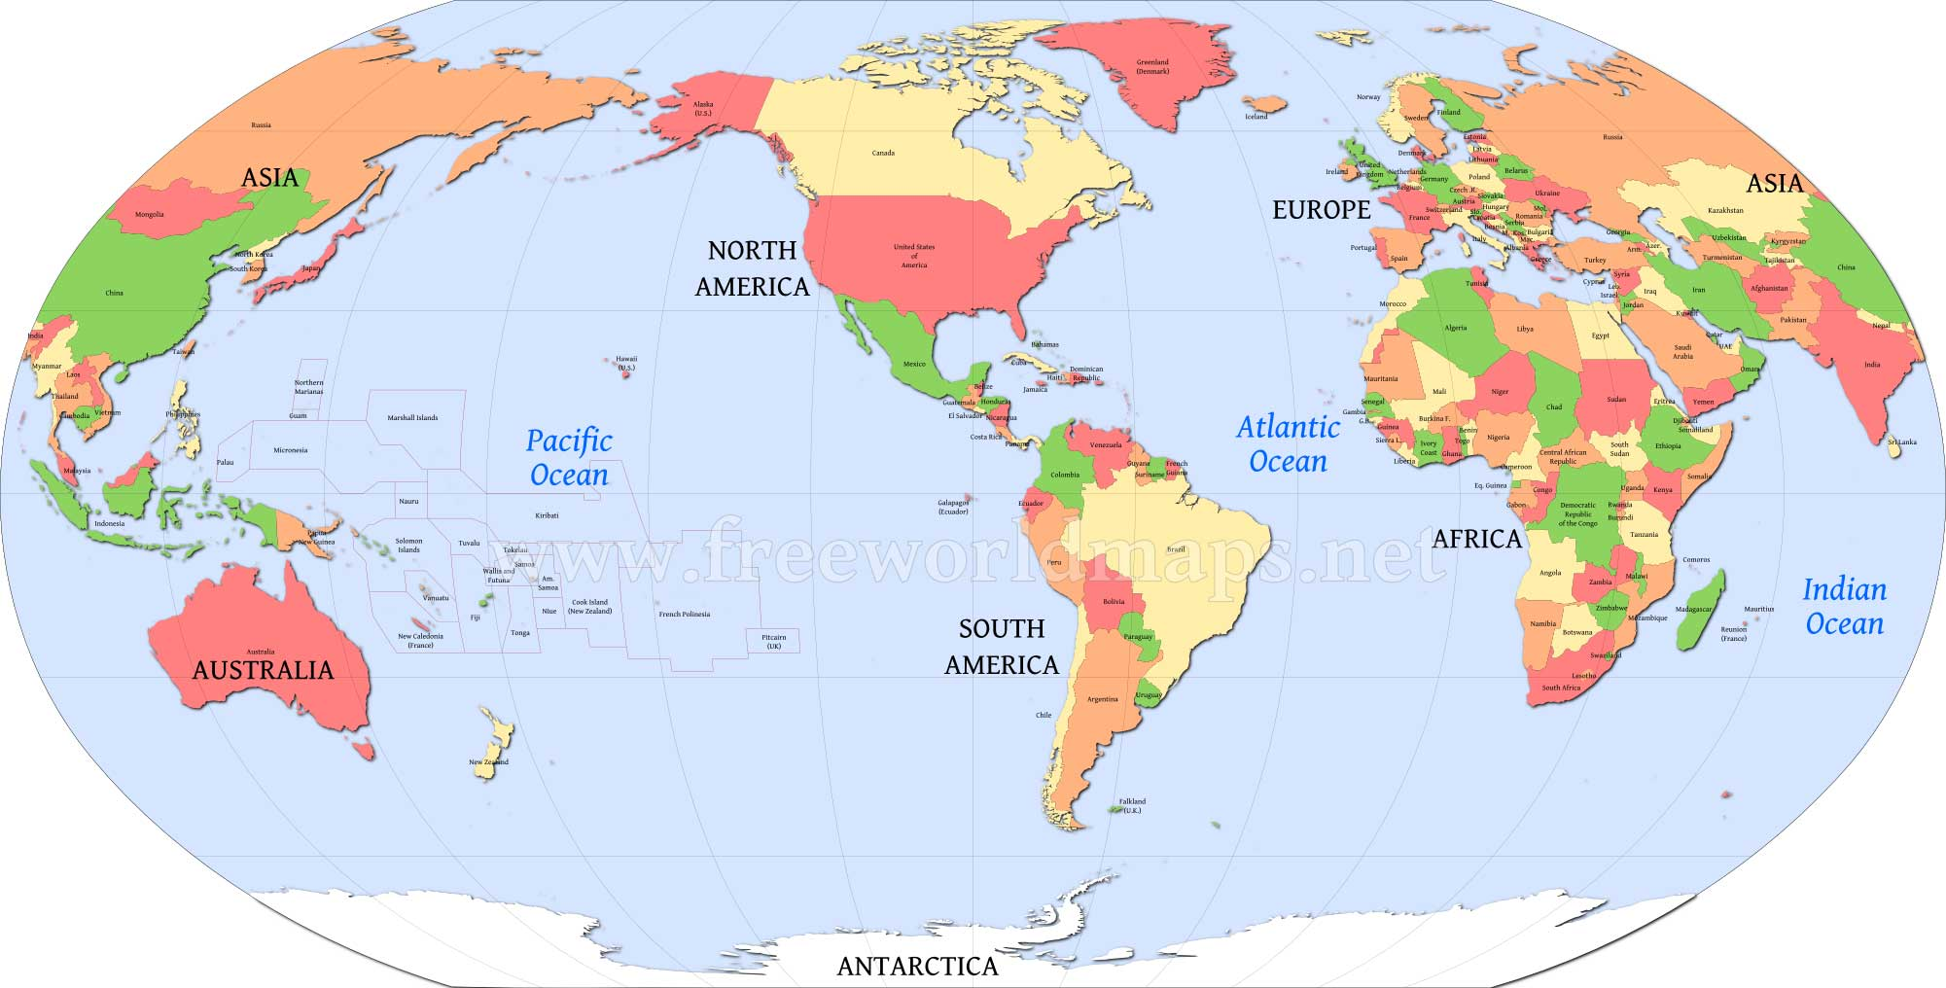
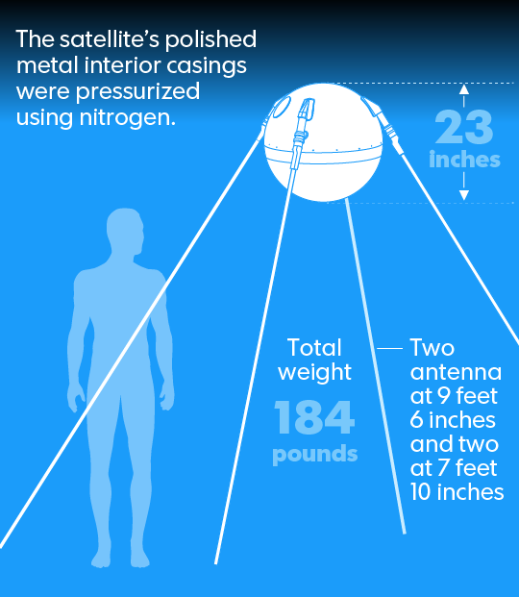
A Brief History of Strategic Bombardment
Post WWII
Oceans no longer protect the USA
4 Oct 57
usatoday.com

Slide 20
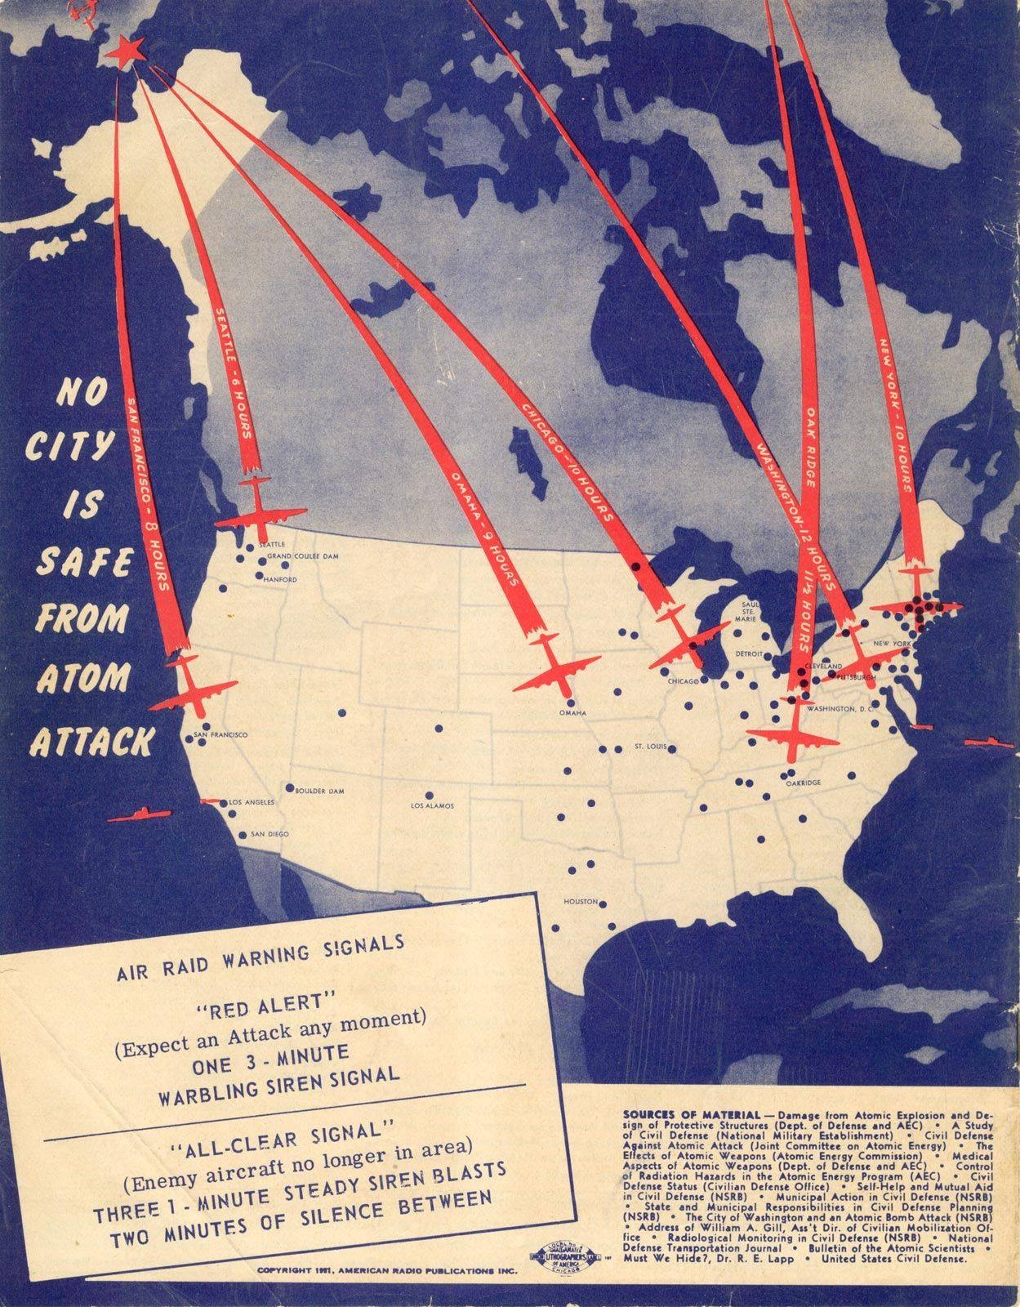
Notes:
The Problem

Slide 21
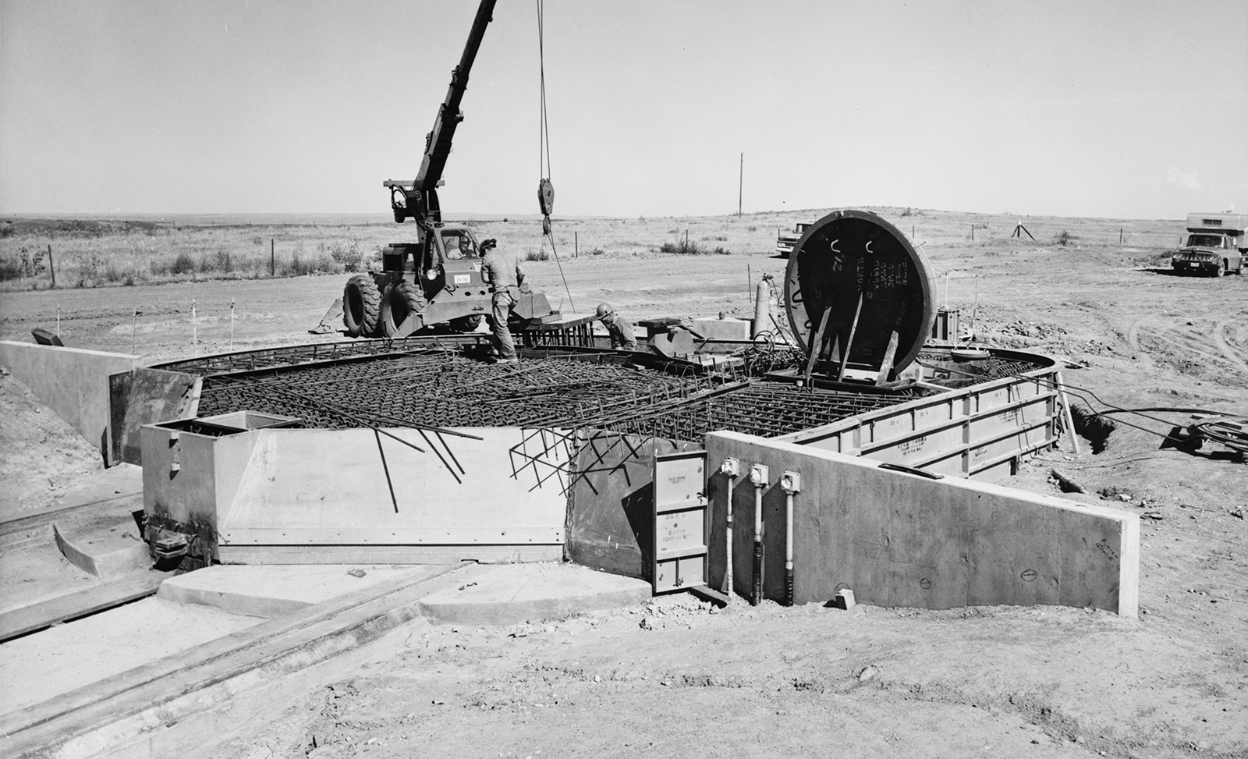
Mission: Deter
Defeat or Defend? Solution is “Deter”
Deter what? Massive existential attack
How? A weapon never used; or used every day
Notes:
The solution

Slide 22
The Minuteman III Missile
Notes:
Describe as much of the missile as time allows, emphasize complexity

Slide 23
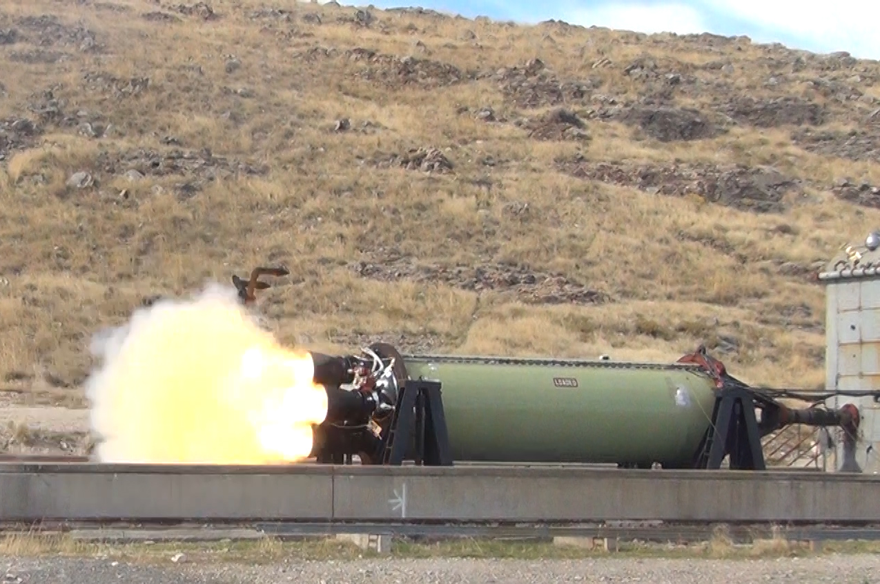
Missile Pyrotechnic, Safe, & Fire Devices
RS/RV
PSRE Isolation valves
Each of the 3 stages
Stage 1-2 Separation
Stage 2 Gas Generator
Stage 2-3 Separation
Stage 3
Stage 3 Thrust Termination System
Stage 3 LITVC Pressure
Stage 3 Roll Control Generator
Notes:
Also for flight test also for ground systems

Slide 24
Launch Control Facility

Slide 25
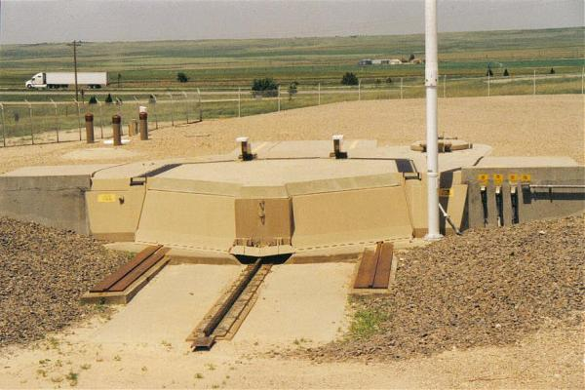
Launch Facility
Continually Demonstrated to Be: Reliable, Accurate, Available, Hard Against Nuclear Attack, Safe, Sure

Slide 26
Minot Missiles
Notes:
Lt Gen Walter Short and the Roberts Commission

Slide 27
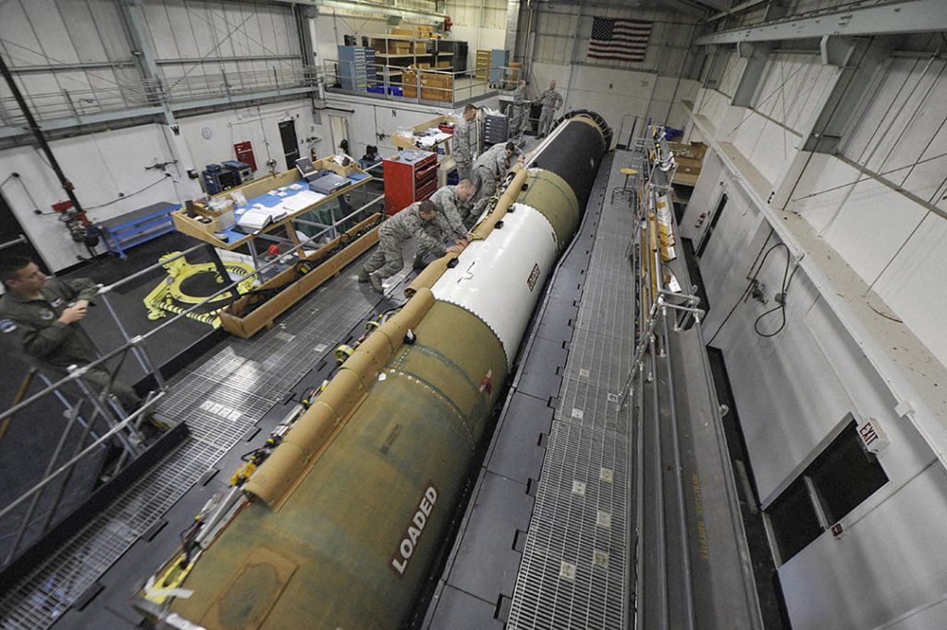
Other Parts of the Weapon System
Ground Support Equipment
Repair ATE and fixtures
Communications, Command, Control
Trainers
Data Bases
Documentation
Processes
People
Etc…..
Notes:
It is the same type of facility as we have a Hill AFB, but the picture is actually from Vandenberg. You can tell by the 576th Flight Test Squadron patch worn by the operator on the left side of the picture and from the command destruct package (racetrack) that runs up the side of the missile that they use for range safety for flight testing.

Slide 28
Other Key Similarities
Atomic Bombs are built to remain viable for decades without physical testing above ground or underground
Large numbers means the advantages of aggregate analysis
Observing complex systems means monitoring, testing, and analyzing
Notes:
Knowing this will be a requirement in the sustainment phase, how do you design a system that predictable?

Slide 29
The Complex System Sustainment Management Model
Readiness Factors
Reliable
Available
Accurate
…
Sustaining Your System
Observe: Assessment Program
Identify: Risk Management
Fix: Long-Range Planning
Enablers
People: Everyone a Leader
IT: Handling Big Data
Processes: Disciplined Approaches
Notes:
“An effective sustainment organization will always find ways to affordably detect threats to the system in time to correct them before the mission is impacted.”

Slide 30
Intercontinental Ballistic Missile
Continually Demonstrated to Be: Reliable, Accurate, Available, Hard Against Nuclear Attack, Safe, Sure

Slide 31
Overview
Sustainment
Viable Highly Complex ICBMs Since the 1950’s
How to design a planetary defense system

Slide 32
Planetary Defense Must Be…
Continually Demonstrated (by monitor, test, analysis) to be…
Effective: Eliminates or mitigates threat (design)
Reliable: All required functions work (measured)
Available: Ready to be used when needed (even after use)
Survivable: Can’t be harmed prior to use (people or nature)
Economical: Can be kept viable with resources available
Anti-Fragile: Stress improves system (beyond long-lived)
Safe & Sure: Doesn’t harm people, things, environment & works only when commanded

Slide 33
Imagine the Systems in a Planetary Defense System
Systems that can be economically monitored and characterized over time and should consist of many copies
For Example, a field of rockets not unlike the Ground-Based Mid-Course Defense System deployed in Greeley Alaska.
Also similar in that Its rockets, radars, command and control, people, and processes are being continually upgraded to make it better.
Imagine a test program similar to the ICBM test program where 3 to 4 rockets are launched each year.
These launches can be exploited to try out new concepts and systems in planetary defense. Perhaps two rockets intercept an asteroid to attach rockets. Then the rockets are controlled from Earth. The other two might deploy a kill vehicle whose effectiveness to maneuver and initiate is tested. The following year, another concept might be tested or currently deployed schemes get further testing.

Slide 34
Conclusion
A Planetary Defense System that can be sustained indefinitely would include:
Majority of the hardware is predictable, state-of-the-practice
Many copies
Continuous upgrades

Slide 35
Q & A

Slide 36
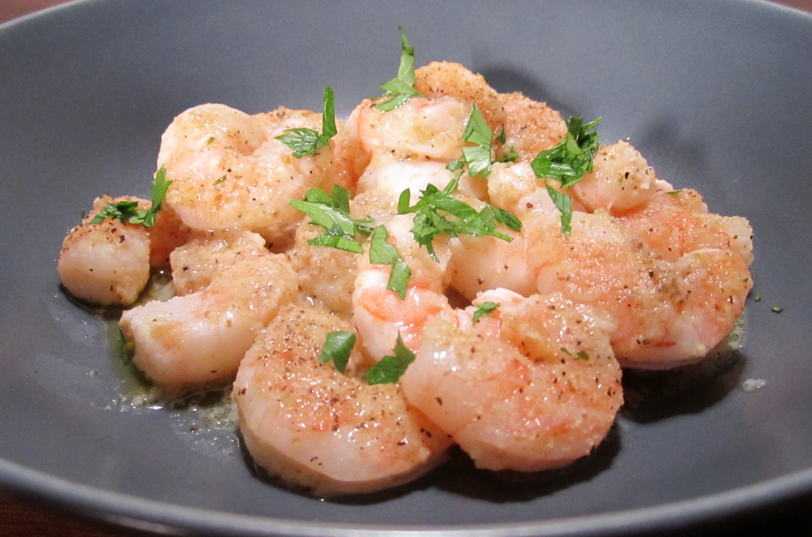
Good Management Models Are SCAMPI
Self-improving – anti-fragile, or at least robust
Constant -- unaffected by changing laws, regulations, or fads
Applicable to the very complex systems employed today
Memorable -- easily called to mind
Practical -- easy to apply, common lexicon
Integrated -- internally consistent
eat-drink-love.com
Notes:
Next chart for details

Slide 37
CSSMM is a Good Management Model
Self-improving
Anti-fragile, or at least robust
Constant self-improvement built in via the processes
Constant
Unaffected by changing laws, regulations, or fads
Changes accounted for in the non-operator requirements
Applicable
to the very complex systems employed today
Memorable
Easily called to mind
Simple at the highest level, capable of infinite add-on
Practical
Easy to apply, common lexicon
Gives everyone a common starting place
Integrated
Internally consistent
Because it is built up from sustainment’s requirements

