Slide 1
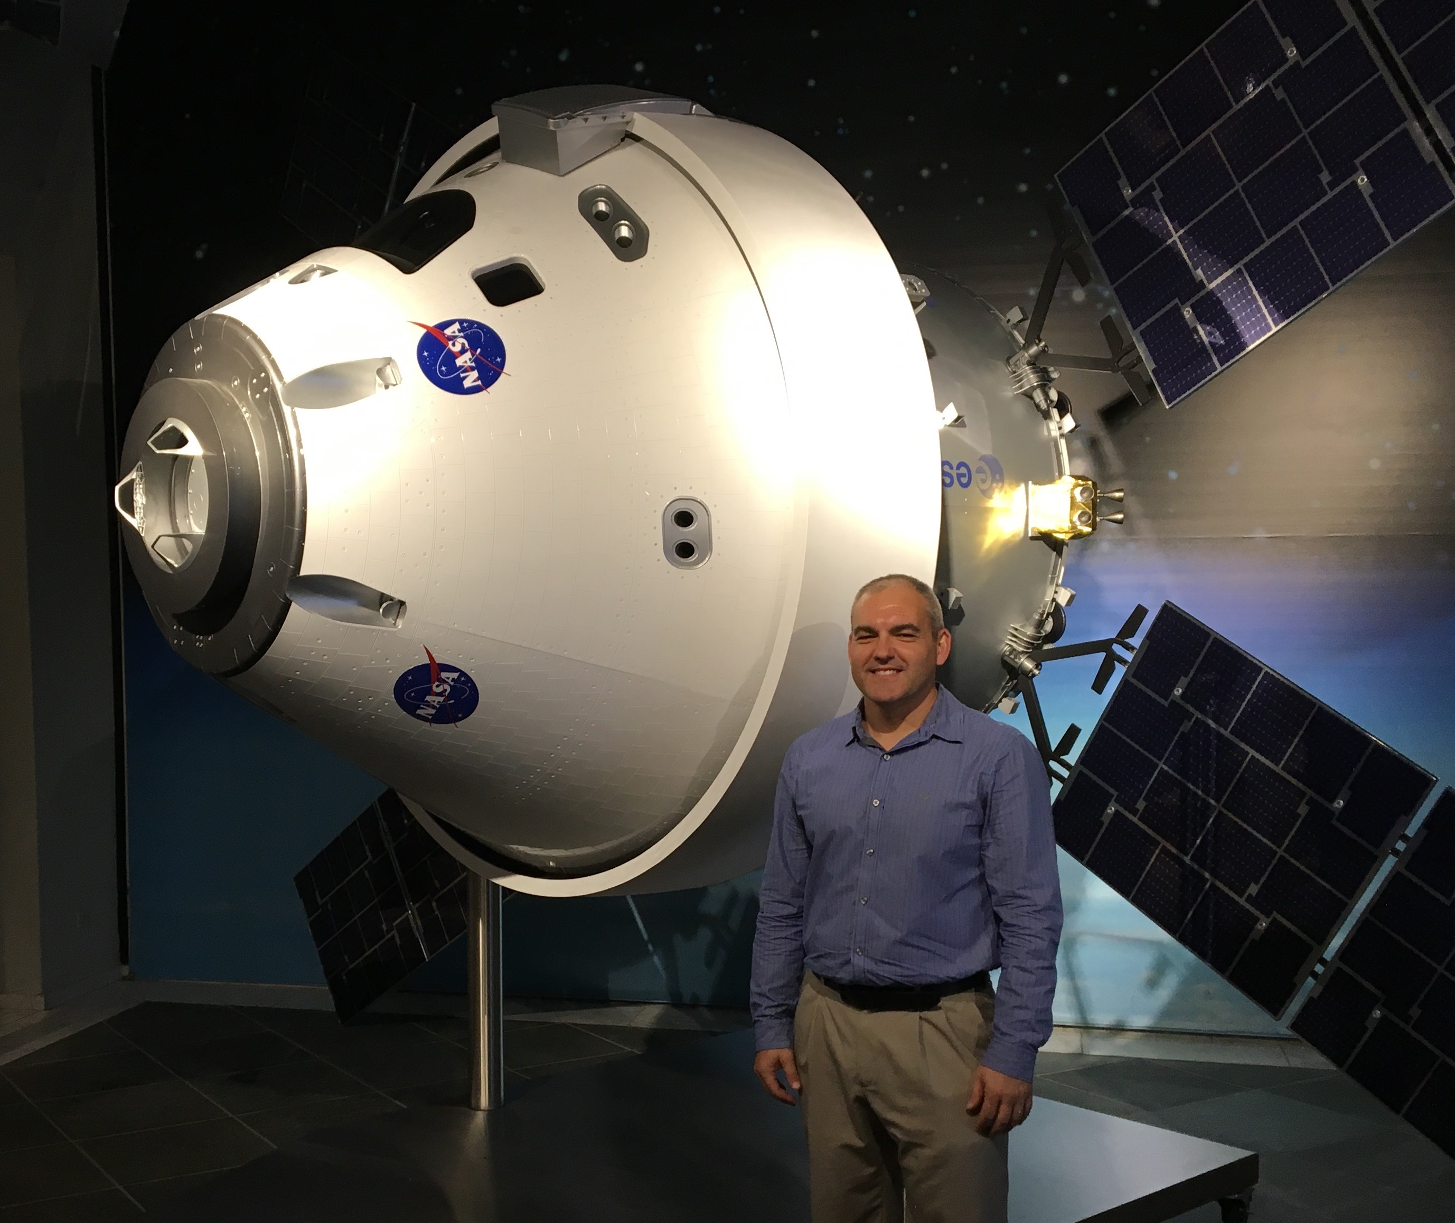
Northern Ohio Section
DISTINGUISHED SPEAKER SERIES
Presents
“The Artemis Missions to Return to the Moon”
Carlos Garcia-Galan
NASA – Orion Program
March 11, 2022
12:00 pm – 1:00 pm (Eastern)
LIVESTREAM EVENT
Zoom Link:
https://aiaa.zoom.us/j/95849434644
+13017158592,,95849434644# US
Abstract: “The Artemis Missions to Return to the Moon”
NASA’s plans to take the first woman and next man to the surface of the Moon are in full swing. The Artemis missions represent an ambitious campaign to test new human and robotic deep-space systems, establish permanent and sustainable presence on the Moon, and stepping stone to go to Mars. This talk will provide an overview of the Artemis missions with focus on the role and development of the Orion spacecraft.
Biography
Carlos is the Manager of the European Service Module (ESM) Integration Office, responsible for the overall integration of the ESA-developed ESM in Orion. Previously, Carlos served in various key technical and management roles for the Orion Program since 2010, including management of integrated spacecraft design and performance, mission analysis, cross-program integration and launch and flight operations support. Prior to joining Orion, Carlos was an International Space Station flight controller, where he supported multiple Shuttle-ISS assembly flights and ISS increment operations from Mission Control in Houston and in Korolev, Russia. Carlos also worked for Honeywell Space Systems as a technical lead developing vehicle health management technologies, including support to Lockheed Martin team during the initial development of the Orion spacecraft.
If you have any questions, contact: aiaanos.diversity@gmail.com

