Slide 1
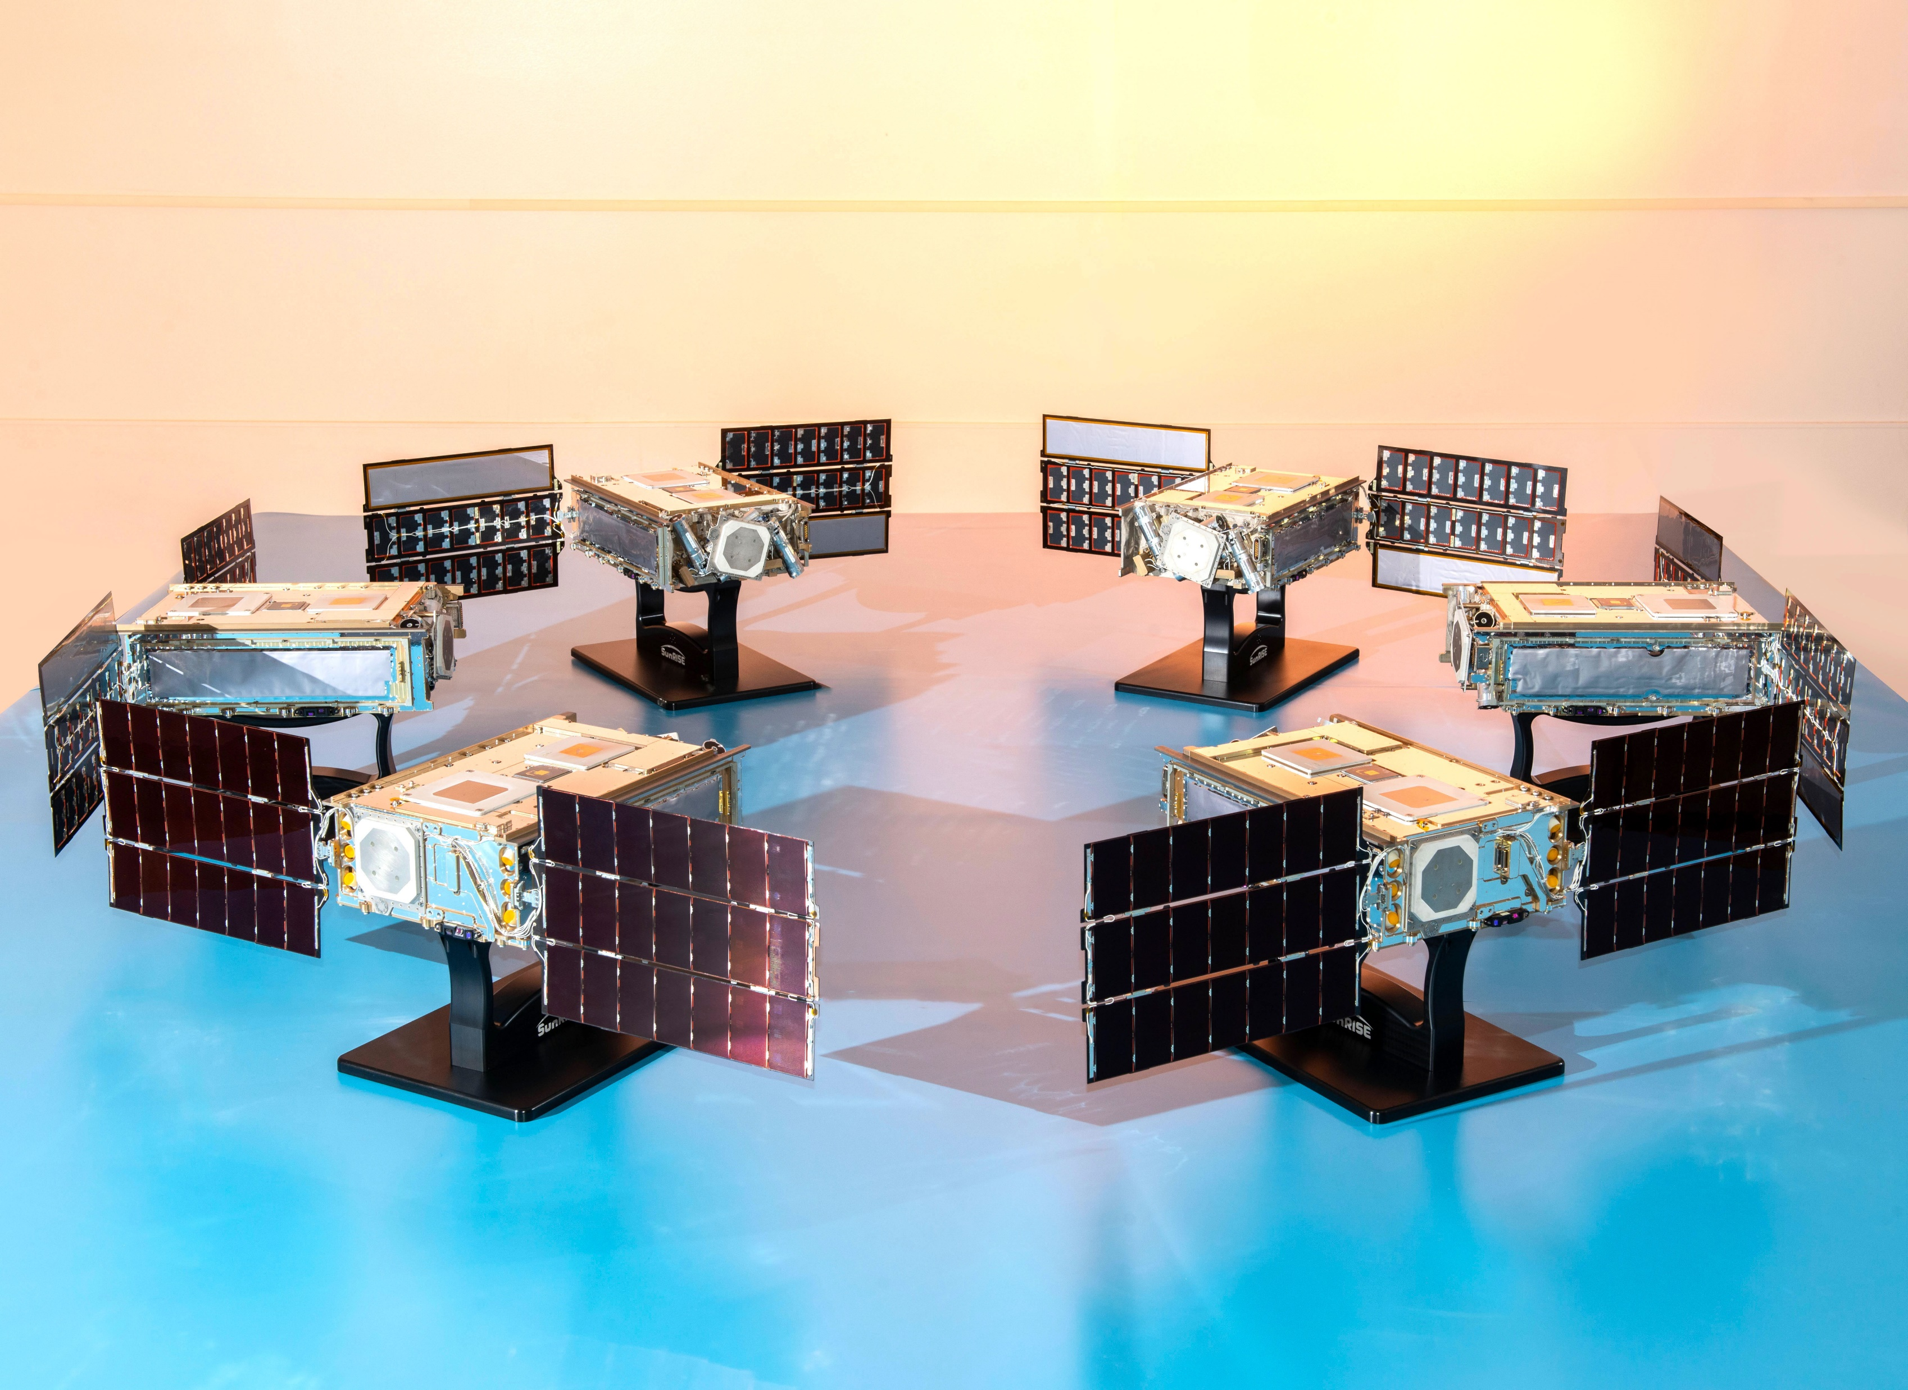
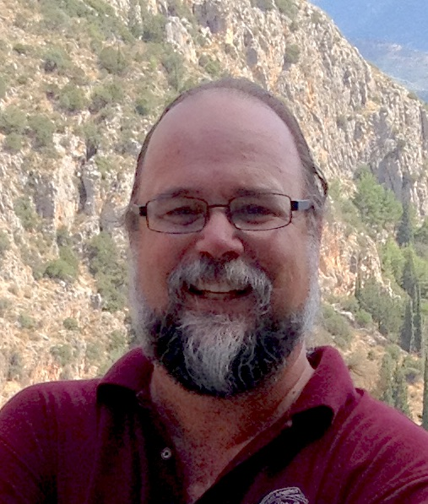
AIAA San Gabriel Valley Seminar
March 20, 2024 at 1pm PST
RSVP online: http://tinyurl.com/aiaa-sunrise
SunRISE – Opening a New Window on the Sun
Abstract: SunRISE is a unique instrument that will fly about 300km above geosynchronous height to observe the radio emissions of the Sun, related to Coronal Mass Ejections (CME) and flares. The six space vehicles (~6U sized) will fly in a loose formation about 10 km across, and include a 100 kHz to 23 MHz receiver and a GNSS receiver which provides accurate time and position knowledge. The recorded signals are post processed on the ground to localize the source of the emissions.
The space vehicles are now in storage awaiting launch in late 2024 to 2025. I’ll be discussing the interesting (and challenging) path to get there.
Speaker Bio: Jim Lux is the project manager of SunRISE. Previously, he managed a DARPA cubesat mission to measure propagation of radio signals through the ionosphere. He also was the Co-PI for the SCaN Testbed which flew on ISS to demonstrate Software Defined Radios.
Before joining JPL in 1998, Mr. Lux worked in physical special effects company creating the world’s largest artificial tornado, among other effects. A California Professional Engineer, he’s also run a software business.

