Slide 2
General Body Meeting

Slide 3
Agenda
Council Introductions
Current Membership Status
Action Item from Region
Report out from Council
Upcoming Events – Recurring & Supporting
Upcoming Events – Hosting
Funding Requests
Honors & Awards Recommendations
Idea Pipeline

Slide 4
Council Introductions
Council Officers
Chairman | Kevin Johnson
Vice Chairman | David Fleming
Secretary | Vacant
Treasurer | Matthew Zuk
Communications | Vacant
STEM K-12 | Melissa Sleeper
Young Professionals | Kineo Wallace
Public Policy | Linda Andruske
Career and Workforce Development | Vacant
Education | Keith Sowell
Honors & Awards | Vacant
Membership | Kimberly Demoret
Technical Programs | Vacant
Member At Large | Elizabeth Balga

Slide 5
 | Current Membership Status
Professional Members | 315
University Students | 122
High School Students | 10
Educator Associates | 28

Slide 6
Action item from Region: Section Stoplight Chart
 | Cape Canaveral
Filled all 4 required section officer positions (Chair, Vice Chair, Secretary & Treasurer) | Need Secretary
Turned in 21-22 Section Annual Report
Turned in 22-22 Section Audit-Budget Report
Held a section election
Consistently participates in RAC meetings
Section council meets on a consistent schedule
Section hosts a minimum of one activity/event per quarter
Had a section representative attend RLC
Is communicative with regional director/AIAA staff
Section seems to have at least one area of strength (K-12, student branch, technical, YP engagement, etc.)
Provides an informative/valuable report at RAC meetings or directly to regional director
Legend
Yes, meets the criteria.
Don't know or sometimes meets criteria but needs improvement.
No, does not meet the criteria.
N/A or ???

Slide 7
Report out from Council
Council Officers
Chairman | Kevin Johnson
Vice Chairman | David Fleming
Treasurer | Matthew Zuk
STEM K-12 | Melissa Sleeper
Young Professionals | Kineo Wallace
Public Policy | Linda Andruske
Education | J. Keith Sowell
Membership | Kimberly Demoret
Member At Large | Elizabeth B

Slide 8
Events – Recurring & Supporting
Recurring
Young Professionals Happy Hour – Carib Brewery (3rd Wed of each month)
Council Meeting – Zoom/In Person – 4th Thursday of the month
Supported
8/25 – James Webb Space Telescope Community Event (Storm Grove Middle School)
8/27 - FIRST Robotics Space Coast Challenge – Viera High School
9/17 – International Coastal Cleanup – Cocoa Beach
9/21 – Brevard Educators Event - Brevard Zoo
9/22 – Florida Institute of Technology – F. Alan Dist Speaker Series: Mike Moses (Pres – Virgin Galactic)
9/22 – Space Enthusiast Symposium
9/22 – Cape Canaveral Technical Society Board Meeting
9/27 – AIAA GPS Resume and Professional Development Virtual Meeting

Slide 9
Upcoming Events – Hosting
Phase: Detailed Planning
SmallSat Education Conference
(https://www.smallsateducation.org/)
October 29th and 30th at KSC Education Center
Dinner Event on 29th (Registration info to be sent soon)
Current Registration Number: 106
Current Sponsors
In Negotiations
Potential Sponsors

Slide 10
Upcoming Events – Hosting
Phase: Detailed Planning
SmallSat Education Conference
(https://www.smallsateducation.org/)
POC: AIAA CC – Kevin
Current Status:
Confirmation with AMF on availability and size of event room
Website & Advertisement sent out
19 Speakers confirmed and Agenda Updated
Dinner Event being planned, target: 180 attendance
CAT III Funding Approved!
FIT Professor agreed to support!
Help Needed:
Ideas for Exhibits for Floor
Additional Sponsors/Outreach

Slide 11
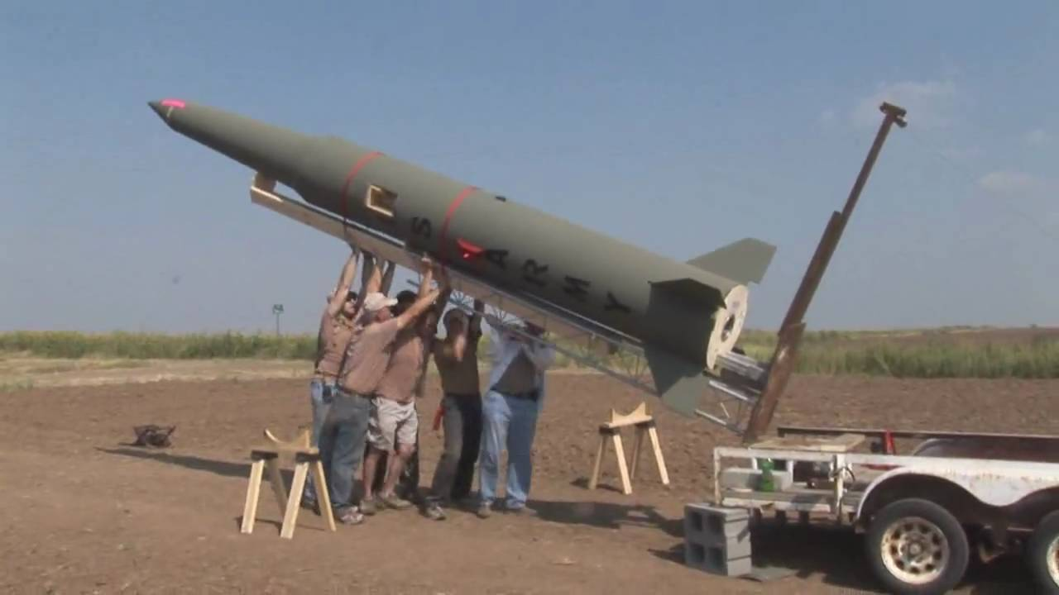
Upcoming Events – Hosting
Phase: Preliminary
Tour – Cape Canaveral SFS
Nov?
POC: Gary Dahlke
AIAA: Keith Sowell
Current Status
Planning event date and time
Historical Site Visits & Drive by of Active Sites
Sands Space History Center
AF Space and Missile Museum (to include firing rooms at 26 and 5/6)
Hangar C (large artifact repository)
LCs 14 & 34, and industrial area
Would require 30 day notice for foreign national
Weekend works best

Slide 12
Upcoming Events – Hosting
Phase: Brainstorming
High Powered Rocketry
November 19th at TBD
POC: Gary Dahlke
AIAA: Primary –Kevin, Secondary - Kineo
Current Status
Idea phase, nothing formal
Targeting 1Q2023 to meet
Coordination ongoing with FIT for venue

Slide 13
Funding Requests
Current Treasury Status:
Requests:
James Webb Space Telescope Night – $75
Events:
SmallSat Education Conference Dinner Event - $300
Bus Trip – TBD
High Powered Rocketry Event - TBD
Good!

Slide 14
Honors & Awards - Recommendations
National is looking for nominees for Premier Awards
Daniel Guggenheim Medal
Distinguished Service Award
Goddard Astronautics Award
International Cooperation Award
Public Service Award
Reed Aeronautics Award
Trailblazing STEM Educator Award

Slide 15
Idea Pipeline and Open Forum
Ideas for 2022/2023
Joint Meeting with INCOSE (Systems Engineering)
Public Policy Discussion
Small Business Presentation
Scholarship Competition (our section)
Internship support?
E-Week?
Space Congress?
Project Support? RASC-AL, etc

