Slide 1
Survivability Technical Committee (SURTC)
Chair: David Liu
david.liu@us.af.mil
571-256-0268
Vice-Chair: Steven Broussard
steven.r.broussard@boeing.com
314-777-0353
Secretary: Andrew Lingenfelter
lingenfeltera@gmail.com
402-841-2190

Slide 2
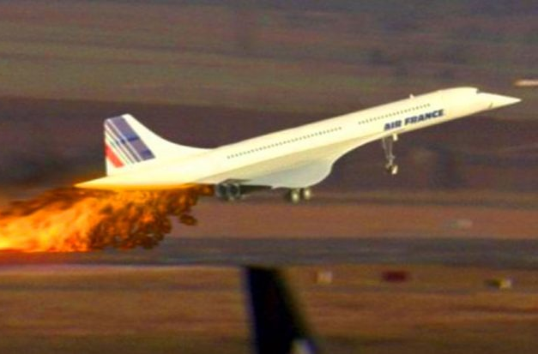
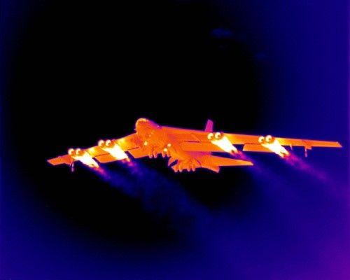
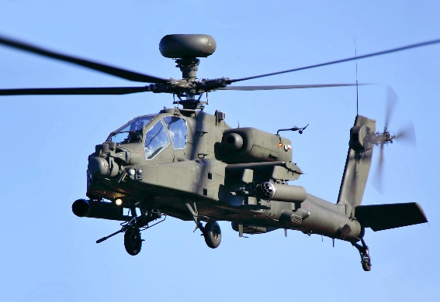
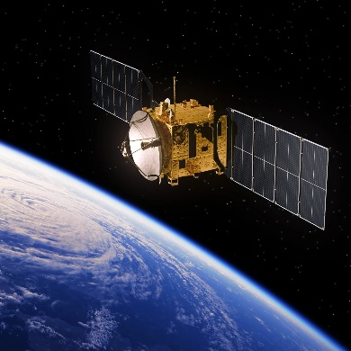
SURTC Mission
The Survivability Technical Committee (SURTC) promotes the advancement of survivability as an aerospace design discipline. This includes both the analysis of survivability and the development of technologies to improve survivability for fixed wing, rotary-wing, and space systems. Aerospace survivability refers to the capability of a system to avoid and/or withstand hostile environments, or natural events such as orbital debris, micrometeorites, or bird strike. Survivability addresses threats that include combat weapons, adverse climate conditions, and other environments hostile to an aerospace system (natural and manmade).

Slide 3
SURTC Membership
Consists of 40 Members and expandable to meet member needs
Wide mix of government, industry, and academia to grow your Aerospace Network

Slide 4
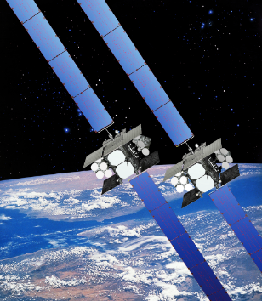
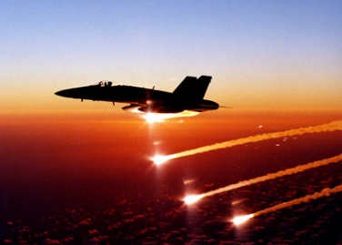
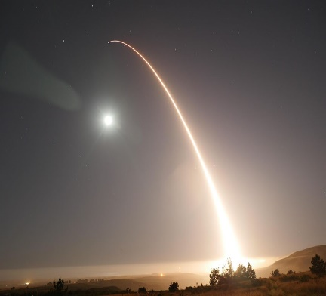
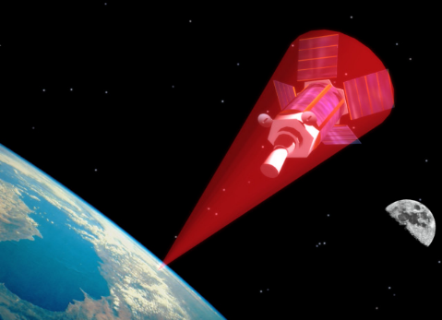
Why Join the SURTC?
Active representation in a high-visibility technical committee that shapes effective aerospace system design
Develop your leadership and technical skills through collaboration with leading aerospace survivability experts from government, industry, and academia
Smaller TC allows more opportunities to publish and present papers at major conferences
Opportunity to influence the development and application of aerospace standards, and recommended practices
Access to the survivability community through professional networks
Survivability Areas
Recent Recognition
Platform Design
Structural Design
Advanced Materials
Countermeasures
Signature Reduction
Additive Manufacturing
Component Hardening
Cyber Threats
Directed Energy
Kinetic Energy Weapons
Orbital Debris
Repairability
AIAA 2020 Survivability Award presented to Mr. Charles Frankenberger
AIAA 2018 Survivability Award presented to Dr. Vincent Volpe
SciTech 2018: Kan Liu (US AFIT) – Lockheed Martin Student Paper Award in Structures
SciTech 2018: Logan Tatman (US AFIT) – Jefferson Goblet Student Paper Award
AIAA Defense Forum 2018: Instructed a Survivability 101 Short Course
SciTech 2017: Kan Liu (US AFIT) – Jefferson Goblet Student Paper Award
Several members inducted as AIAA Associate Fellows

