Slide 1
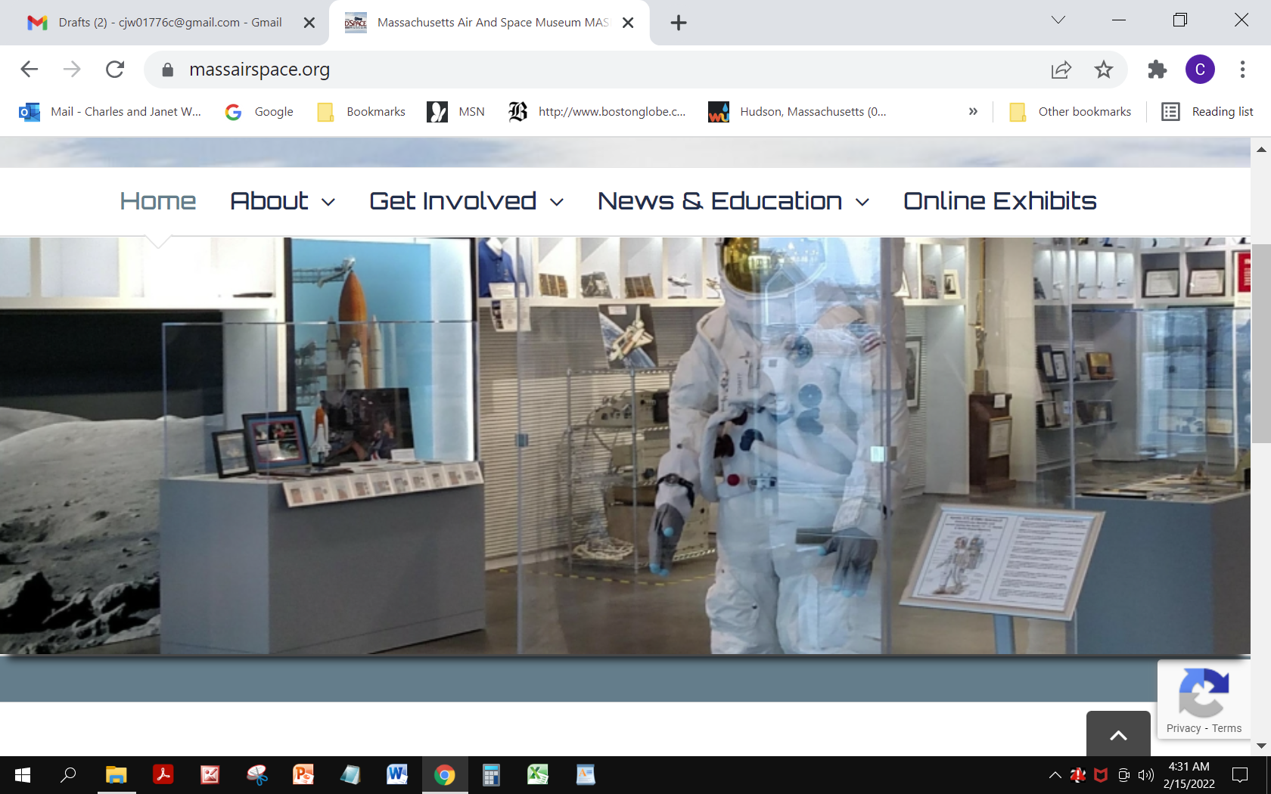
The Massachusetts Air & Space Museum is a boutique museum in Hyannis that showcases exhibits on the history of aviation and space exploration, focusing on ties to Massachusetts people and industry. There are several hands-on interactive exhibits to engage visitors to simulate flight. 501(c)3 Non-Profit New Location’s Opening Spring 2022! 434 Main Street, Hyannis, MA
Visited by the AIAA New England Section in September 2021
https://www.massairspace.org/

Slide 2
Thurston Teal Amphibious Aircraft Raffle Underway at Massairspace
This classic 1970 Thurston Teal is a 2/3 place all aluminum amphibious airplane valued at $58,500. It has fewer than 1,350 hours of total time. The 150 HP Lycoming engine and Hartzell prop have ~130 hours since overhaul.
In addition, the lucky winner will receive an additional $3,000 to put towards a tailwheel endorsement and seaplane rating.
100% of the funds raised will go towards supporting the Massachusetts Air and Space Museum’s educational services.
https://www.massairspace.org/airplane-raffle/

