Slide 1
FALLING FROM 10,000 ft - Investigating one of the most mysterious airplane accidents and the story of the sole survivor
Teresa J Konopka

Slide 2
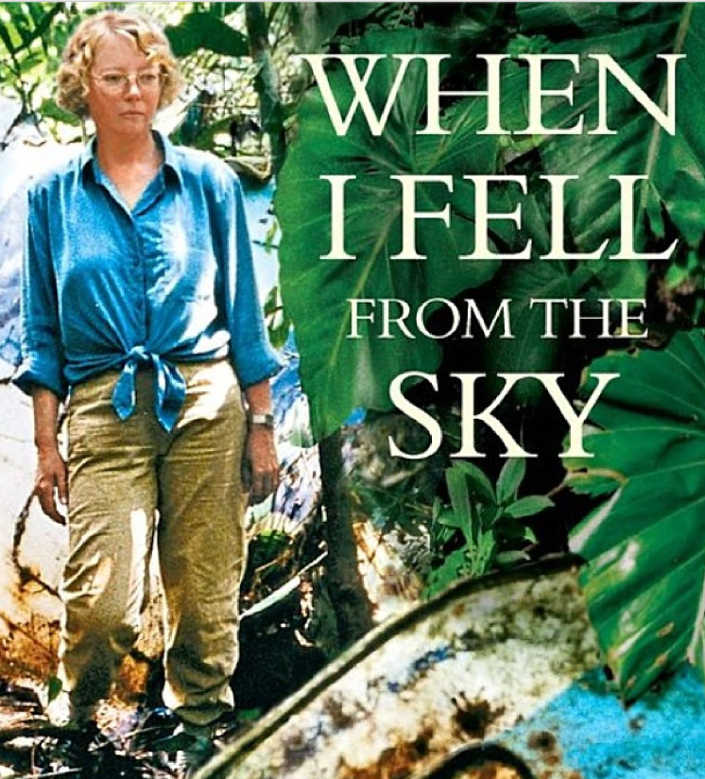
“With a jolt the tip of the airplane falls steeply downwards. Even though I’m in a window seat right at the back, I can see the whole aisle to the cockpit, which is below me. The physical laws have been suspended; it’s like an earthquake. No, it’s worse. Because now we’re racing downwards. We’re falling. People are screaming.”
~“When I Fell From The Sky: The True Story of One Woman's Miraculous Survival” by Juliane Koepcke

Slide 3
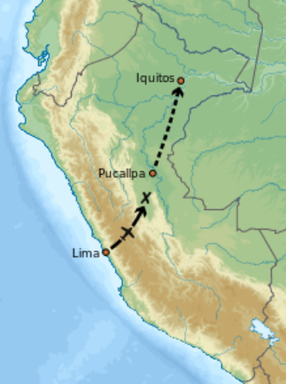
facts
The Flight
December 24, 1971
LANSA Flight 508 from Lima to Pucallpa (Peru)
Lockheed L-188A Electra Turboprop
The Girl
17 year old daughter of biologist and zoologist
Homeschooled in jungle of Peru
Fell from 9200 ft into the Amazon rainforest
Stranded for 11 days until rescued

Slide 4
“My mother is no longer at my side and I’m no longer in the airplane. I’m strapped into my set, but I’m alone. Alone. At an altitude of about ten thousand feet, I’m alone. And I’m falling.”
~“When I Fell From The Sky: The True Story of One Woman's Miraculous Survival” by Juliane Koepcke

Slide 5
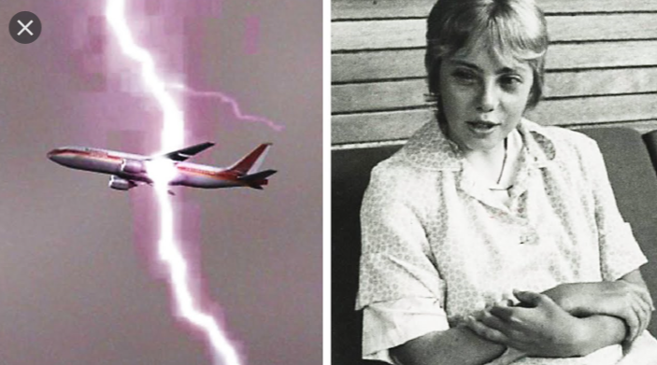
The crash
The aircraft was flying at 21,000 ft when it hit severe turbulence and thunderstorms
With pressure to meet holidays schedules, the crew continued the flight
The aircraft broke apart mid-air

Slide 6
“For the first time since I set off on my own in the jungle, I’m horrified. I come around the next river bend, and there I see it. A three-seat bench, just like mine, only this one here is rammed headfirst about three feet into the earth. The heads of the passengers—two men an a woman—are also stuck there in the rain forest floor, only their legs jutting grotesquely upwards.”
~“When I Fell From The Sky: The True Story of One Woman's Miraculous Survival” by Juliane Koepcke

Slide 7
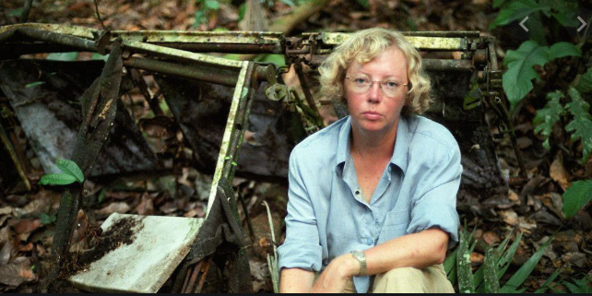
Surviving the amazon
Juliane survived her fall from two miles in the sky and….
had a broken collarbone, right eye swollen shut, and a large wound on her arm
followed a stream to civilization….who thought she was a river goddess (natives never saw a white person before)
poured gasoline on her arm to get worms out from under her skin (they had laid eggs)
her mother survived the crash but died due to injuries

Slide 8
“My mother tried to get a flight on the reliable Faucett airline, but they were all booked. The only other airline that flew to Pucallpa that day was LANSA, which had already lost two planes in crashes. My father had specifically urged my mother not to fly with that airline. But the alternative would have been waiting another day, or even two. And my mother didn’t have the patience for that. ‘Ah,’ she said, ‘not every plane’s going to crash.’ And so she booked two seats for us on that plane.”
~“When I Fell From The Sky: The True Story of One Woman's Miraculous Survival” by Juliane Koepcke

Slide 9
Interview with juliane
https://www.msnbc.com/today/watch/woman-fell-from-the-sky-survives-plane-crash-44516419983

Slide 10
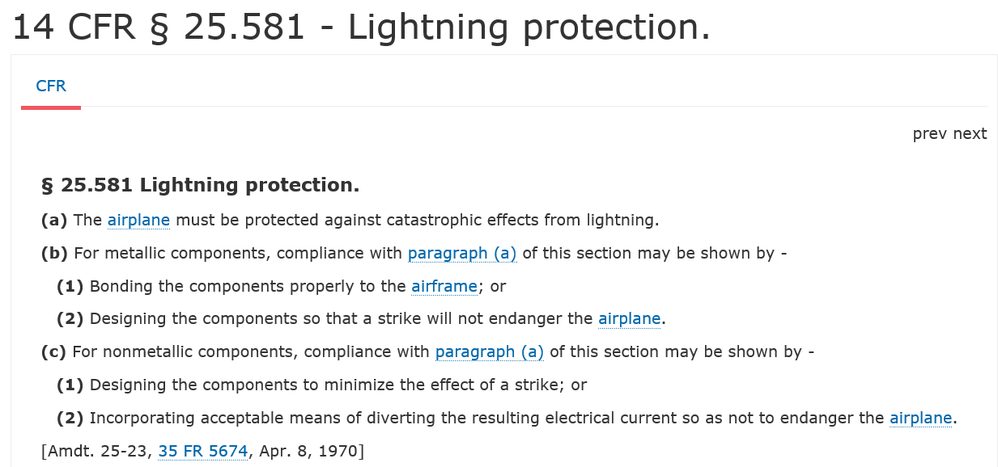
Regulations

Slide 11
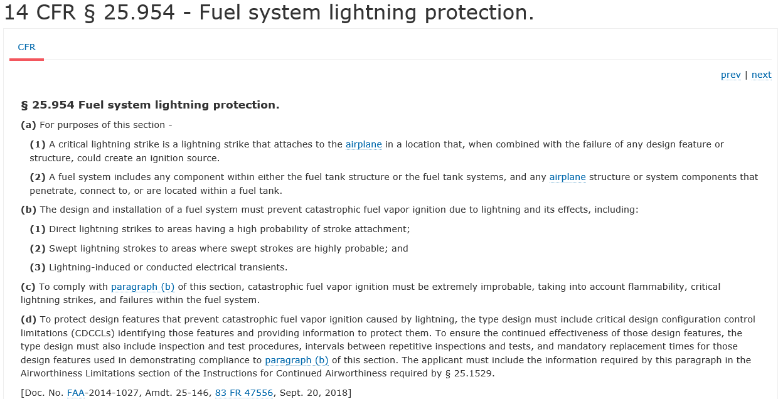
Regulations

