Slide 1
Greater Philadelphia Section
Virtual
October 2020

Slide 2
Introductions – Cheers!
AIAA GPS Council:
Chair: Jonathan Moore
Vice Chair: Liza Kupp
Treasurer: Steve Matthews
Secretary: Nick Altobelli
Membership: Jason Boyer
Public Policy: Joi Spraggins
STEM K-12: Chris Reynolds
Attendees:
Name?
Professional/Student?
Aerospace Interests?
Other Info?
October 2020

Slide 3
AIAA GPS Membership Survey 2021-2022
Survey Link:
https://forms.gle/ab793yugwh5EHCY18
1 active member that fills out the survey will receive $50 towards their 2022 membership!
Fill it out by Jan 3rd to be eligible for $50!
October 2020

Slide 4
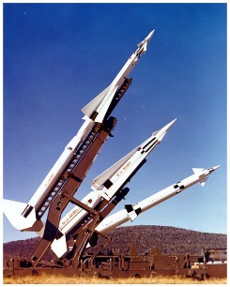
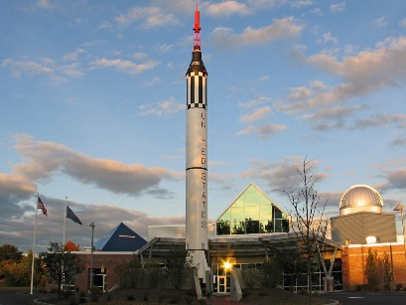
AIAA GPS – 2021
Jan-Feb
Rod Brimhall – Project Nike
GBM #1
Mar-Apr
Dr. Tony Calise – Solar Powered Flight
Congressional Visit Day
May-June
First Robotics Volunteering
GBM #2
Elections!
Jul-Aug
Professional Development / Resume Event
VFS Panel Conference
Sept-Oct
AIAA HQ Visit
Design Build Fly Participation
Pres #3
Nov-Dec
NASA Globe Volunteering
McAuliffe-Shepard Discovery Center Event
GBM #3
Did you attend any of these events?
October 2020

Slide 5
AIAA GPS – 2020
Jan-Feb
Mar-Apr
May-June
Jul-Aug
Sept-Oct
Eugene Fleeman – Missile Design Development
Nov-Dec
Did you attend any of these events?
October 2020

Slide 6
AIAA GPS - 2022
January
MLK Day Volunteering
GPS Logo Contest
??
February
Professional Development Event
??
March
International Day Event
Congressional Visits Day
??
April
In Person Happy Hour / Guest Speaker
??
May
Scholarship Banquet
Volunteering
Elections!
??
Jun-Dec
????
Any ideas or events you’d like to see?
October 2020

Slide 7
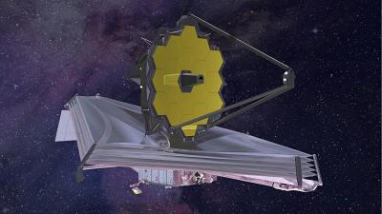
Open Discussion – James Webb Telescope
James Webb Recap Video:
https://www.youtube.com/watch?v=iGdrWaTSt4Y
Really cool video if you have 8 min:
https://www.nasa.gov/feature/goddard/2021/the-road-to-launch-and-beyond-for-nasa-s-james-webb-space-telescope
October 2020

Slide 8
AIAA TRIVIA EXTRAVAGANZA
13 Intense Aerospace Questions
? Number of Contestants
1 Winner:
$25 Amazon gift Card
October 2020

Slide 9
FIN
Happy Holidays!
Fill out the survey!
1 Member will receive $50 towards renewing membership in 2022
October 2020

