Slide 1
Continuous Improvement to Smart Factory
James Crean President
Franco van Heijningen
Director, Client Success
Cris Frusina
Chief Technologist & Technical Program Manager
Carlos Chavez Director, Business Process Evolution

Slide 2
Who We Are
World Class Aerospace Expertise
Founded 2002, HQ in Austin, TX
Teams across the US
250+ Aerospace Subject Matter Experts
Space, Launch, Missile, & Aviation
Smart Factory
Business Process Evolution
Our team members have done hundreds of business optimizations resulting between 20% to 75% operational improvements in the Aerospace & Manufacturing industry.
Notes:
James

Slide 3
Change Happens What Motivates Us
“We choose to go to the moon…” – JFK Sept 12, 1962
“…One giant leap for mankind.” – Neil Armstrong, July 20, 1969
Blackberry tops 50% mobile phone share – June 28, 2007
“Every once in a while, a product comes along that changes everything.” – Steve Jobs, June 29, 2007
Blackberry market share: 0.8% – June 2014
“Only 8 percent of companies surveyed said their current business model would remain economically viable if their industry keeps digitizing at its current course and speed.” – McKinsey 2018

Slide 4
The Business Challenge
Rapid Innovation is Imperative
Today we are faced with a business environment that is changing at an ever-increasing rate; You are either the Hunter or the Hunted
Continuous improvement approach although good takes time to evolve into a program that effectively transforms the company
We Don’t Have Years to Transform
In the transformative process, One Size Does Not Fit All
Continuous Improvement Programs must also evolve

Slide 5
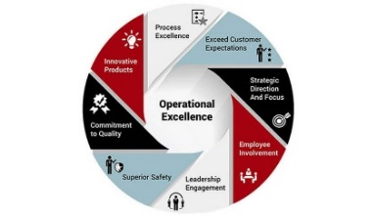
Continuous Improvement
In today’s business environment:
Continuous Improvement’s (CI) goal must become focused on rapidly assisting the company in improving their position in the marketplace
Adapt a system-wide transformative process that will rapidly identify all required activities
Allowing for company improvements opportunities that are purposeful and coordinated to reach the stated CI goal
For Low Rate High Mix manufacturing it is necessary to use the Continuous Improvement Principles and Techniques but adapt them to fit nonrepetitive manufacturing
CI must not only strive to achieve the traditional objectives (i.e. implement Flow, Waste Reduction and Defect Elimination, etc..) but also optimal use of Information Systems and utilization of Smart Factory technologies

Slide 6
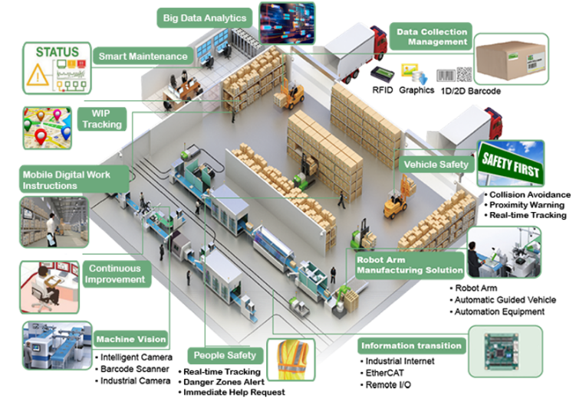
Smart Factory Technology
Smart Factory Technology (Industry 4.0) is here
Are you ready?
Smart Factory technologies are revolutionizing every business sector
Delivering smarter operations and intelligent business systems
This has made the current transformation cycle far quicker, far more disruptive, and far more destructive to those that fail to act quickly enough
The challenge of continuously evolving your business processes has never been greater
Together a System-Wide Transformation Method, Information Systems and Smart Factory Technologies will rapidly increase a company’s position in the marketplace

Slide 7
Smart Factory Technologies (examples)
Once the system-wide transformative process is in place, Smart Factory becomes the natural next step
MES (Digital Travelers)
Asset Tracking
Predictive Maintenance
Safety (People, Equipment)
Inventory Management
Robotics/Automation
Real-Time Monitoring and Alters
Big Data Analytics (Data Driven Decisions)
Smart Factory, where do I start?

Slide 8
Smart Factory Technology
Where Do I Begin?
There are many choices when considering Smart Factory technologies
Making where to begin confusing
Picking the right technology is really determined by the Business Condition – What are your pain points?
In most companies Asset Visibility is critical
Tracking availability, location and bottlenecking of Work-In-Process (WIP), Inventory, Tools and Equipment
To achieve Asset Visibility there are levels of tracking capabilities required: Open Air and Discrete Locations
Open Air will provide location tracking within a certain parameter. This is especially important when items leave their normal route
Discrete Location will include: Smart Racks, Smart Workstations, Smart Test Stations, Discrepant Item locations and Tool and Equipment monitoring
Both levels of tracking are required to provide accurate reporting on assets
This enables real-time tracking and reporting on assemblies, inventories, tools and machines

Slide 9
Summary
There are many tools, techniques and technologies available to assist us to rapidly transform our company – it’s about choosing the right ones
We must quickly move from the traditional approaches of continuous improvement
Train the workforce & change the culture
Create value streams of individual processes and optimize those specific areas by primarily using Lean and Six Sigma
Identify specific use case(s), select and implement an appropriate technique or technology
We must adopt:
A system-wide approach combining
Lean, Six Sigma, Theory of Constraints Principles
Optimal ERP Utilization
Smart Factory/Industry 4.0
We must rapidly strengthen the business to gain a competitive advantage in the marketplace

Slide 10
Contact Us
James Crean
President
Cell: 310-704-9759
Email: james@CreanAssociates.com
Carlos Chavez
Director, Business Process Evolution
Cell: 951-383-9386
Email: CChavez@CreanAssociates.com
Cris Frusina
Chief Technologist & Technical Program Manager
Cell: 737-932-0310
Email: Cfrusina@CreanAssociates.com
Franco van Heijningen
Director, Client Success
Cell: 512 450-4735
Email: franco@CreanAssociates.com
Austin Office:
1200 Lakeway Drive, STE 7,
Austin, TX 78734 512-337-6587

