Slide 1
APOLLO
50th anniversary
Lunar Landing
AIAA ASAT Conference
November 9, 2019
Ed Smith
Larry Korb
Chuck Lowry

Slide 2
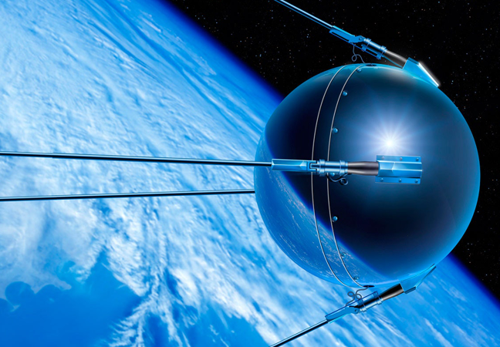
USSR
Sputnik 1
Oct 4, 1957
184 lb

Slide 3
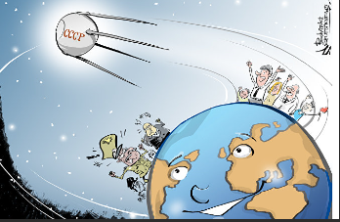

Slide 4
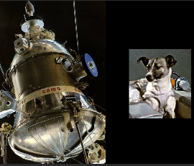
Sputnik 2
Nov 3, 1957
Laika
1100 lb
Big Booster!!

Slide 5
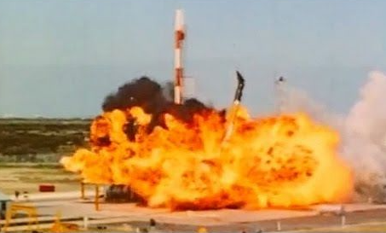
USA
Vanguard TV-3
Mar 17, 1958
Failed
Explorer 1
Feb 1, 1958
Successful
31 lb
Vanguard 1
Dec 6, 1957
Successful
3-4 lb

Slide 6
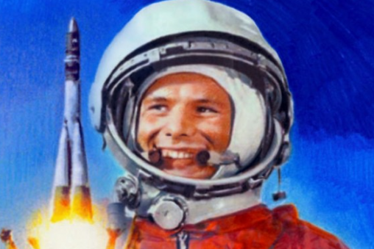
USSR
1st Man in Space
Yuri Gagarin
Vostok 1
Apr 12, 1961
1 Orbit

Slide 7
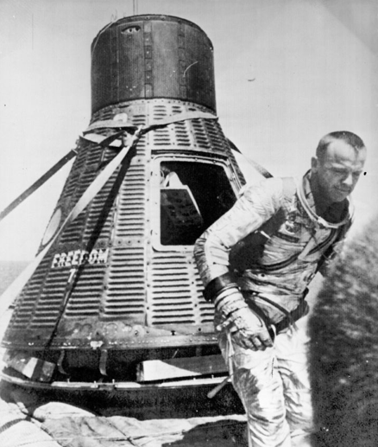
USA
1st USA Man in Space
Alan Shepard
15 Min Suborbital Lob
May 5, 1961

Slide 8
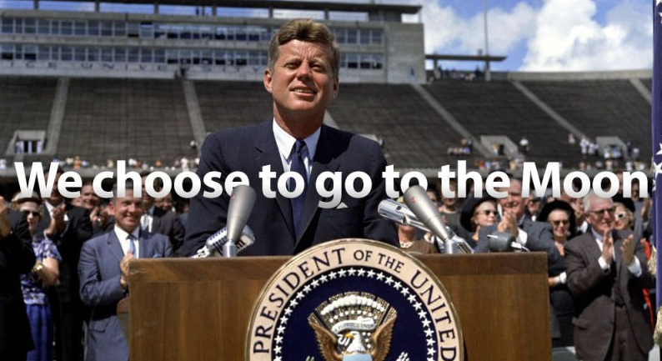
Sept 12, 1962----Rice University, Houston

Slide 9
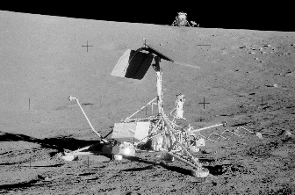
Surveyor 1----Landed May 30, 1966

Slide 10
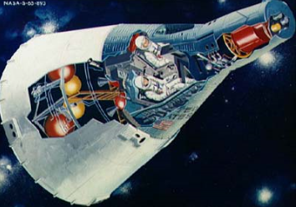
Gemini
2 Man
1st Flt Mar 23, 1965

Slide 12
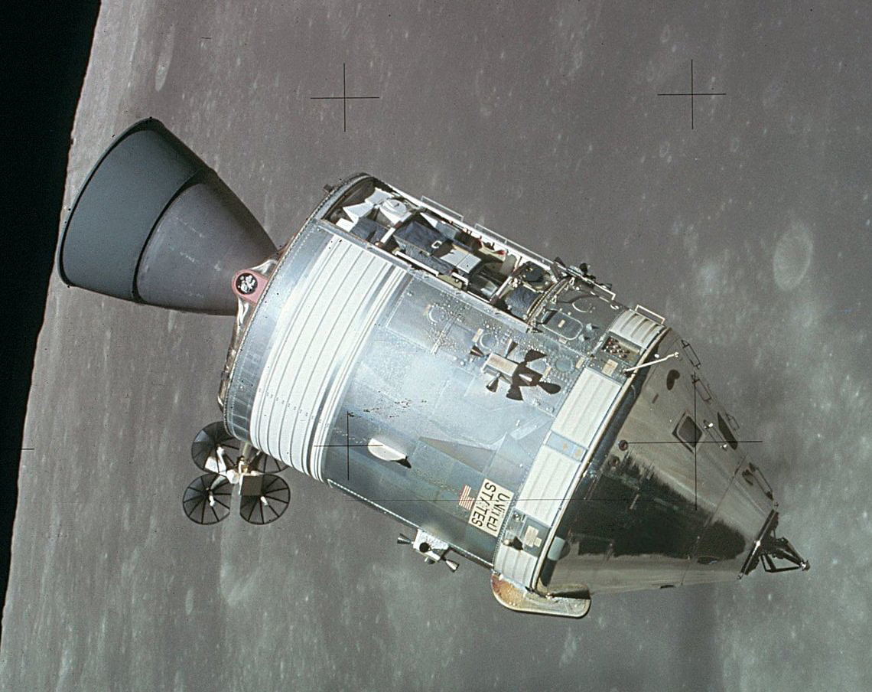
Command & Service Modules (CSM)

Slide 13
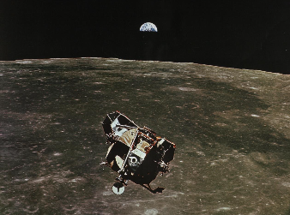
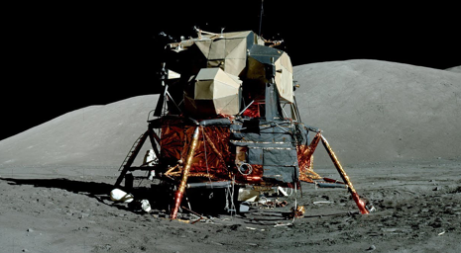
Lunar Module (LM)

Slide 14
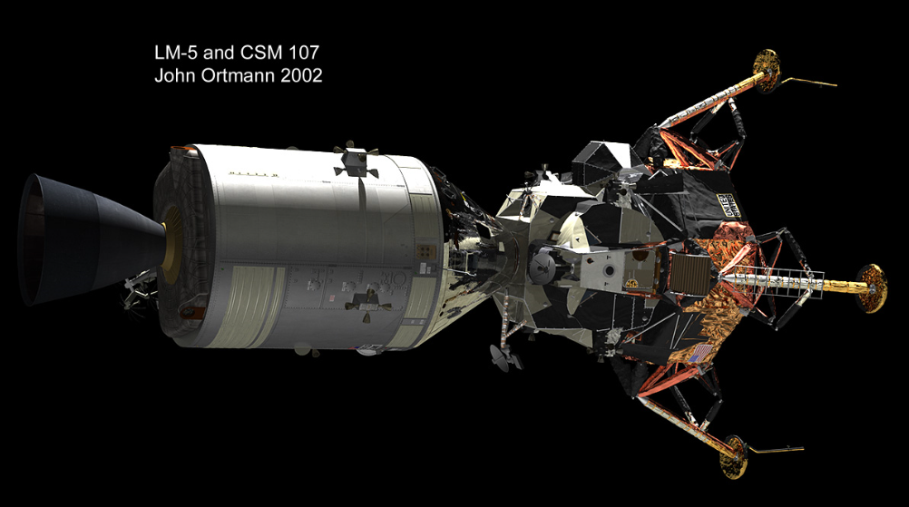
CSM/Lm Docked---Trans Lunar

Slide 15
KSC Launch Complex

Slide 16
Crawler

Slide 17
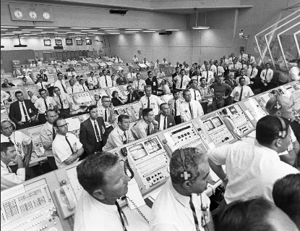
Ground Support
Mission Support
Mission Analysis
Mission Planners
Astronauts/Training
Assembly/Checkout
Army of Support

Slide 18
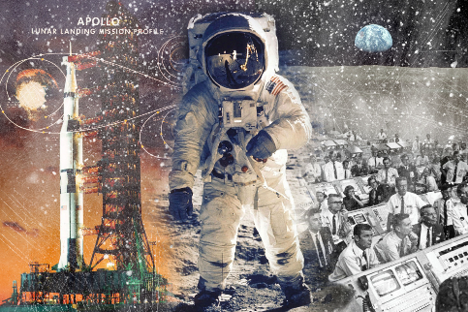

Slide 19
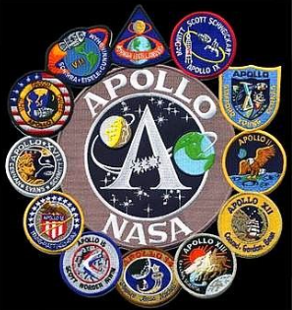

Slide 20
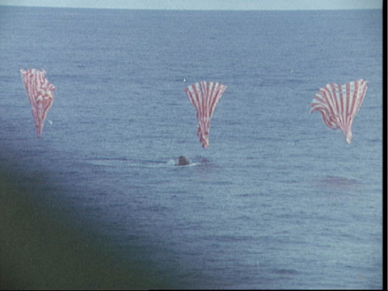

Slide 21
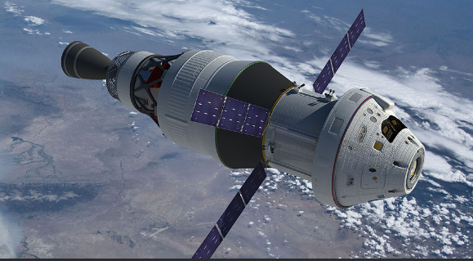
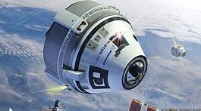
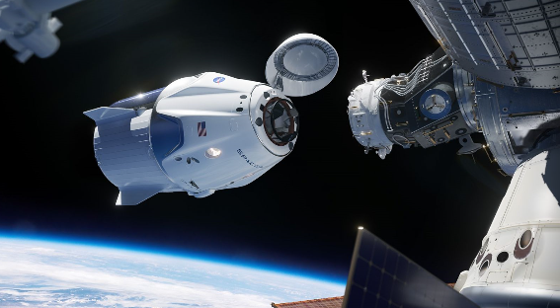
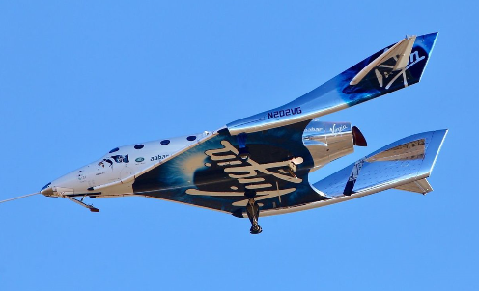
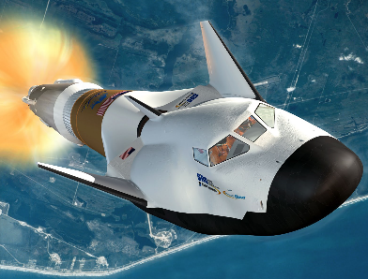
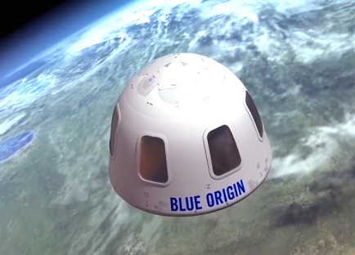
NASA Orion
Boeing
Starliner
Space-X
Dragon
Virgin Galactic
Unity
Sierra Nevada
Dreamchaser
Blue Origin
New Shepard

Slide 22
BACKUP

Slide 25
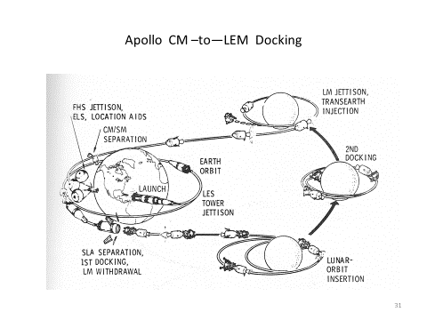

Slide 26
Key Man-In-Space
4/12/61 Gagarin Orbital-USSR
5/5/61 Shepard-1st Mercury-Suborbital
2/20/62 Glenn Orbital-Mercury
3/23/65 Grissom-1st Gemini
1/27/67 Apollo 1-Fire
10/11/68 Apollo 7-1st Manned-Earth Orbit
12/21/68 Apollo 8-Lunar Orbit
3/03/69 Apollo 9-Earth Orbit with LEM
5/18/69 Apollo 10-Lunar Orbit with LEM
7/16/69 Apollo 11-1st Lunar Landing
1969-1972 Apollo 12-Apollo 17
1973 Apollo Skylab-3 Flights (up to 84 days)
7/15/75 Apollo Docking with Soyuz
4/12/81 Space Shuttle-1st Flight
11/02/00 ISS-1st Habitation

Slide 27
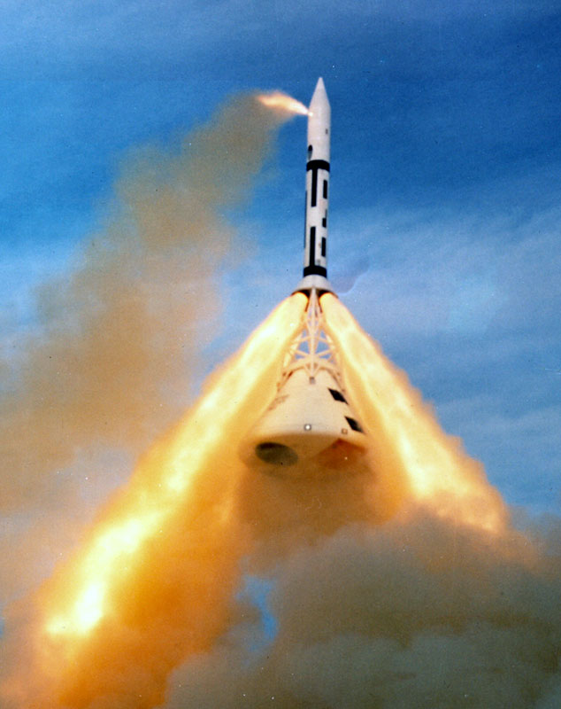
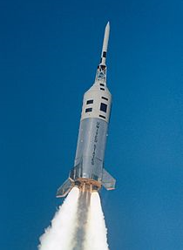
Safety First, Schedule Second
Prior to Manned Flight
6 WSMR Launches
Unmanned
Abort Tests
4 KSC Launches
Unmanned
Boosters
AeroThermal-Heat Shield

Slide 28
