Slide 1
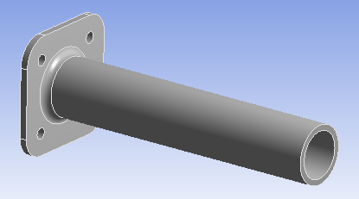
Effect of End Fixity Modeling on Vibration Behavior of Bolted Components
EAC
Engineering Analysis Consultants
Background Information
Boundary conditions for bolted joints are usually modelled as fixed constraints at bolt holes.
Three approaches are discussed for modeling bolted joints:
Fixed constraints at bolt holes
Explicit modeling of bolts and attachment
Fixing remote points associated with bolt holes
Component simplified as cantilevered cylinder with end flange attached with four bolts
Modal and random vibration results are compared for the three approaches

Slide 2
Modal Analysis of Component with Fixed Constraints at Bolt Holes
First Six Modes with Holes Fixed

Slide 3
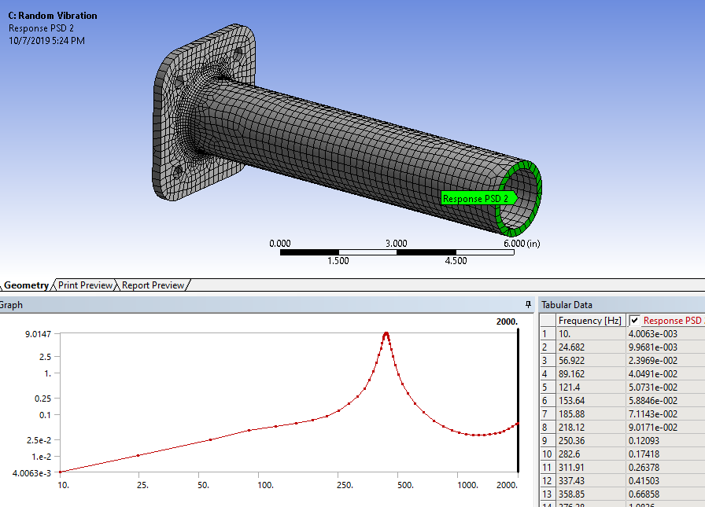
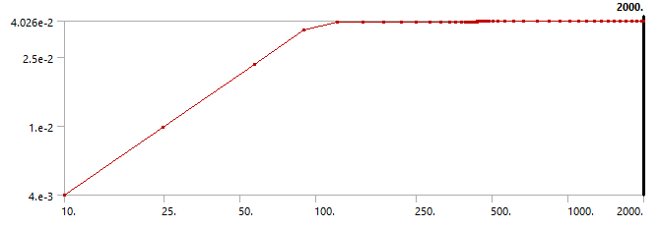
Acceleration & Stress Response to Random Vibration
Input Accel. PSD
Max. Acc. PSD Response = 9.01 G²/Hz
Max. Equiv. Stress = 5.1 KSI

Slide 4
Modal Analysis of Component with Explicit Bolts & Fixture (High Level Excitation)
First Six Modes with Explicit Bolts & Fixture

Slide 5
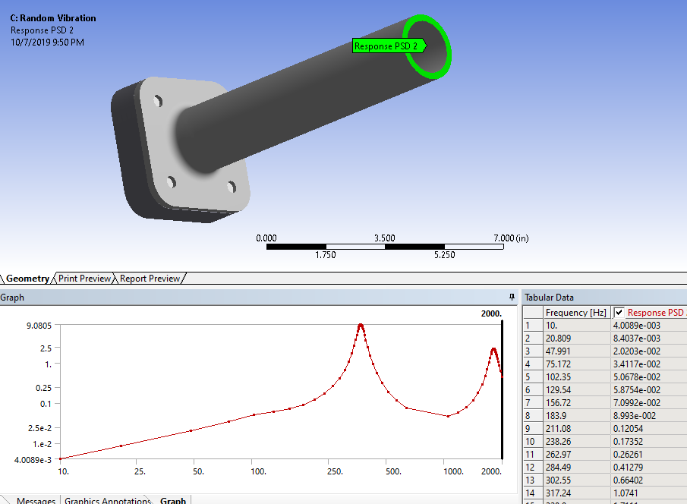
Acceleration & Stress Response to Random Vibration
Input Accel. PSD
Max. Acc. PSD Response = 9.08 G²/Hz
Max. Equiv. Stress = 5.6 KSI

Slide 6
Modal Analysis of Component with Explicit Bolts & Fixture (Low Level Excitation)
First Six Modes with Explicit Bolts Intact

Slide 7
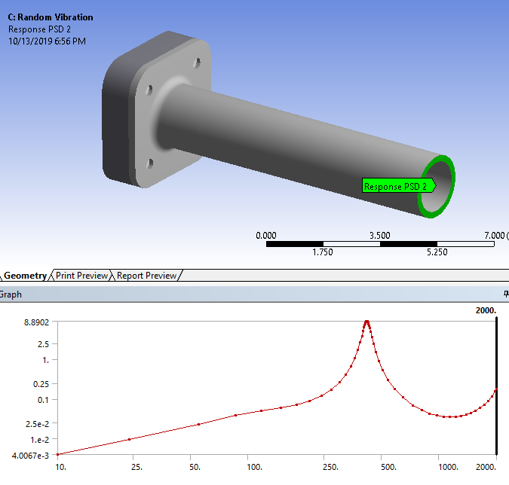
Acceleration & Stress Response to Random Vibration
Max. Acc. PSD Response = 8.89 G²/Hz
Max. Equiv. Stress = 5.1 KSI

Slide 8
Modal Analysis of Component with Remote Points
First Six Modes with Remote Points

Slide 9
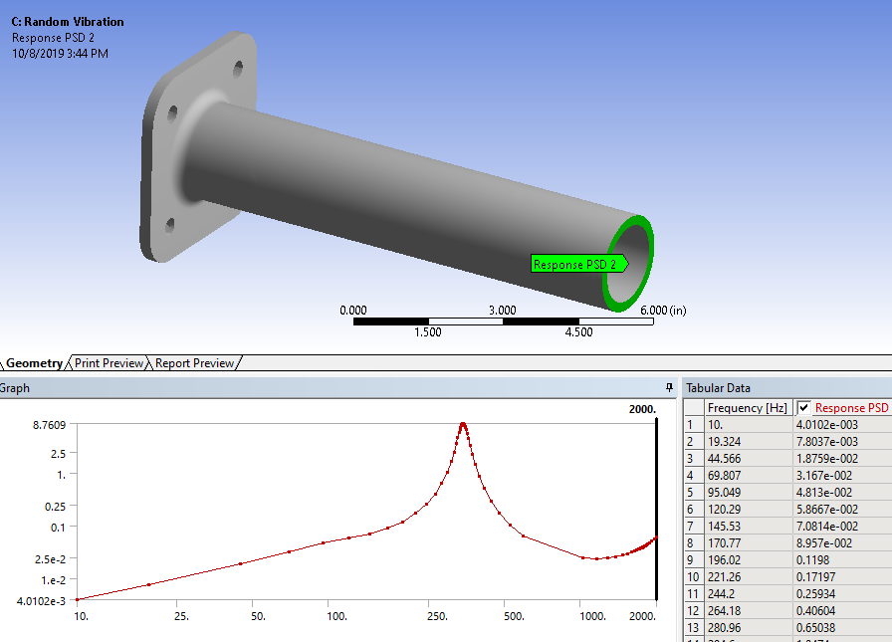
Acceleration & Stress Response to Random Vibration
Max. Acc. PSD Response = 8.76 G²/Hz
Max. Equiv. Stress = 6.2 KSI

Slide 10
Conclusions
Fixing bolt holes leads to unconservative stress response
Explicit modelling of bolts, while more laborious, produces higher and more realistic stress estimates.
Remote point approximation will predict higher stresses and lower accelerations
Fixing bolt holes may be acceptable for low excitation levels as the bolts will remain tightened.
For higher excitation level explicit bolt modelling is recommended.
For low level excitation higher contact stiffness bolted connection results approach fixed hole constraint results.

