Slide 1
Translating Industry Experience into the Classroom
Notes:
20-25 minutes presentation
5 minutes Q & A

Slide 2
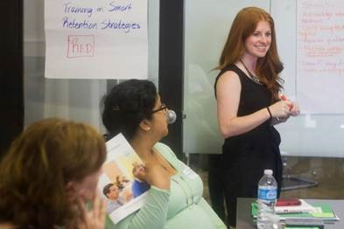
Who am I?
Bethany Orozco
Statewide Recruitment & Communications Director
bethany.orozco@encorps.org
@mrsbethanyorozco
@encorpsstemteachers
@BethanyOrozco
@EnCorps
Notes:
1 min
Introduce myself and my teaching background

Slide 3
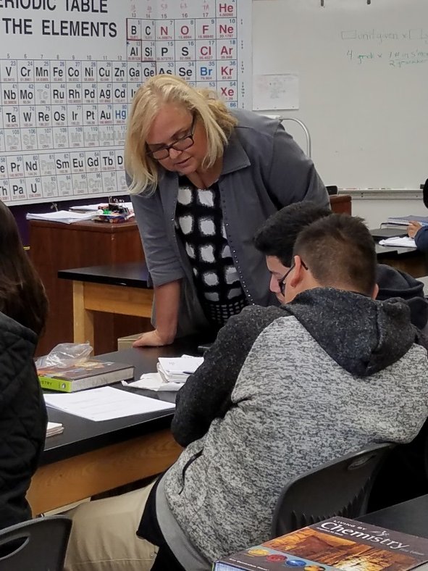
Raise your hand if you…
…have had an excellent teacher.
…would like to see more diversity in aerospace and the STEM fields.
…have volunteered with K-12 students.
…are an engineer. Manager. Researcher. Student. Who else?
Notes:
1 min
I would love to know a little about all of you. Raise your hand if you…
…have had an excellent teacher.
…would like to see more diversity in aerospace and the STEM fields.
…have volunteered with K-12 students.
…are an engineer. Manager. Researcher. Student. Who else?

Slide 4
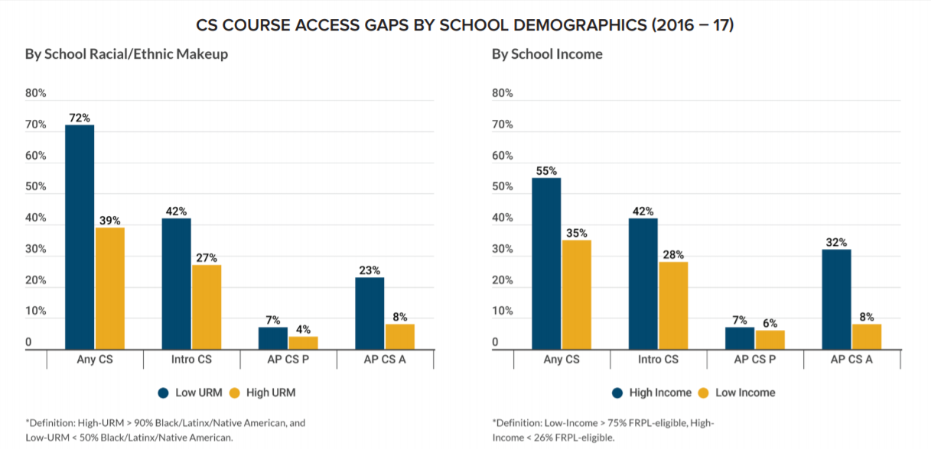
Inequity in STEM Education
Only 39% of schools in CA offer computer science education
"It's not a pretty picture, we are not doing an adequate job educating poor kids, black kids, Latino kids.“
Tyrone Howard, UCLA Education Professor
Data source: Kapor Center, Computer Science In California’s Schools
Notes:
1 min
I am going to make some assumptions about why you are here. I am assuming that you care about diversity in the STEM fields. I am assuming that you would agree with me that all kids should have access to computer science education to get us there.
Sadly, as you may be aware – that is not currently true. Of high schools where most students are black, Latino and Native America, only 39 percent offer computer science courses, compared with 72 percent of schools where white or Asian students make up the majority.
Source: https://www.kaporcenter.org/wp-content/uploads/2019/06/Computer-Science-in-California-Schools.pdf

Slide 5
Inequity in STEM Education
California Assessment of Student Performance and Progress
California Overall
39% MATH
Data source: California Department of Education. Graphic by Yuxuan Xie.
Notes:
1 min
We believe that all students should have access to a great STEM education, teachers and opportunities. And this is not currently true. STEM education in the US and CA is lacking, especially for minority and low-income students.
In the most recent results from the Smarter Balanced Assessments (or CA Assessment of Student Performance and Progress - spring 2018) –you can see the math results here -only 39% of students in California met or exceeded the math standard. And it’s worse when we look at the data by ethnicity. The racial achievement gap persists. While 54% of white students met or exceeded the math standards in 2018, only 27% of Latino students and only 20% of African American students met or exceeded them. And that is not okay.
Source: https://edsource.org/2018/a-small-rise-in-californias-math-and-reading-scores-in-2018/603099

Slide 6
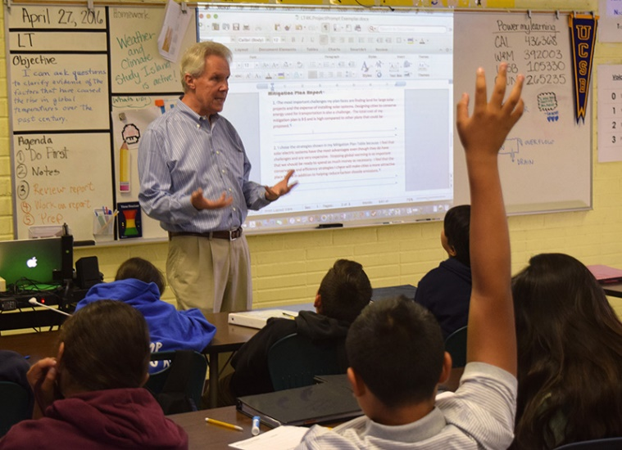
Inequity in STEM Education
Effective teachers make a measurable difference! How much?
Encountering an above-average teacher for five years in a row could overcome the achievement gap;
A teacher who performs one standard deviation above the mean effectiveness in a class of 20 students can annually produce marginal gains of over $400,000 in present value of student future earnings (Hanushek, 2011).
Notes:
1 min
And, we know that students excel in excellent teacher’s classrooms.
Research shows that teachers are the most important school-based factor in student achievement (McCaffrey, Lockwood, Koretz, & Hamilton, 2003; Rivkin, Hanushek, & Kain, 2000; Rowan, Correnti & Miller, 2002; Wright, Horn, & Sanders, 1997) and that encountering an above-average teacher for five years in a row could overcome the achievement gap.
Teachers can have a huge role on a student’s future, including their future earnings. This is why we are working to find STEM professionals who can bring real-world experience, expert content knowledge and access to opportunity to our highest need schools. YOU could be that teacher.
(Hanushek: based on data from several Texas school districts, Hanushek and Steven Rivkin (2004) further highlighted the importance of effective teaching by concluding that if a student encounters an above-average teacher for five years in a row, that could overcome the achievement gap typically found between students qualifying for free or reduced-price lunches and those from higher-income backgrounds.)

Slide 7
21st Century Classrooms
Notes:
4.5 min
So we are working to bridge that gap by putting professionals from science, technology, engineering and math industries in underresourced middle and high school classrooms and training them to be excellent teachers.
Play video

Slide 8
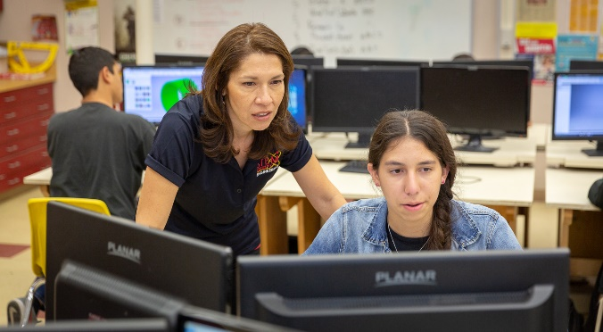
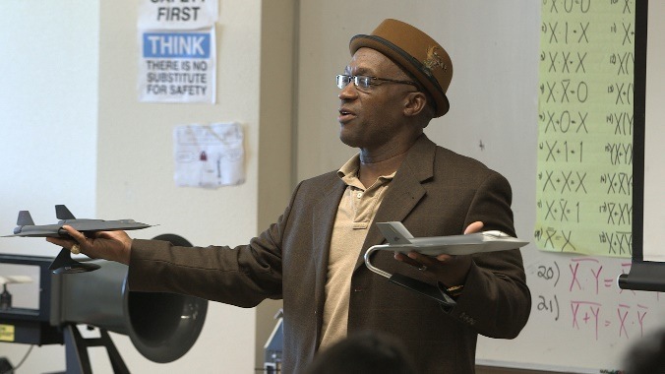
Classrooms in the 21st Century
“I saw a spark in those kids and I want to see more of that. I want to see these kids say, yes, that’s what I want to do with my life!”
-EnCorps Teacher, Erika Parker
“At the end of the day, what’s going to be your legacy?
-EnCorps Teacher, Julian Lewis
Notes:
2 min
Classrooms in the 21st century look different than they might have when you or I went to school:
-Technology – computers, tablets, cell phones, drones, wind tunnels, 3D printers
-CTE classes – engineering, computer science, business and finance, etc
-Real world connections are more important – students are asking “why do I need this in my future?” We need people that can answer that question.
-Project-based learning – many schools are beginning to do PBL curriculum and ALL their projects must have a real-world connection.
EnCorps Teacher Julian Lewis not only connects his students to real applications of math and science in his aerospace engineering classroom, he inspired one student to pursue an education at Embry Riddle Aeronautical University, just like he did. A former Lockheed Martin aerospace engineer of 34 years, Lewis grew up in the South Bronx and was inspired by an eighth grade teacher who was a pilot. He says that the satisfaction of working on amazing aircraft equals the satisfaction he gets from watching his students become engaged in aerospace. “At the end of the day, what’s going to be your legacy? What have you impacted? As I share my experience, they are realizing I too can do that. They will be better individuals because I am here.”

Slide 9
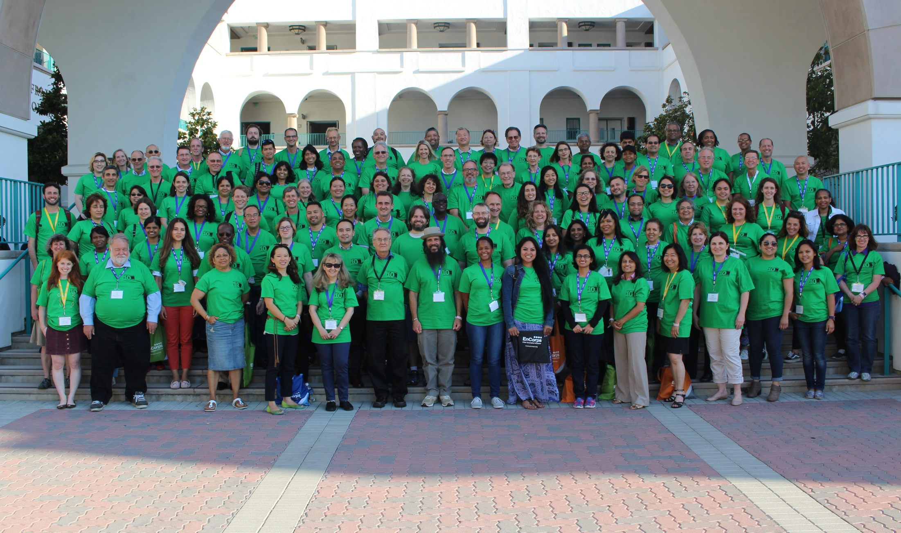
“I wondered if I could turn my volunteer work into my next profession. EnCorps is attractive because of the resources, support and networking in this new field.”
EnCorps Fellow
Make an impact.
Notes:
1 min
Tell my story about Phoebe

Slide 10
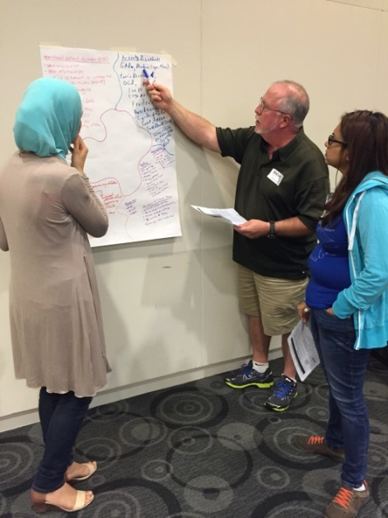
Fellowship & Beyond
What we offer
Online professional development modules
In-person workshops & trainings
Volunteer time in a classroom with an EnCorps Host Teacher
Access to:
Program support
Cohort of peers
Scholarship opportunities
Earn a teaching credential
Become a teacher by next fall
Notes:
2 min
The EnCorps Fellowship is a pathway to transition to teaching middle school or high school. The Fellowship includes:
Online professional development modules
In-person workshops & trainings
Volunteer time in a classroom with an EnCorps Host Teacher
Access to:
Program support
Cohort of peers
Scholarship opportunities
Earn a teaching credential
Become a teacher by next fall

Slide 11
Fellowship & Beyond
Career & Technical Education Credential
Subject Areas
Arts, Media, and Entertainment
Energy, Environment, and Utilities
Engineering and Architecture
Business and Finance
Health Science and Medical Technology
Information and Communication Technologies
Manufacturing and Product Development
Transportation
Process
Obtain verifications of employment and official transcripts
Online coursework beginning October, February or June for 3 months
Notes:
2 min

Slide 12
Who inspired you?
Notes:
4 min
Now, I want you to think of WHO inspired you to pursue your career path and passion. Think of just one name. Raise your hand if that one person was a teacher or mentor.
Young people need teachers and mentors who believe in them. YOU can be that person.

Slide 13
Innovate. Empower. Ignite. TEACH. www.encorps.org/apply WINTER application deadline: November 15, 2019 Bethany Orozco Statewide Recruitment & Communications Director bethany.orozco@encorps.org
Notes:
1 min
Even if you yourself do not wish to teach, please consider spreading the word.

