Slide 1
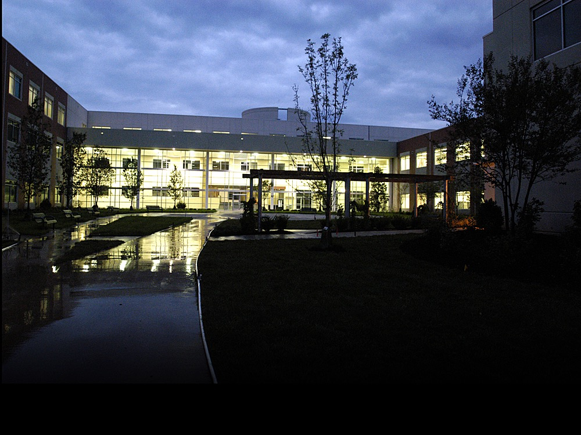
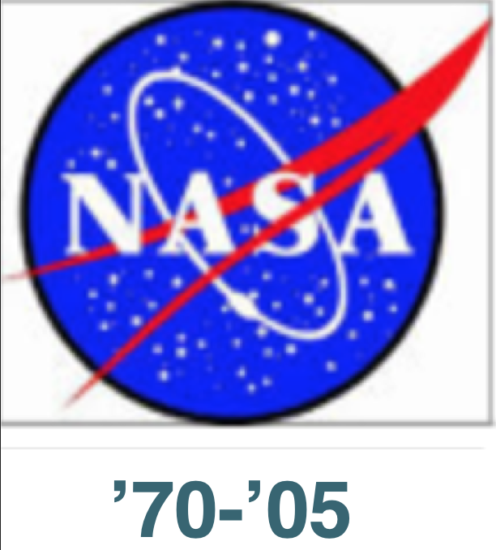
SUPERcomputers,
Analysis
& NASA Missions
1
27 Sep 2016
AIAA Hampton Roads
NASA-LaRC 16 Oct 2020
Dr. Olaf O. Storaasli VP Synective Labs
Future Technologies Group, ORNL ‘05-’12
Sr. Scientist, NASA ‘70-’05
1
Notes:
Good PM I’m happy to share SC info PPF
NASA+ORNL(3x) “dessert”
1st USNA + ANM: UK & Scan

Slide 2
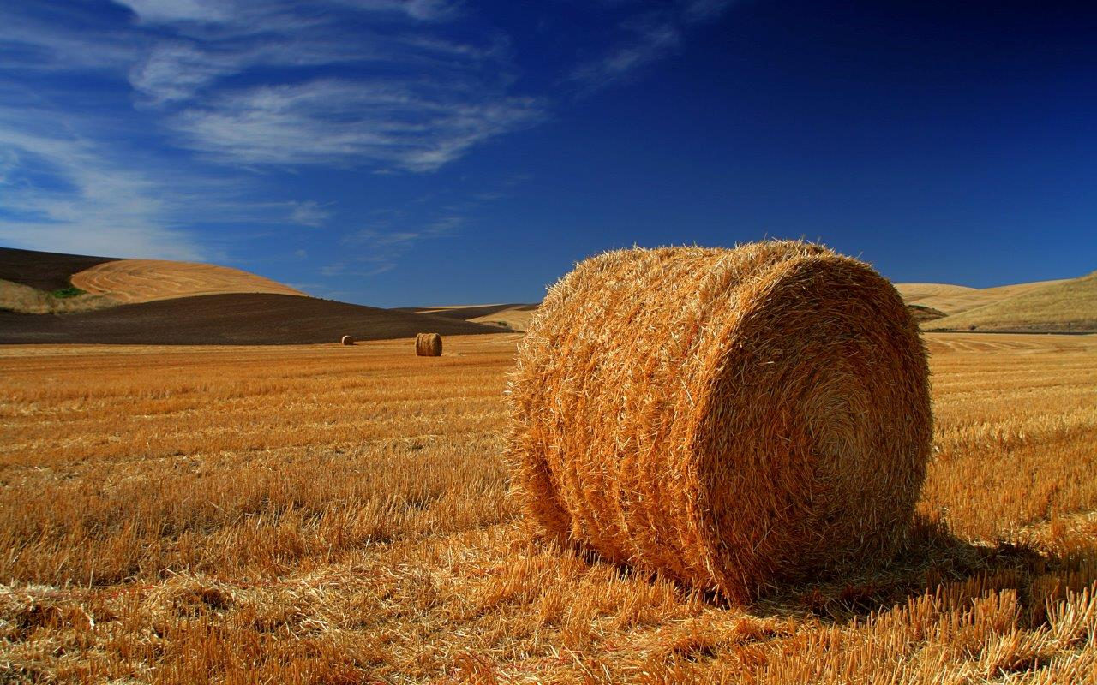
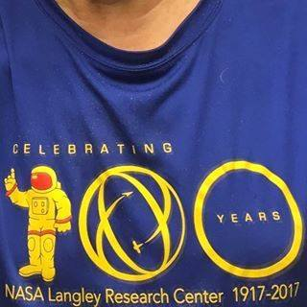
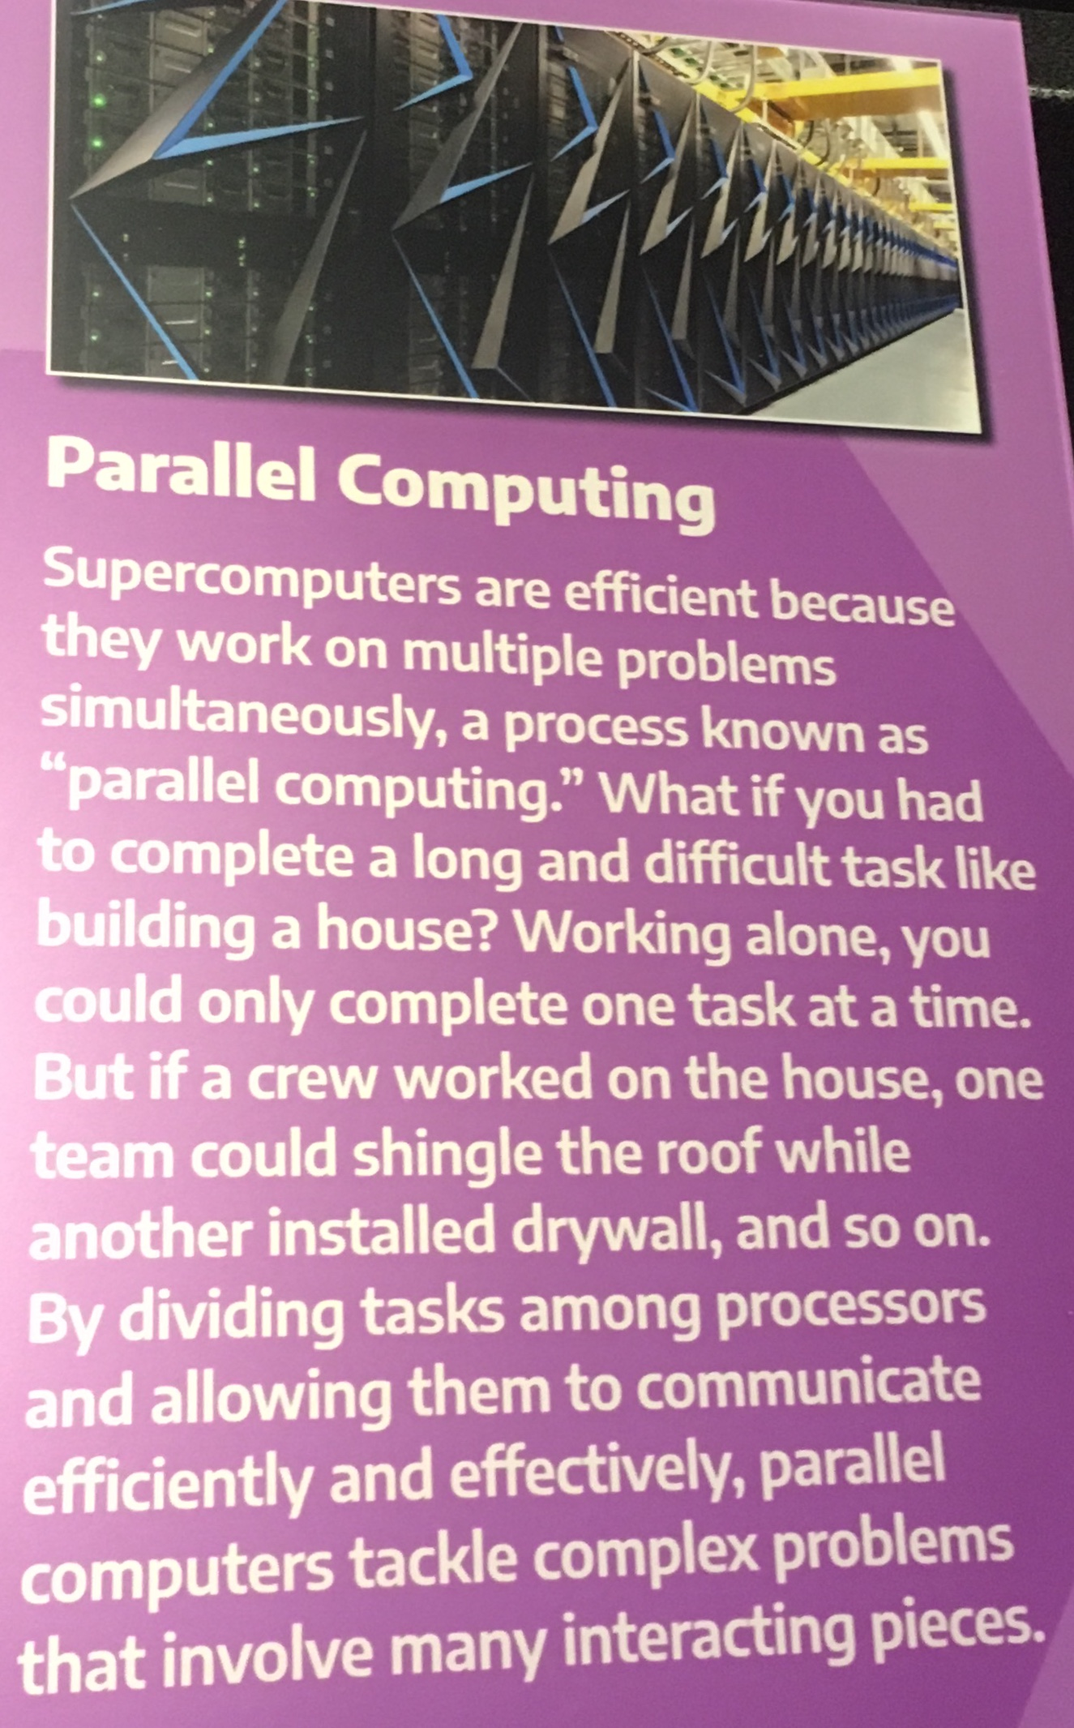
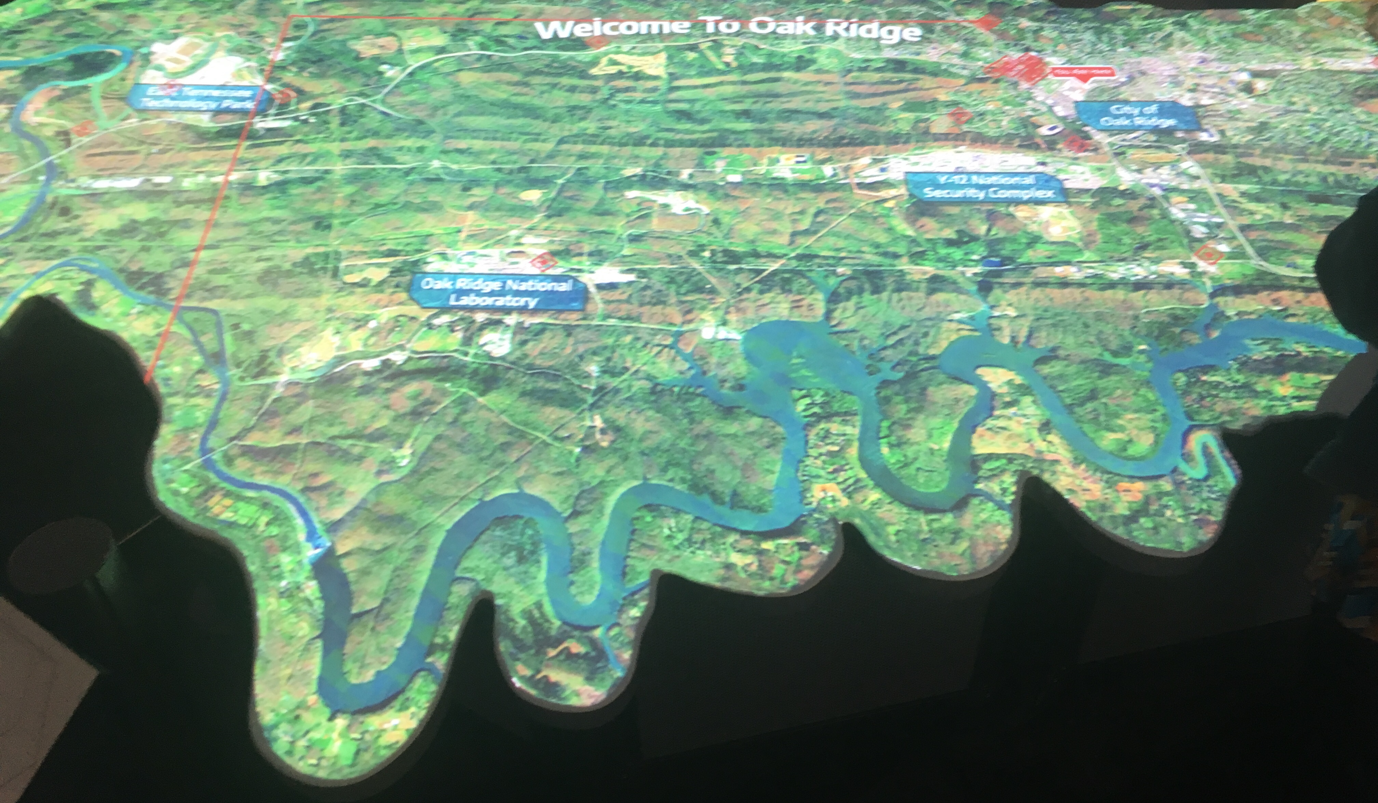
Prairies => VA => TN
Saskatoon
NASA
ORNL
Notes:
Breakfast>Main Course>Dessert
N Mentors: Uncle Bar/EL MN/SD>MIT EE/Y>Calutrons ended WW2
Computing: Slide Rule>SC (Eng-Scientist)
Takeaways: 10^15, GF phone, US Threat (WW2, Space, AI)

Slide 3
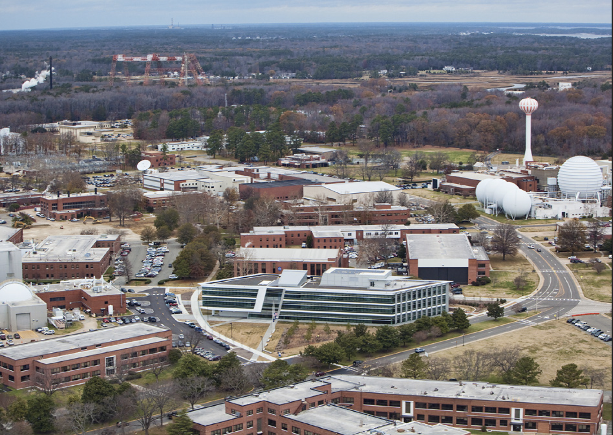
NASA Langley Research Center, Hampton VA
Olaf
Katherine Johnson CRF
Notes:
1229-Katherine Johnson CRF: ’17 - Hidden Figures
1148-X641-X1229+

Slide 4
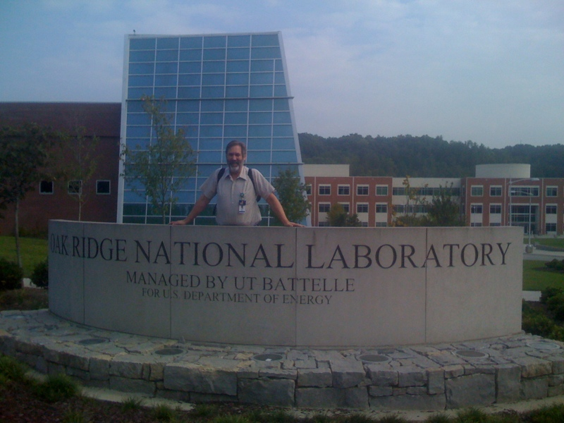
US Supercomputer Lead
WW2 Manhattan Project X10
now ORNL
2
Notes:
FTG recruited from NASA in ’05 >(accelerator-based SC)
2

Slide 5
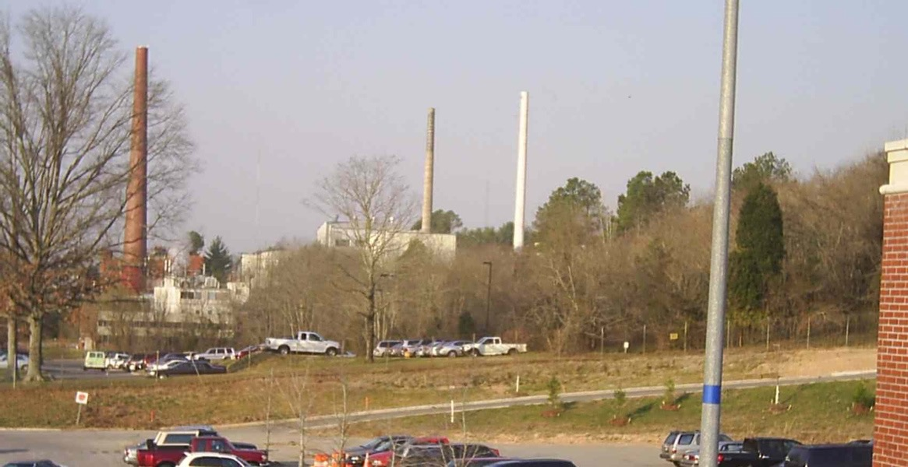
X10: 1st Pilot Pu Reactor => PNL
+U Labs: K25 Y12 Ernest Lawrence + uncle built Calutrons
Notes:
’43 Manhattan Project @X-10/ORNL Secret Plutonium Reactor =>PNL
2nd Atomic bomb ended WW2 => worldwide peace.
1st Nuclear reactor to generate electricity & medical isotopes.

Slide 6
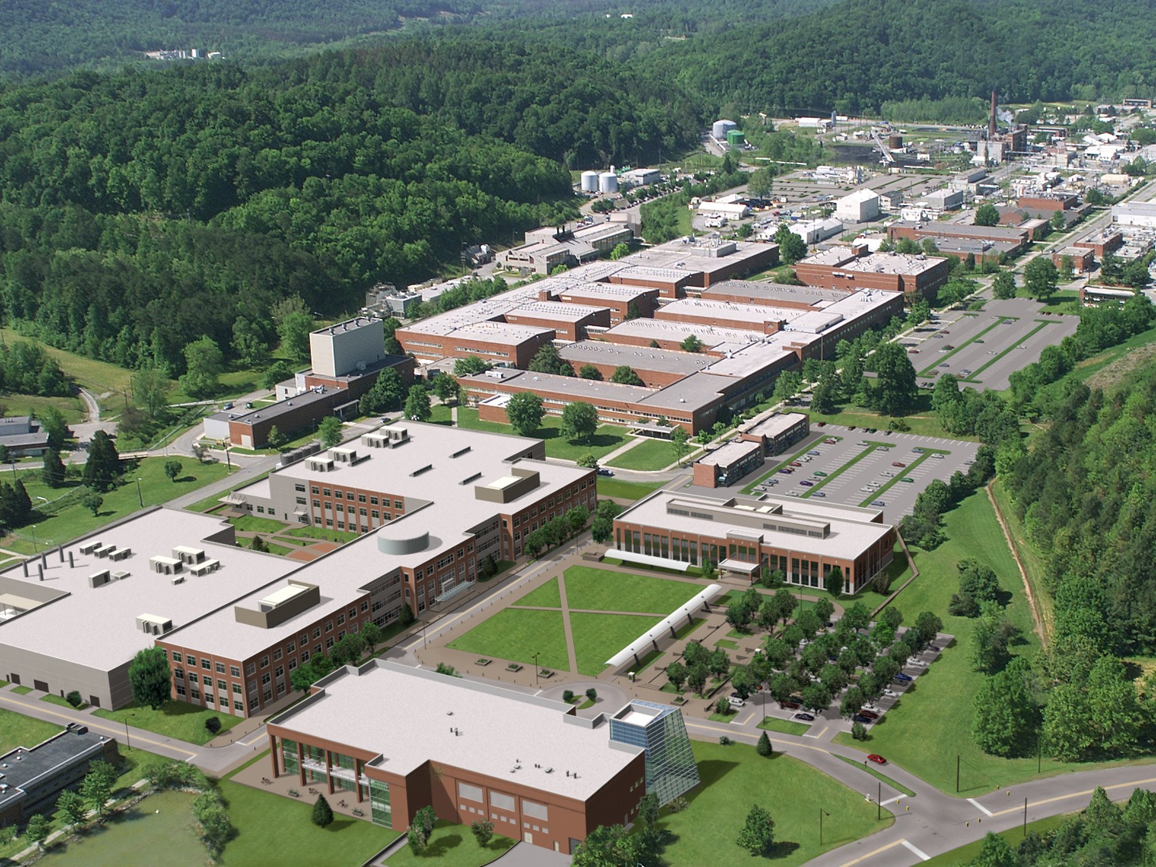
ORNL: US #1 Energy & Science Lab
· 4K + 3K guest researchers
· #1 US Supercomputer+NSF+NOAA+USAF
· $1.3B/yr
3
7
Notes:
3 Summit

Slide 7
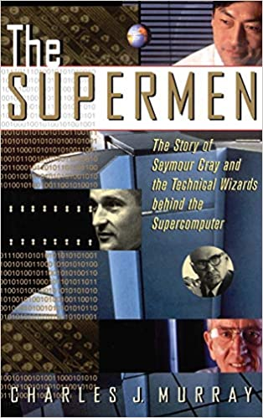
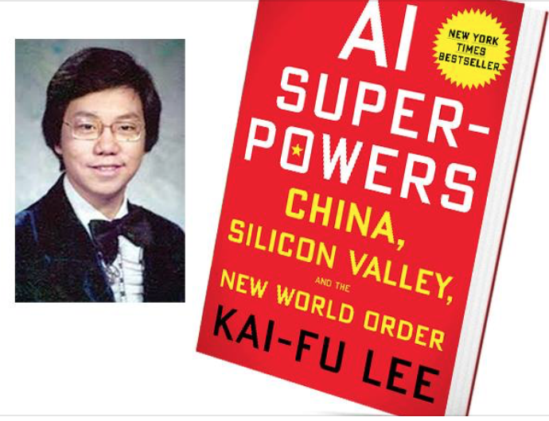
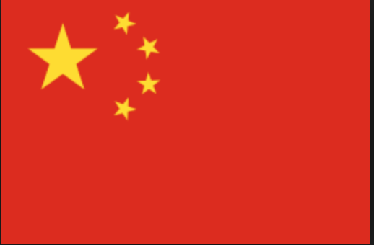
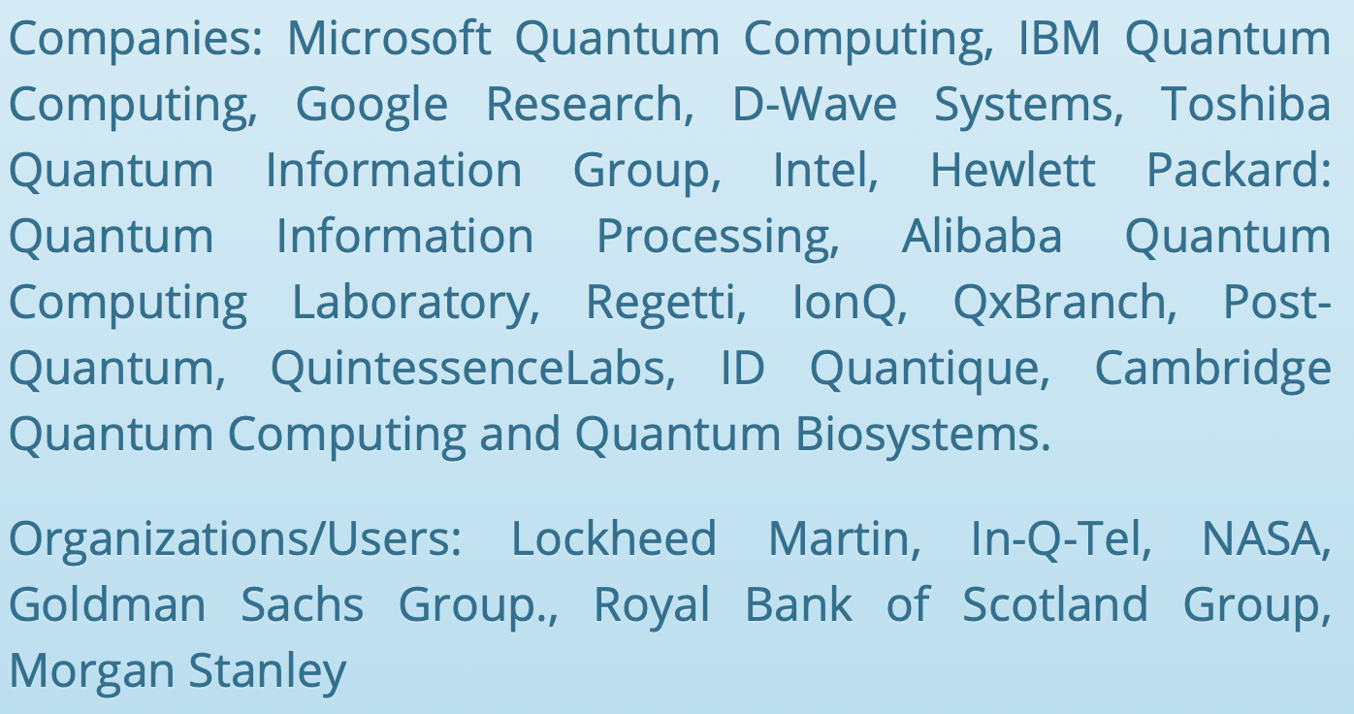
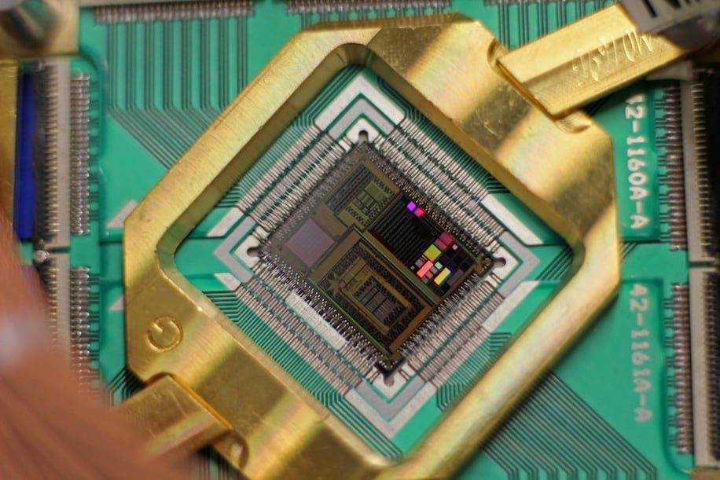
M
Motivation
Past
Future
WP 11 May ’18 Max Nikias
WP Max Nikias
QC
Notes:
Worldwide SC race, includes quantum computers & communication
Active in QC: 01, Accenture, Airbus, Alibaba, Amazon, Archer, AT&T, Atos, Baidu,
Booz Allen, D-Wave, Google, Honeywell, IBM, Intel, JSR, Lockheed Martin,
Microsoft, Mitsubishi, Nokia Bell, Northrup Grumman, NTT, QCI, QNC, Quemix, Raytheon, BBN, Toshiba,

Slide 8
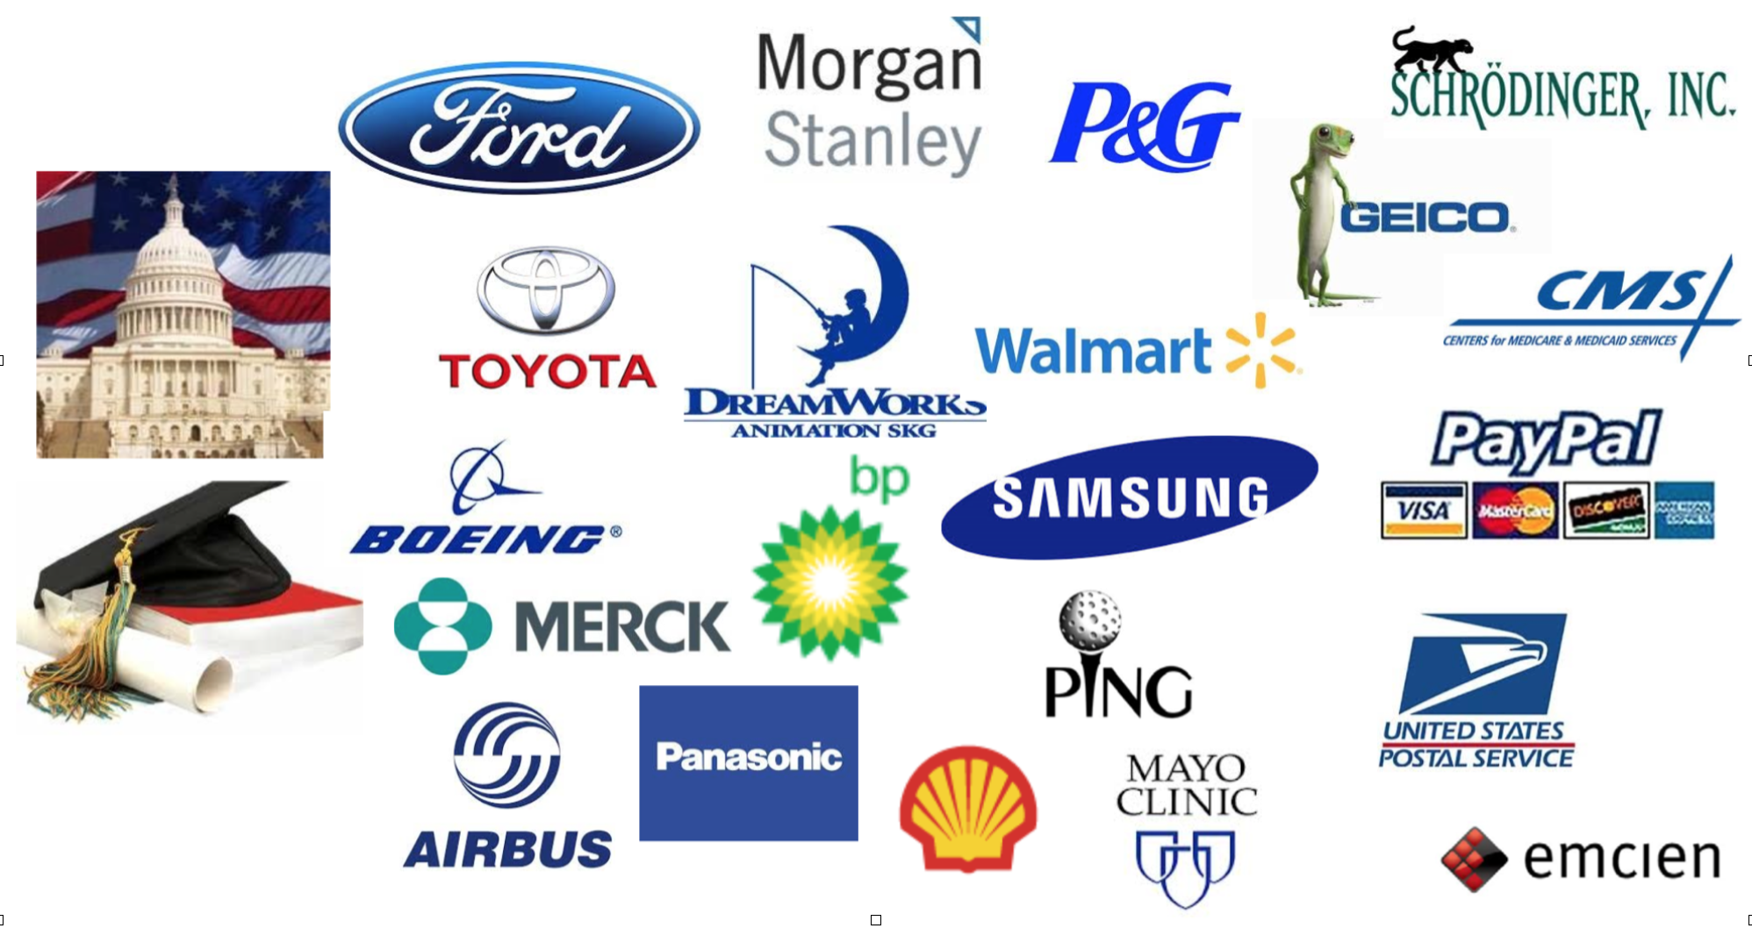
Technical Computer Market
$10B (’13) => $15B (’18)
SC: $4B => $5.7B
1960s
Now
Notes:
Growth + Diverse growth in TC & SC Market

Slide 9
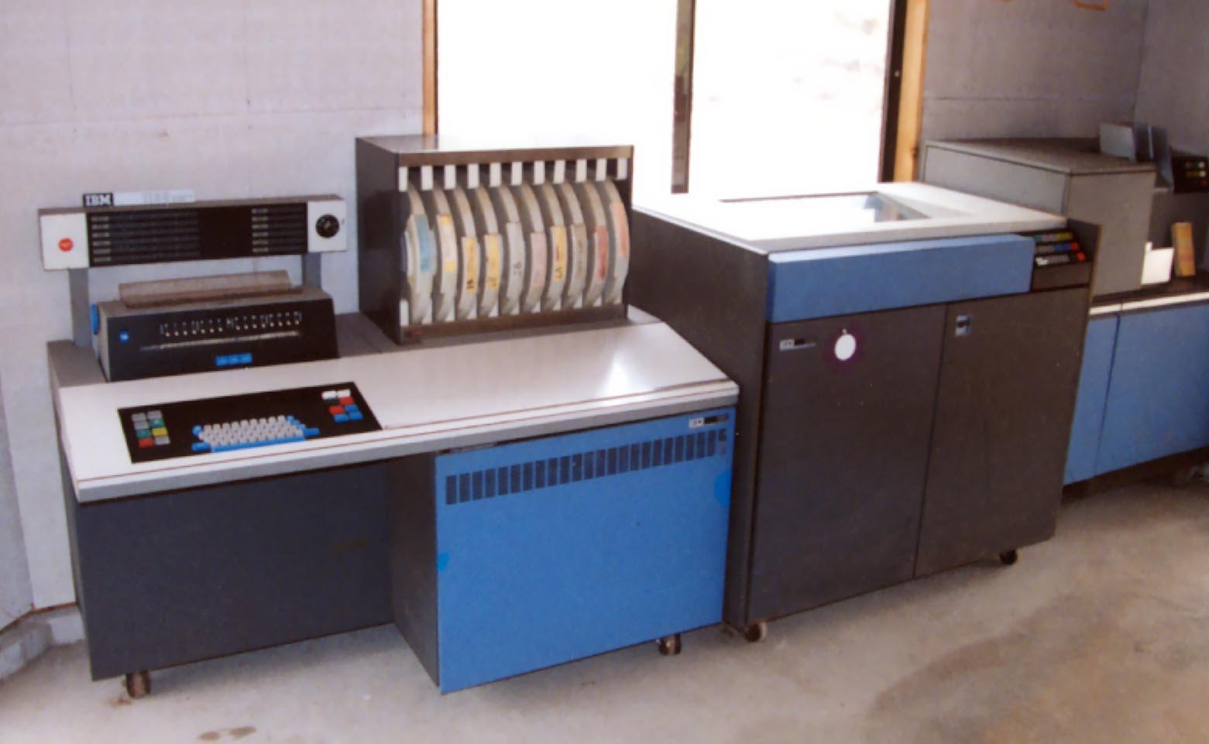
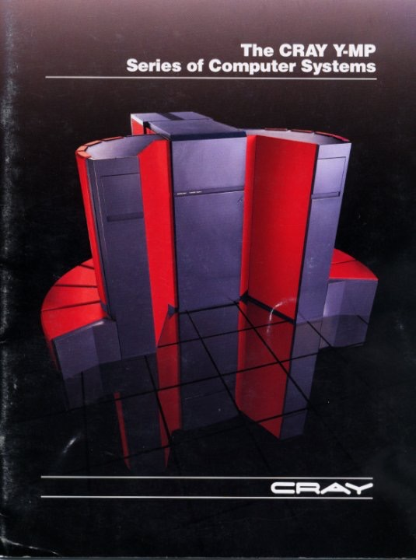
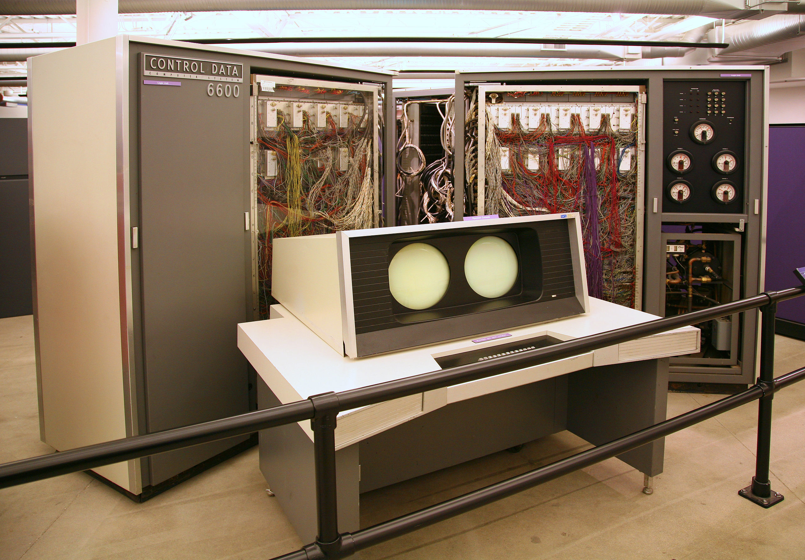
Past
57-yr Speedup
‘79
16P
‘64
1P
We hit
“Power
Wall”
NASA Finite Element Machine
IBM 1130 16 bit
1.5KF
‘89
8VP
‘70
1VP
CrayYMP YMP-YMPYMP
275MF
CDC6600
0.5MF
‘21
27PF
Now
Frontier: ’21/’64 = 1.5EF/1.5KF
EF=10^18 / KF=10^3
1,000,000,000,000,000 X faster
1.5EF
Notes:
Trip down SC memory lane. Speedup?

Slide 10
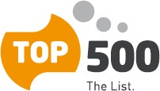
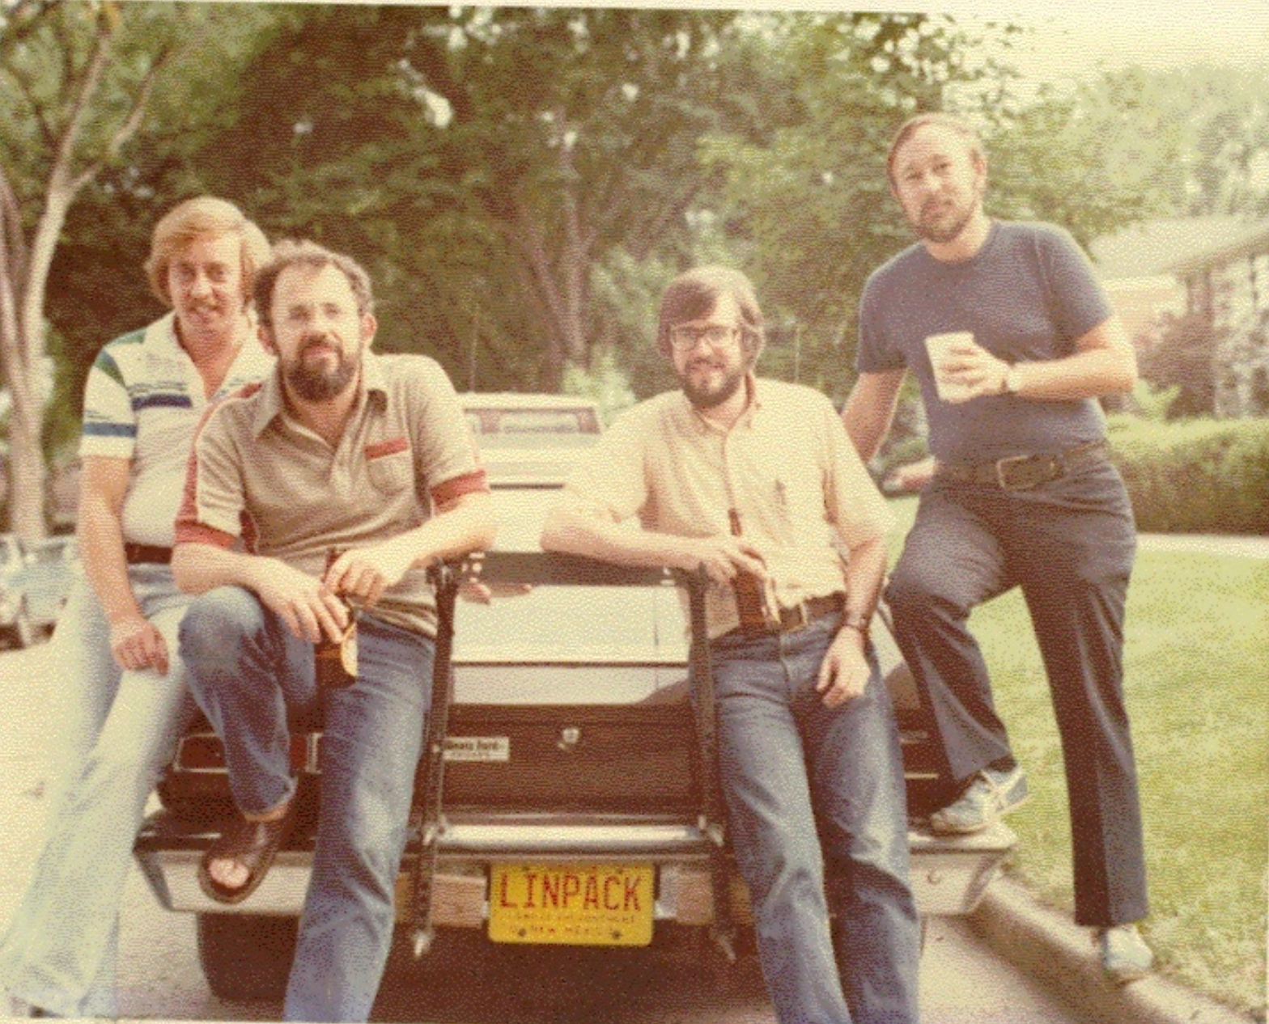
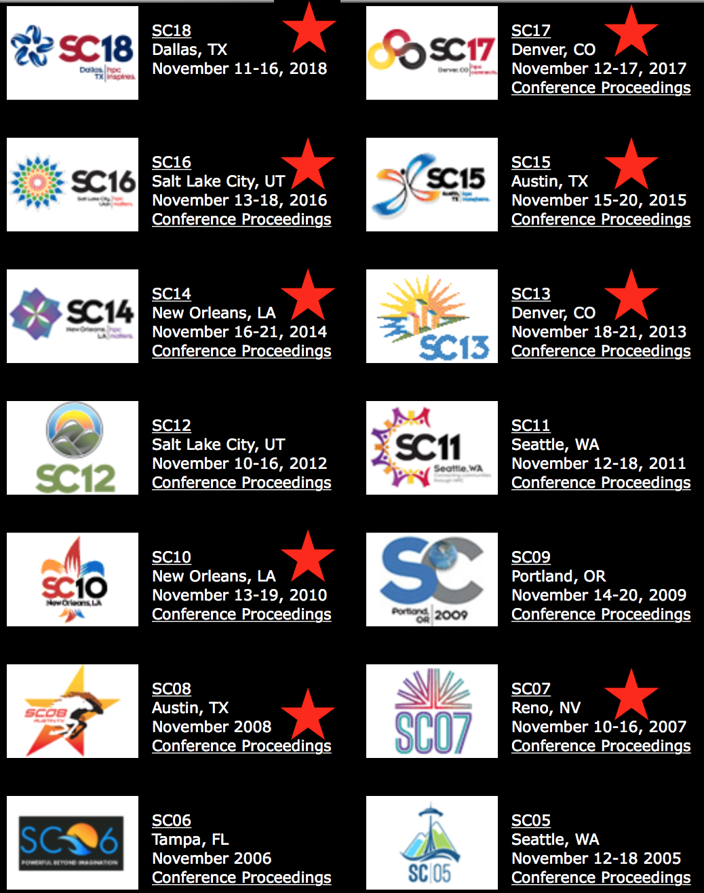
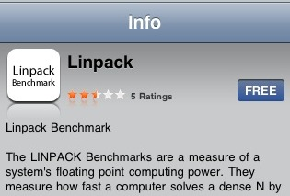
World’s Fastest Computers List
top500.org July/ISC, Nov/SC
Thanks 4 slides
Linpack benchmark: Ax=b Jack Dongarra
Try it! My iPhoneXr ~ 21GF, Craig Hunter:
MacBookPro ~ .25TF MacPro28 ~ 1.5TF
Notes:
Like racecars or aircraft, SC speed measured 2x/year (June & November)
How to measure HPC speed? Linpack benchmark
Even iPad, iPhone & Macs

Slide 11
HPC Speedup: 1000X per Decade
(ORNL?)
(Shultness - ORNL)
(ORNL)
(Storaasli - NASA)
2021
1 Exaflop = 1,000 Petaflops = 1,000,000 Teraflops = 1,000,000,000 Gigaflops = 1,000,000,000,000 Mflops
Notes:
70s MF => 20s EF =>1000X /decade
In 89 GF SC89 Cray Award: SS-SRB in 6sec => Bx since

Slide 12
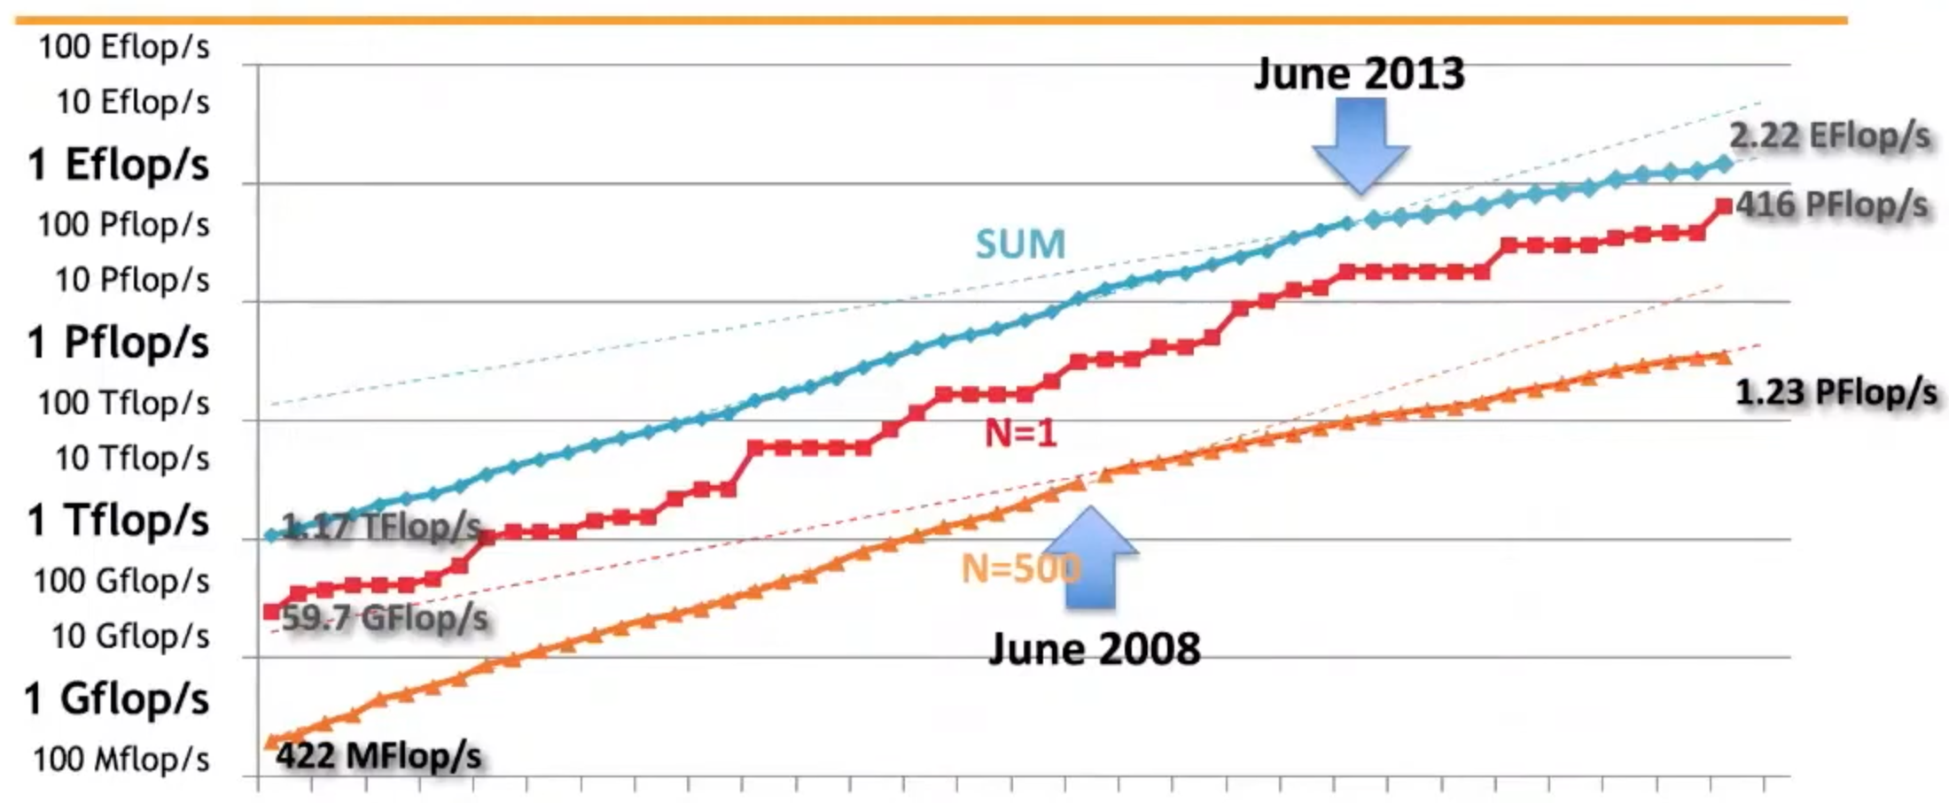
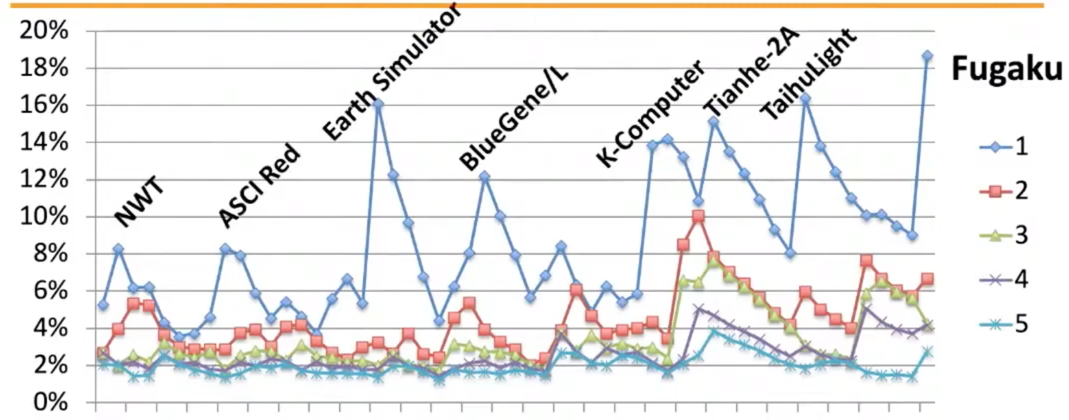
Supercomputer Speedup
Craig’s MP
Olaf’s iPhone Xr
‘95
‘00
‘05
‘10
‘15
‘20
Top5 %
of 500
Notes:
25yrs SC Speedup: #1, #500, SUM
Iphone MB

Slide 13
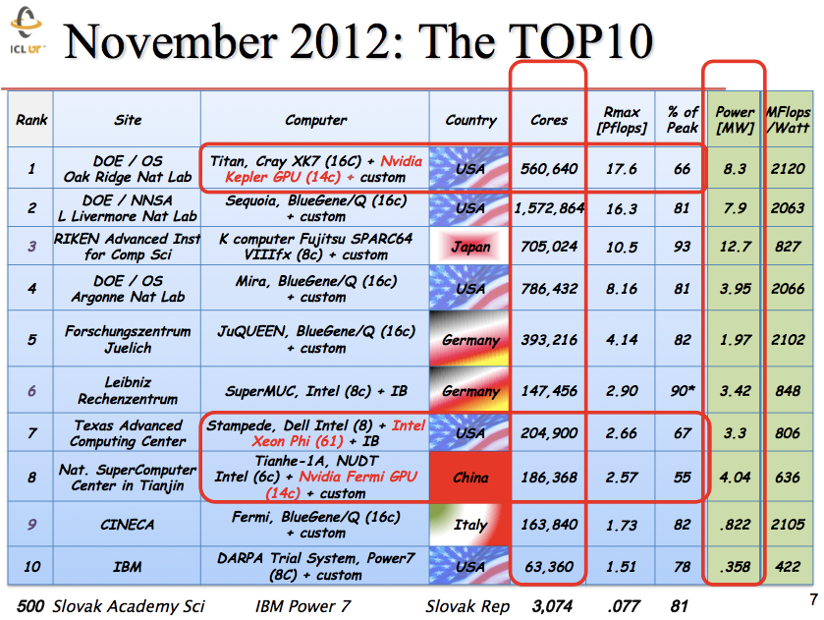
Notes:
#1 Titan 560K cores + GPUs 7-8
2PF/MW+4 IBMs => now 15 (China 6)
Top10-US ’05-7-7 ’08-10 ’09-8 ’10-19-5 ’17/20-4

Slide 14
Top10 Supercomputers June 2016
Speed-TF, Power-kW, Cores-M
10
M
15
kW
18
8
8
4
93
33
18
17
11
9
8
8
7
7
Notes:
Huge China entries

Slide 15
Top10 Supercomputers June 2018
Speed-TF, Power-kW, Cores-M
9
11
15
kW
11
18
122
93
72
61
20
20
18
17
14
14
Notes:
US (ORNL) regains top

Slide 16
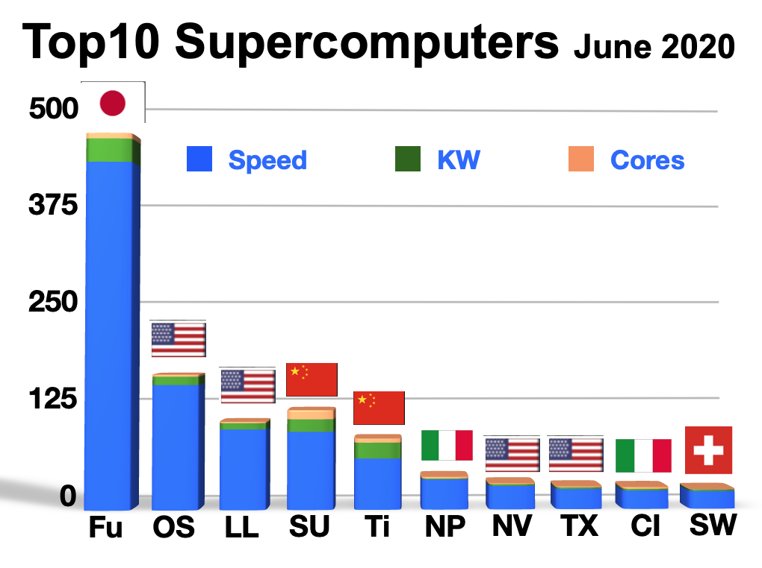
Notes:
Japan 3x US

Slide 17
Top10 Supercomputers June 2020
new to Top10
#1 EF for HPL-AI (less precision)
15GF/W 1-3
6GF/W 4-5
Notes:
4 new EF 4 AI

Slide 18
#1 Supercomputer Fugaku = 537 PF

Slide 19
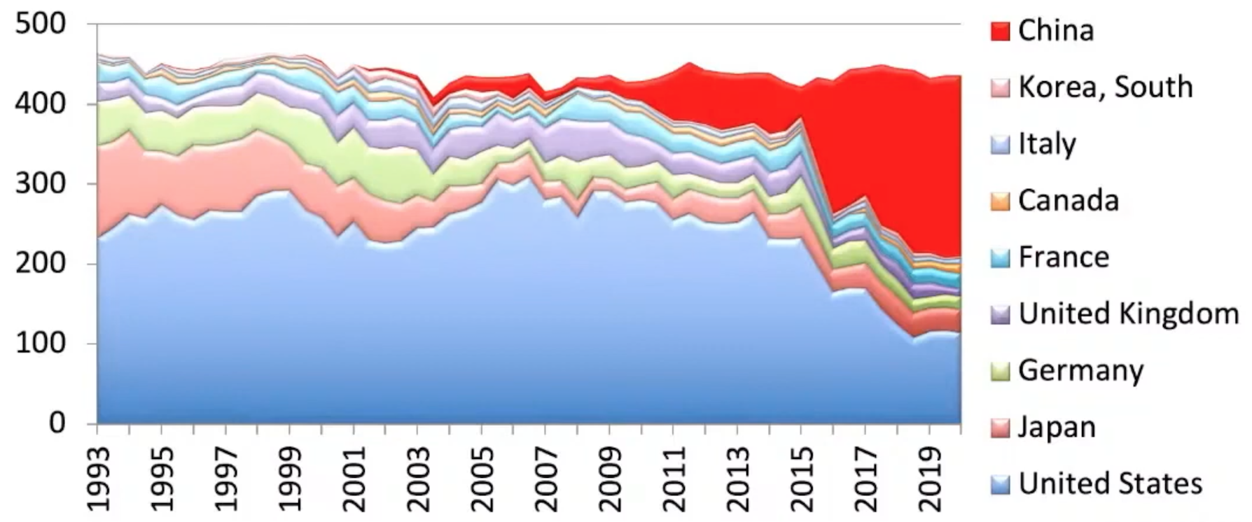
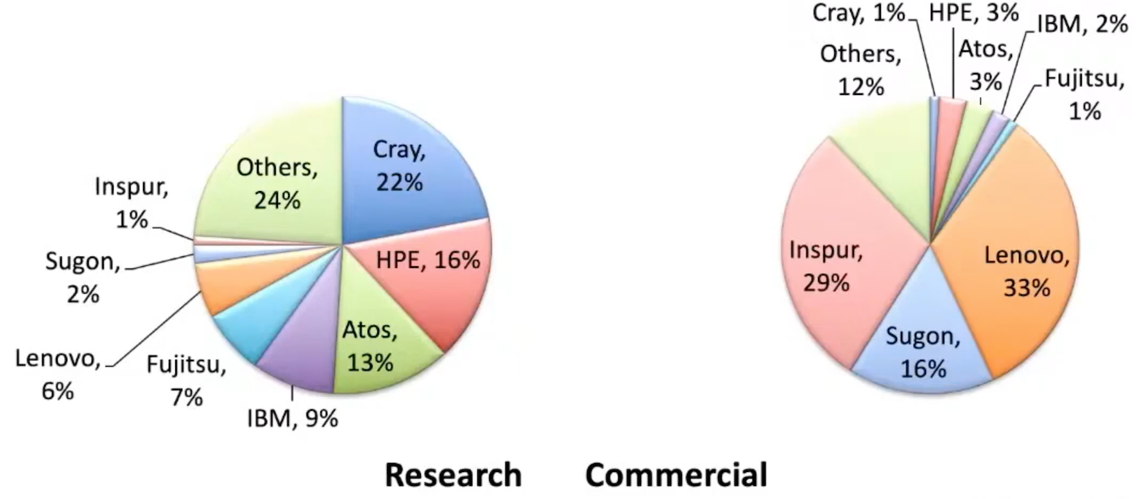
China leads #Systems
, Top5 as % of 500
Notes:
China growth: Systems, especially Commercial

Slide 20
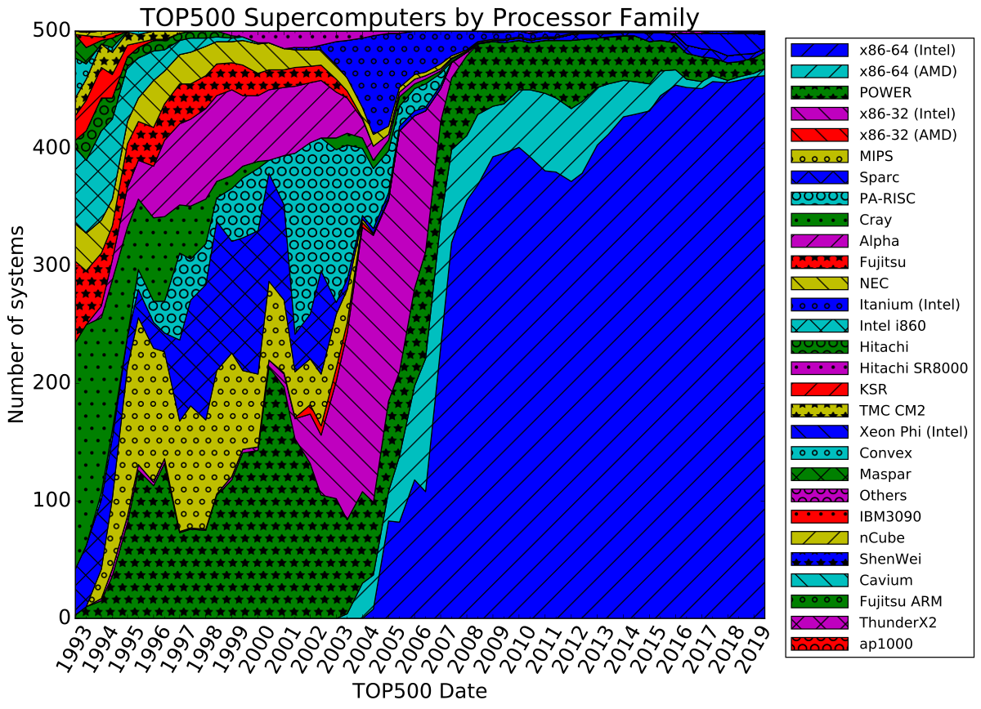
Notes:
Intel X86 dominates

Slide 21
Unified x86/Accelerator Development Environment common look and feel & fast
Cray Debug Support Tools
Cray Compiling Environment
X86-64
Cray Message Passing Toolkit
Cray Performance Monitoring
and Analysis Tools
Accelerators
CUDA SDK
Cray Scientific & Math Libraries
Slide Courtesy of Cray Inc
Notes:
Intel Dvpt Tools speed SW

Slide 22
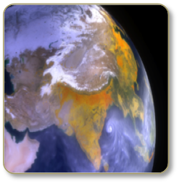
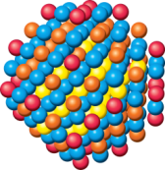
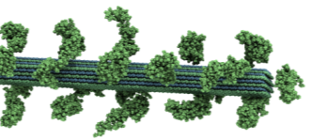
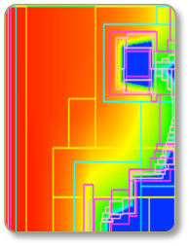
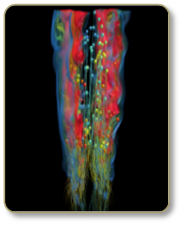
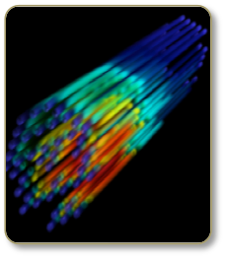
Science Applications
Material Science
(WL-LSMS)
Role of material disorder, statistics & fluctuations
in nanoscale materials
& systems.
Climate Change (CAM-SE)
Realistic climate change adaptation & mitigation scenarios: precipitation & tropical storm patterns/statistics.
Biofuels (LAMMPS)
Multiple function molecular dynamics
Astrophysics (NRDF)
Radiation transport for astrophysics, laser fusion, combustion, atmospheric dynamics & medical imaging.
Combustion (S3D) Combustion simulations to enable next generation diesel/bio-fuels to burn more efficiently.
Nuclear Energy (Denovo)
Calculate Radiation transport for nuclear energy & technology apps.
Notes:
ORNL SciComp team: yrs b4 delivery
Look at one that broke PF

Slide 23
Courtesy of Thomas Schulthess
Notes:
Superconductivity basics were not well understood until Dr. Shultness HPC breakthough in 2009

Slide 24
Who?
Notes:
Teams rqd 4 Successful breakthrough project - Schultness

Slide 25
Bill Dally NVIDIA VP, Chief Scientist, Stanford Prof
HiPEAC’15 Keynote Amsterdam Jan 19, 2015
Notes:
How Summit emerged

Slide 26
CPUs use 12x power of GPUs
Notes:
GPUs: Key to eliminate exotic cooling & save energy

Slide 27
Summit: CPU (IBM P9), GPU (Volta) & NVLink

Slide 28
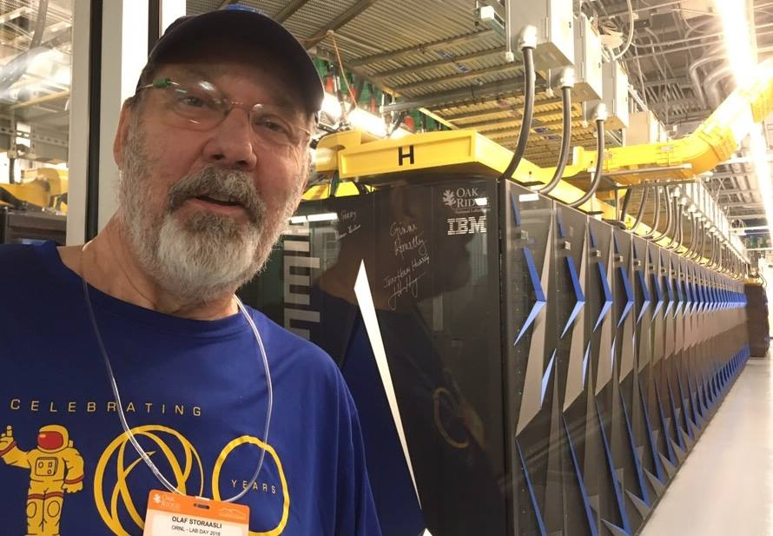
Summit
Notes:
Fastest US SC: signatures - no raised floor - size of BB court

Slide 29
Analysis - Top SC Use
Nastran
Dyna
Ansys
Abaqus
Star
Foam

Slide 30
Notes:
FEA = contract detailed model (plate, spar) elements => simulate real structure

Slide 31
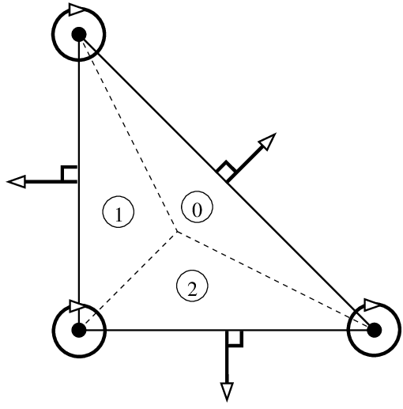
Boeing/Berkeley FE Theory to Aircraft Analysis
Jim Tocher, 1962-63 post doctoral fellow in Norway
continued triangular plate element research in
coordination with Clough. Former Clough student,
T. K. Hsieh, suggested complex triangular element
satisfying displacement compatibility with
excellent results, Named HCT element, after
Hsieh, Clough & Tocher.
Clough
B/B
+
Tocher
B/B
+
Hsieh
B
=> FEA Code
Boeing Problem => Theory
Refine
History: http://www.edwilson.org/History/Butterfly%20Effect.pdf
Notes:
2 complex triangles better than plate

Slide 32
Supercomputer Impact
on
Finite-Element Analysis
NASA Anticipated SC advance => developed NASTRAN
NASA STRuctural ANalysis in 1970
Joe Gloudeman MSC Nastran (IEEE 1984)
Spinoff
Reduce FEA time, main Structural Analysis Tool
Enable huge detailed & unsolvable analysis
Extend to Design, Optimization, Nonlinear apps, AI
Widespread Gov’t, Industry & Academia use
Effective Vector, Multiprocessor & Accelerator use
Notes:
Joe Gloudeman 1984

Slide 33
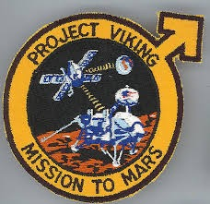
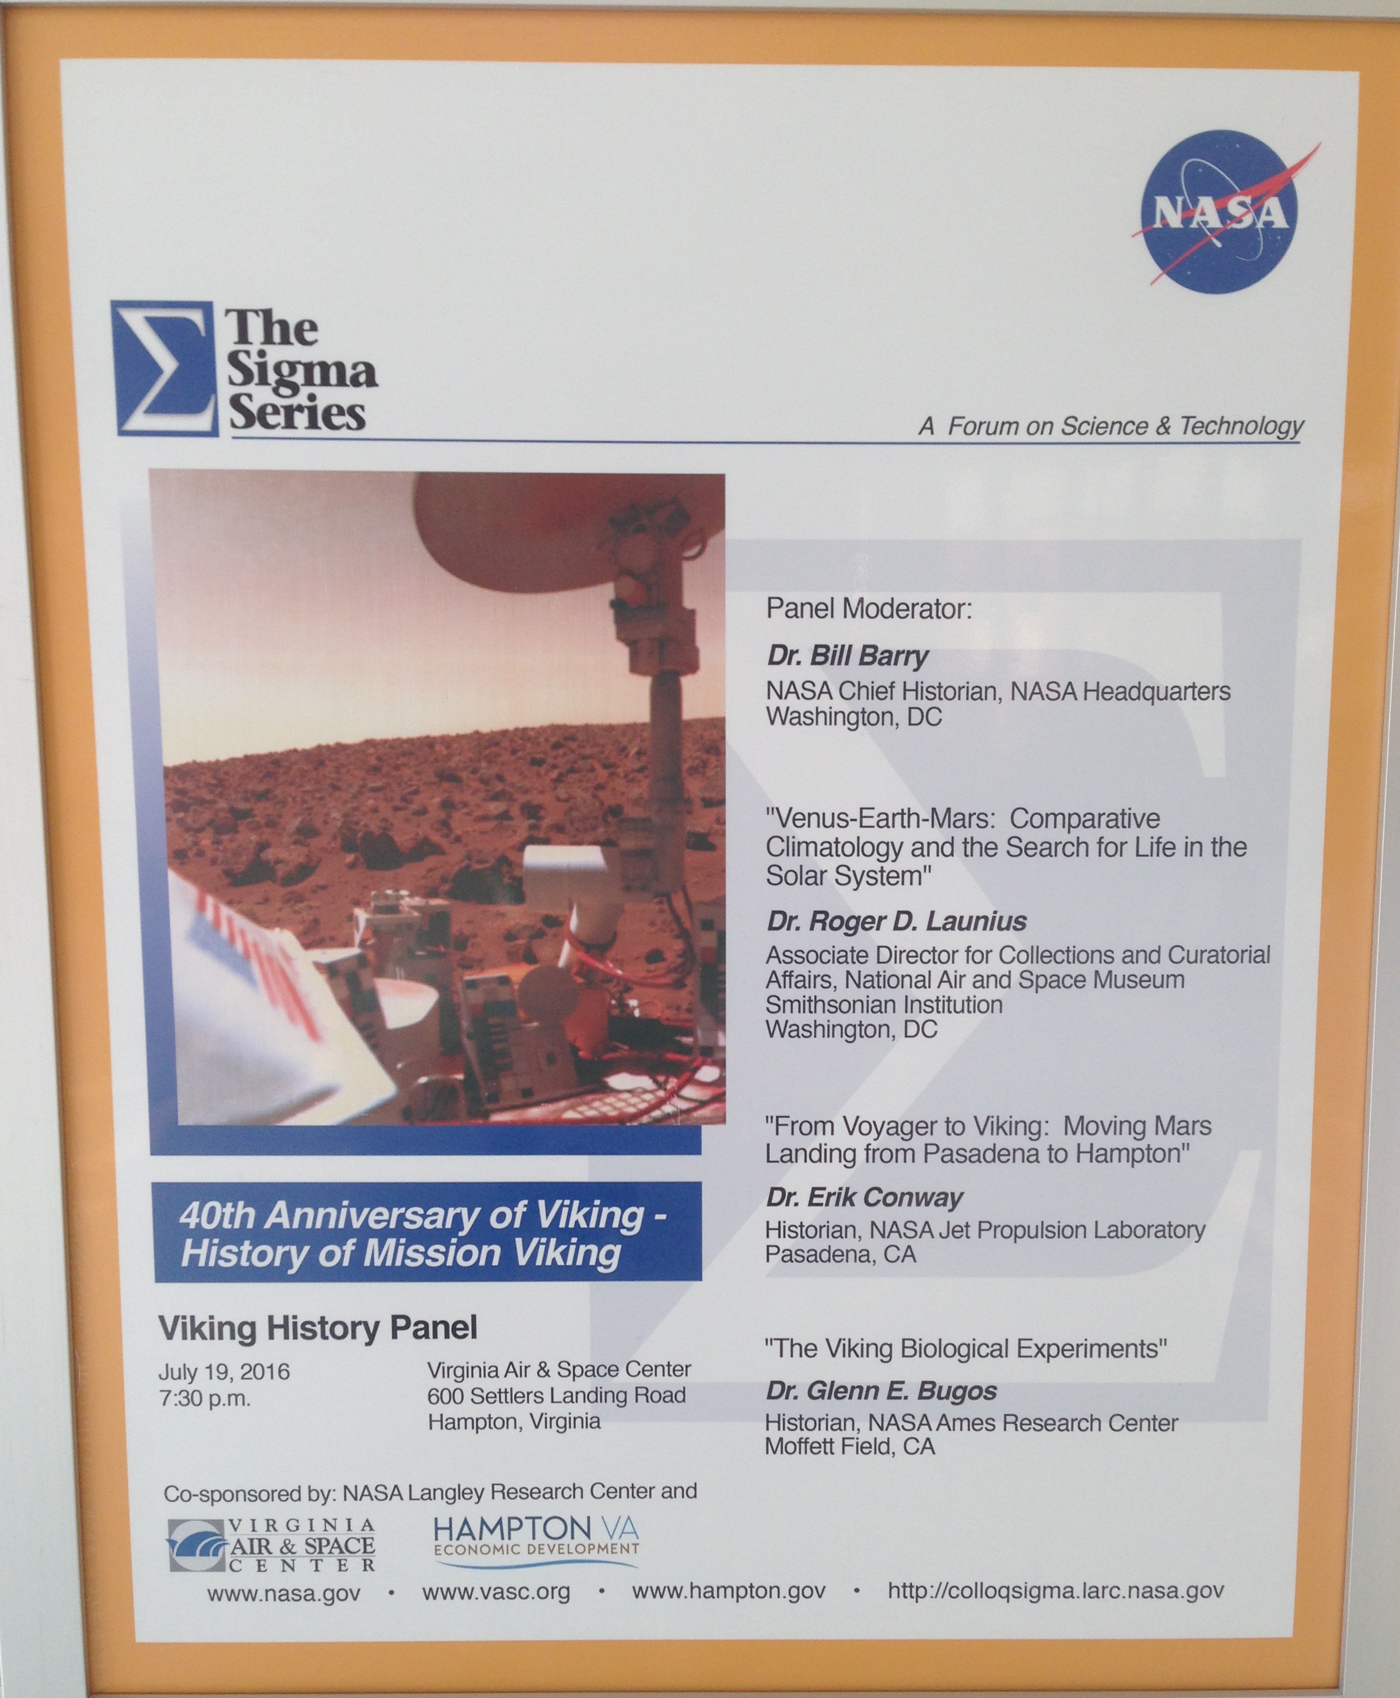
NASA Missions: Viking
July 20 1976 1st Mars Soft Landings
http://livestream.com/viewnow/viking40
http://livestream.com/viewnow/viking40
Notes:
Langley ran plus designed lander
Video35, 39 40 reunions @ Langley

Slide 34
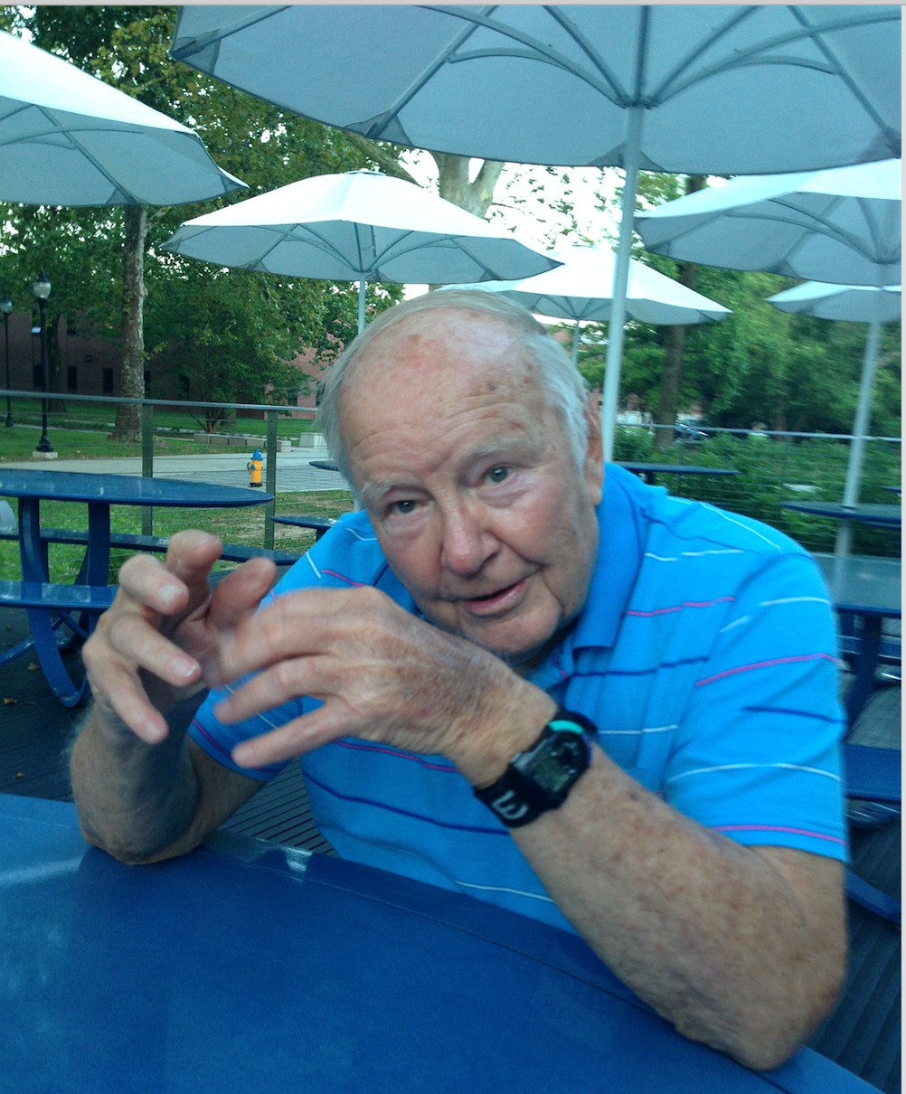
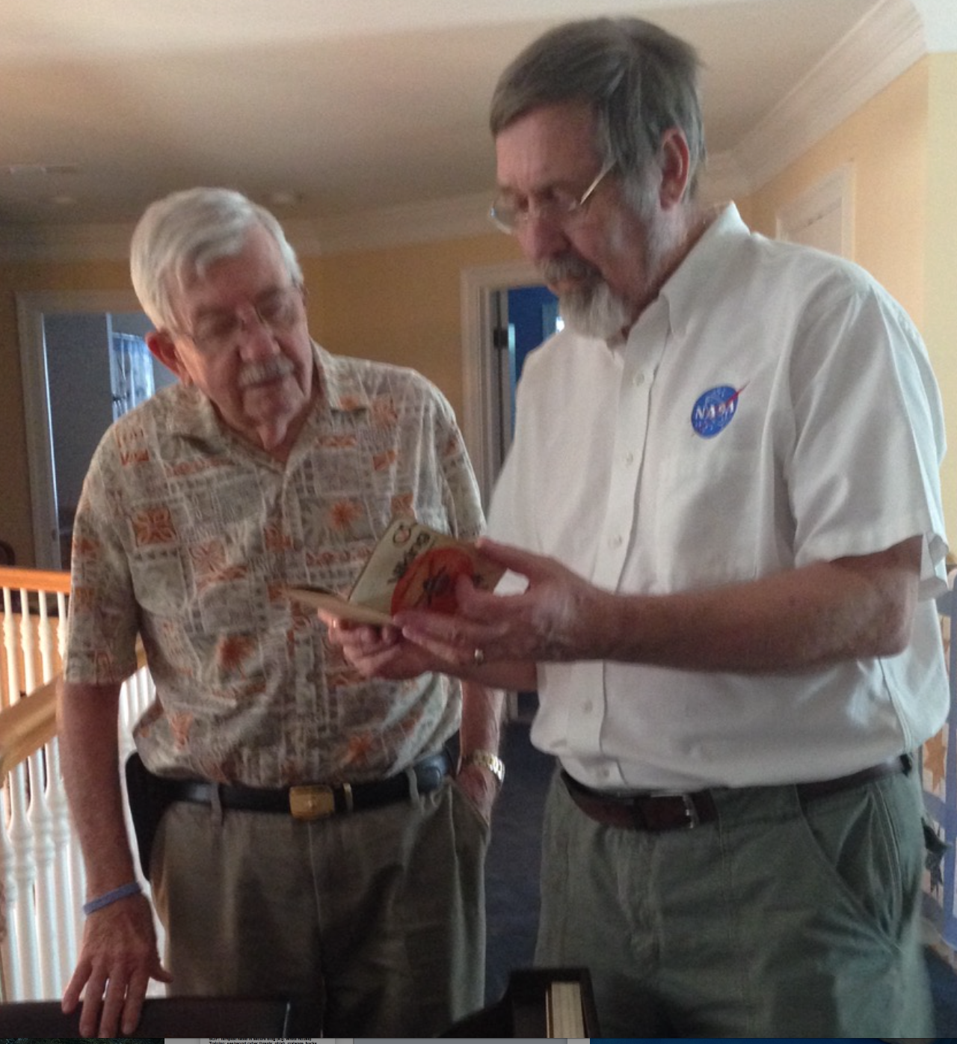
NASA Viking 1st Mars Landings
Many Langley engineers “pulled it off”
Mel Anderson - Aeroshell
Dick Snyder & Olaf - Lander
Notes:
In Viking top10 problem meeting said aeroshell won’t survive - added stiffeners
Olaf did static, dynamic & FR analysis plus complete design of “GCMS box”

Slide 35
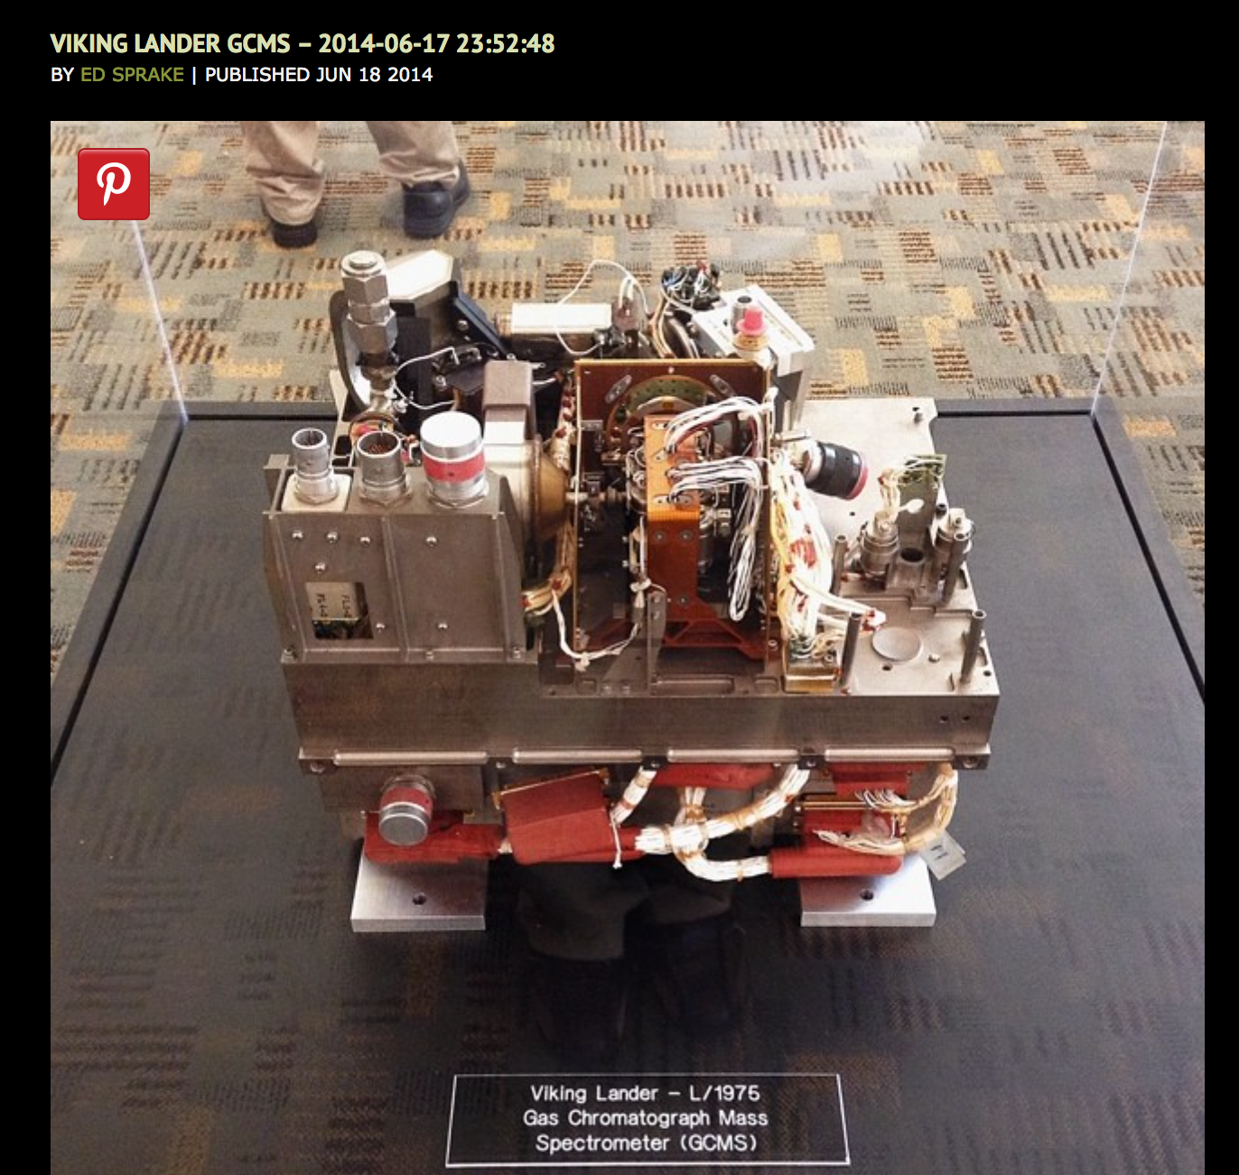
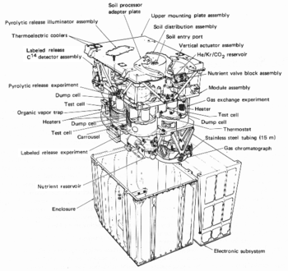
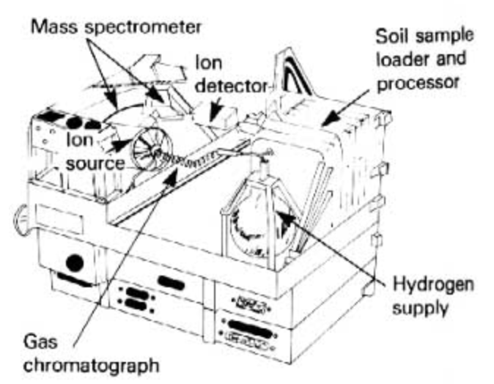
Viking Lander GCMS
Notes:
GCMS = Gas Chromatograph, Mass Spectrometer 4 Soli composition
GC separates gases, MS analyze composition - compared with
3 bio experiments: gas exchange, Lableled & pyrolytic release

Slide 36
NASA Viking - Labelled Release Experiment
Notes:
Dr. Levin claims his LR experiment found life on Mars - NASA looking again!

Slide 37
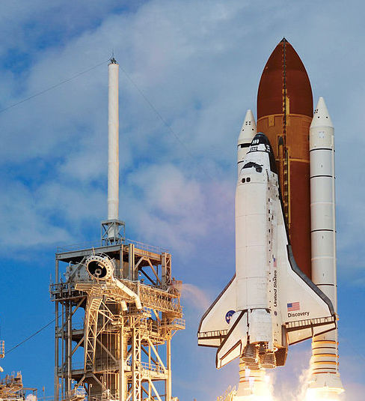
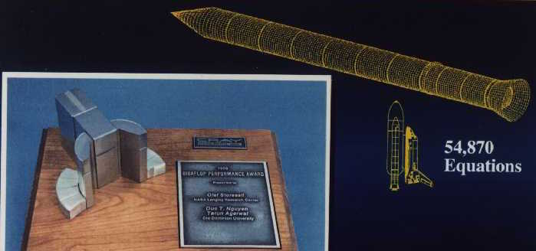
Space Shuttle (pre/post Challenger)
- Wing/tail structural analysis
- Solid Rocket Booster Redesign

Slide 38
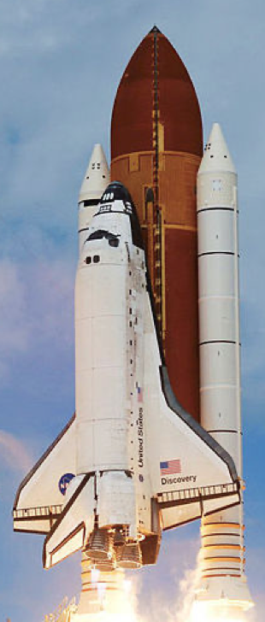
Summary
• Huge SC growth: Vector MP Multi-core Hybrid eras
- Past: Vector => MP 1Mx/decade
- Present: Multi-core: Fugaku = 7.3M Summit = 2.4M
- Future: Hybrid: Frontier Exaflop ‘21
• Exascale Innovation
- Code 10M Fault-Tolerant Cores
- Power: 2 GF/W (’15) => 15 GF/W (’20)
NASA Missions: Viking, Shuttle
- Rapid analysis key to success
before, during & after missions
Notes:
Remarkable SC speed: vector , MP, MC, Hybrid QC eras
US, China & Japan => Exaflop in ‘21

Slide 39
Thanks for listening!
Contact
Google Storaasli
Olaf@cox.net
Web OlafTN.com
Notes:
Thanks for your time & the opportunity to
share this exciting progress with you.
I’m happy to answer your questions.

