Slide 1
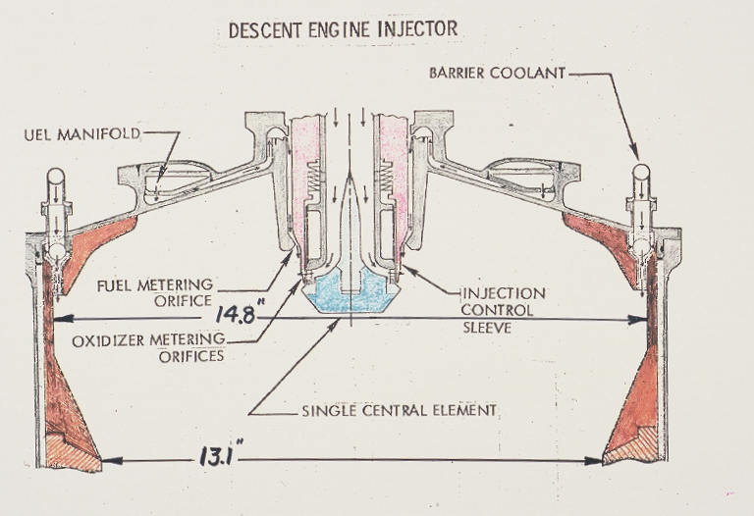

Slide 2
Oxidizer Flow Control Valve

Slide 3
LMDE Head
End Assembly

Slide 5
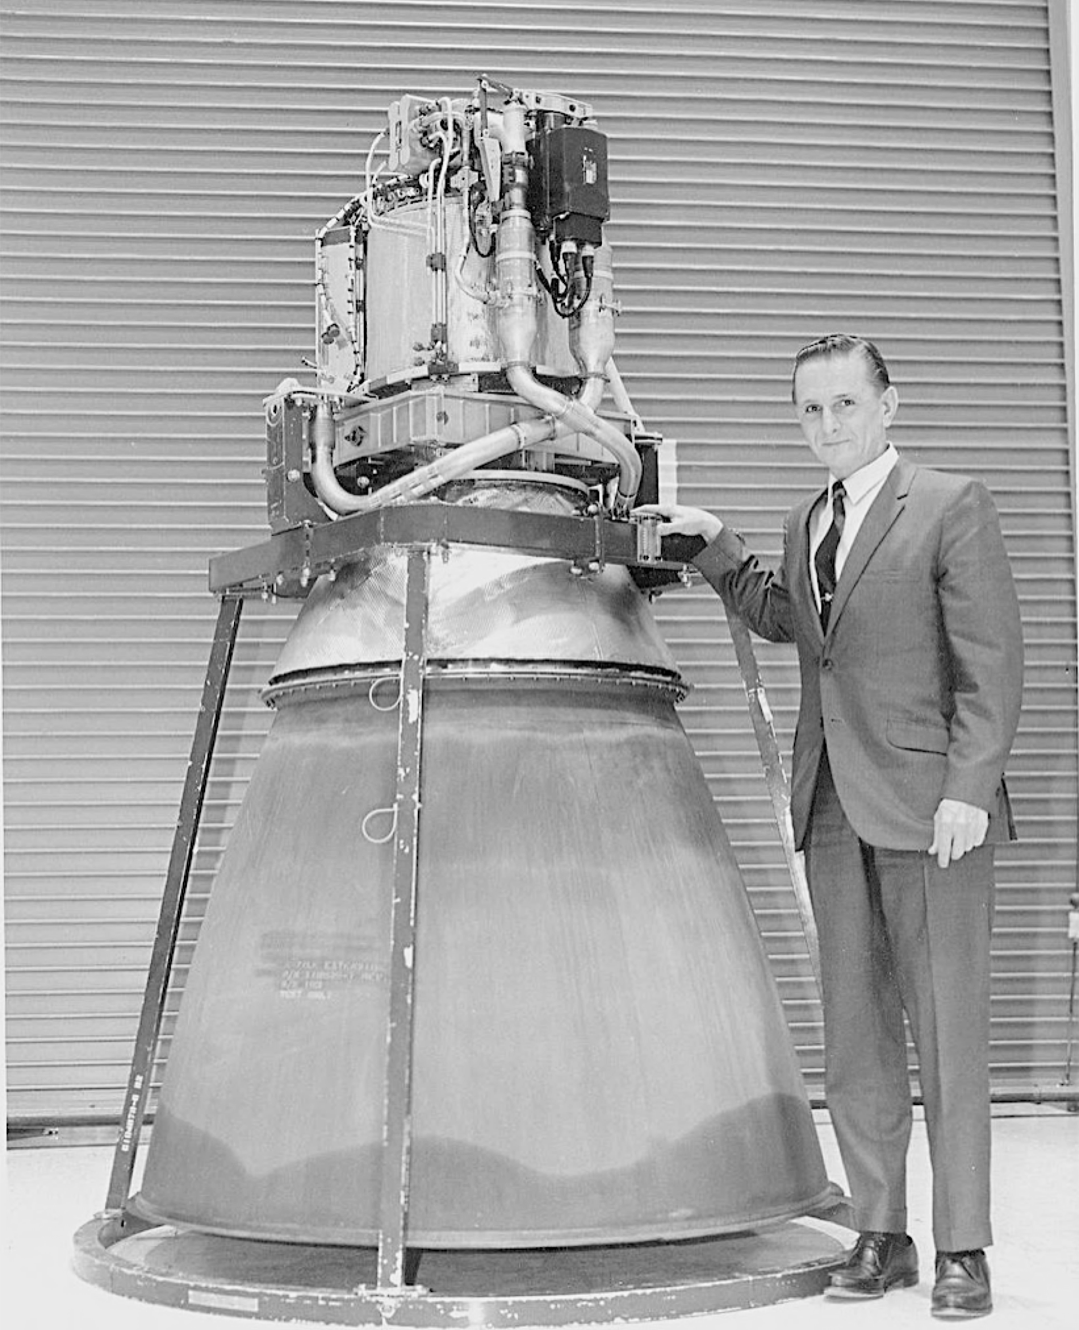

Slide 6
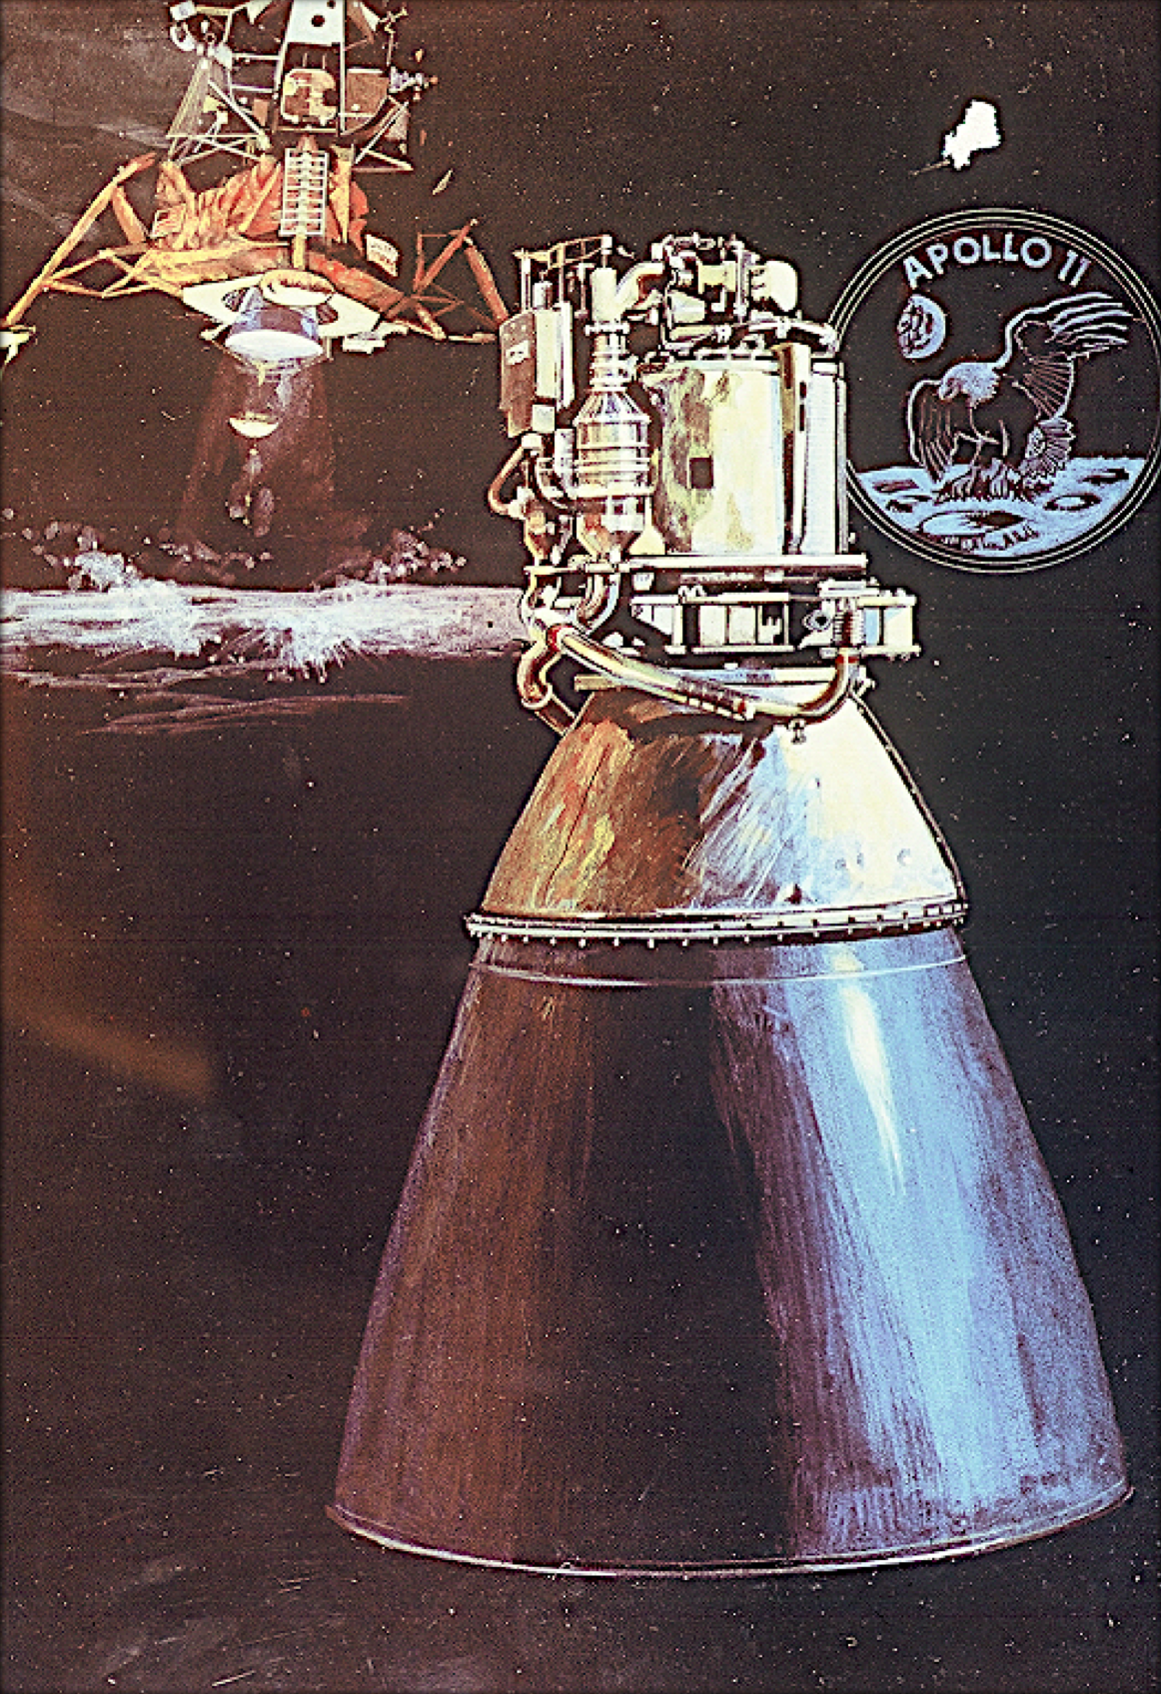

Slide 7
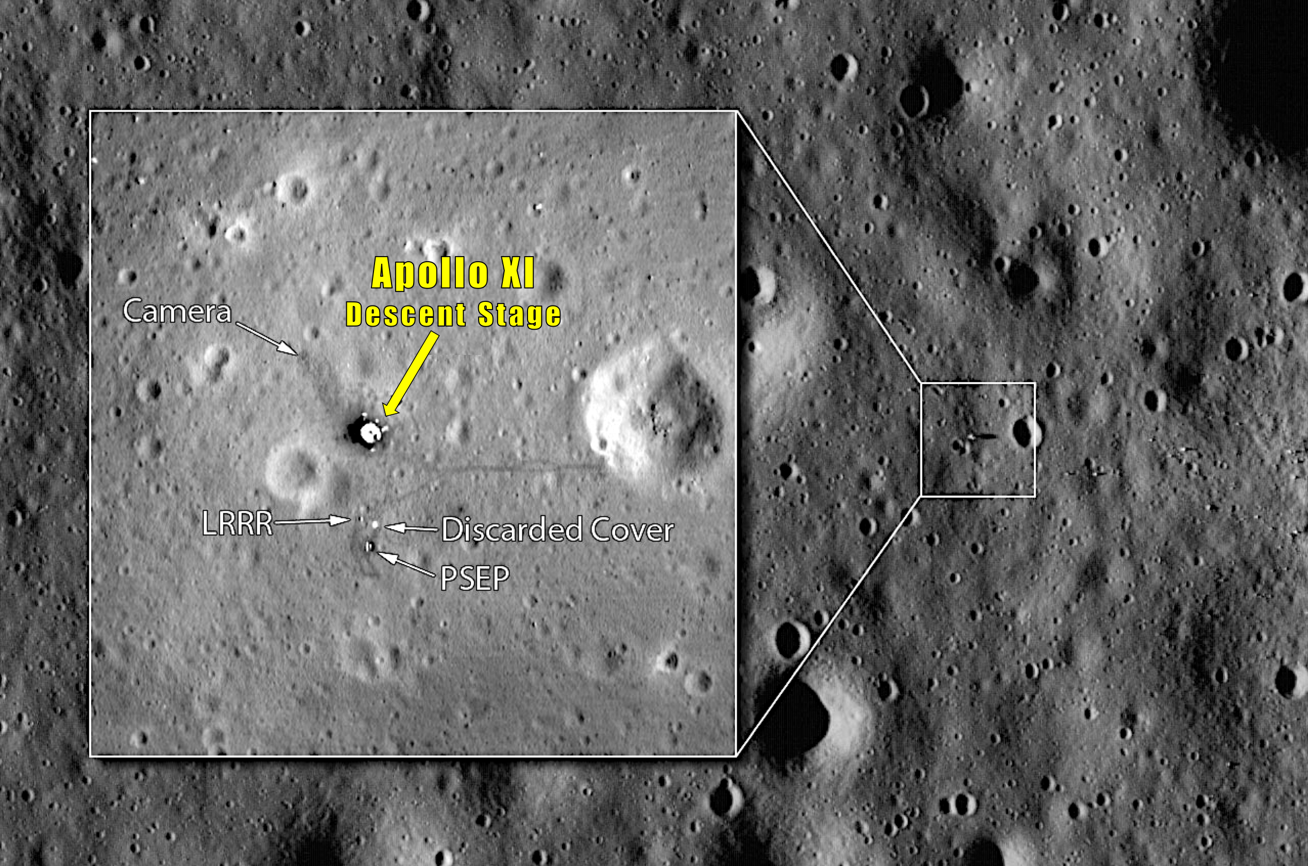

Slide 8
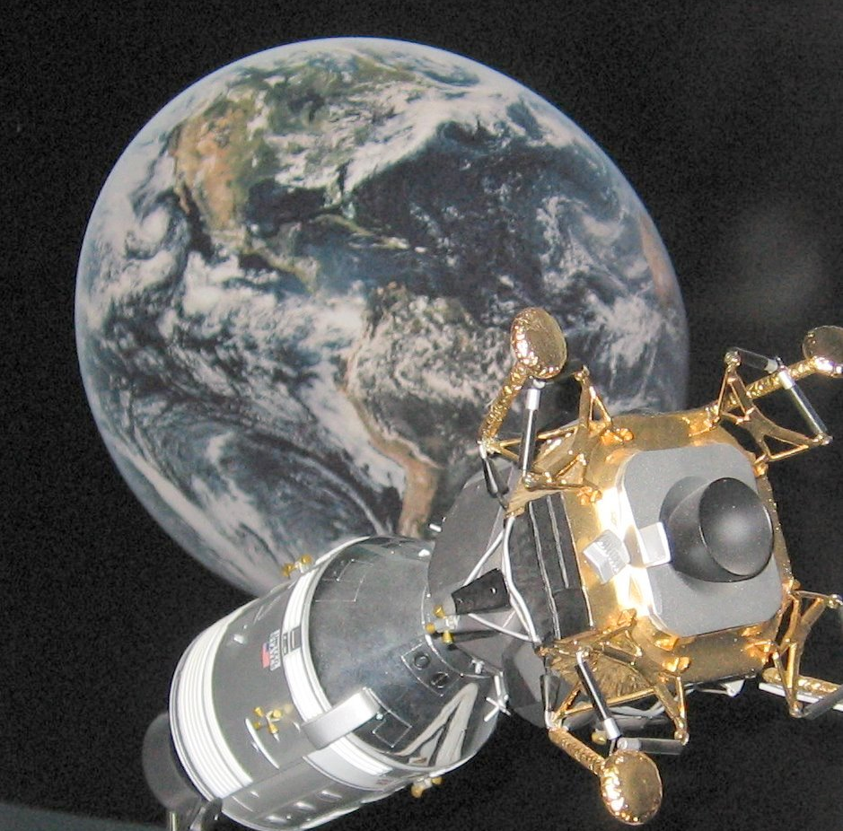

Slide 9
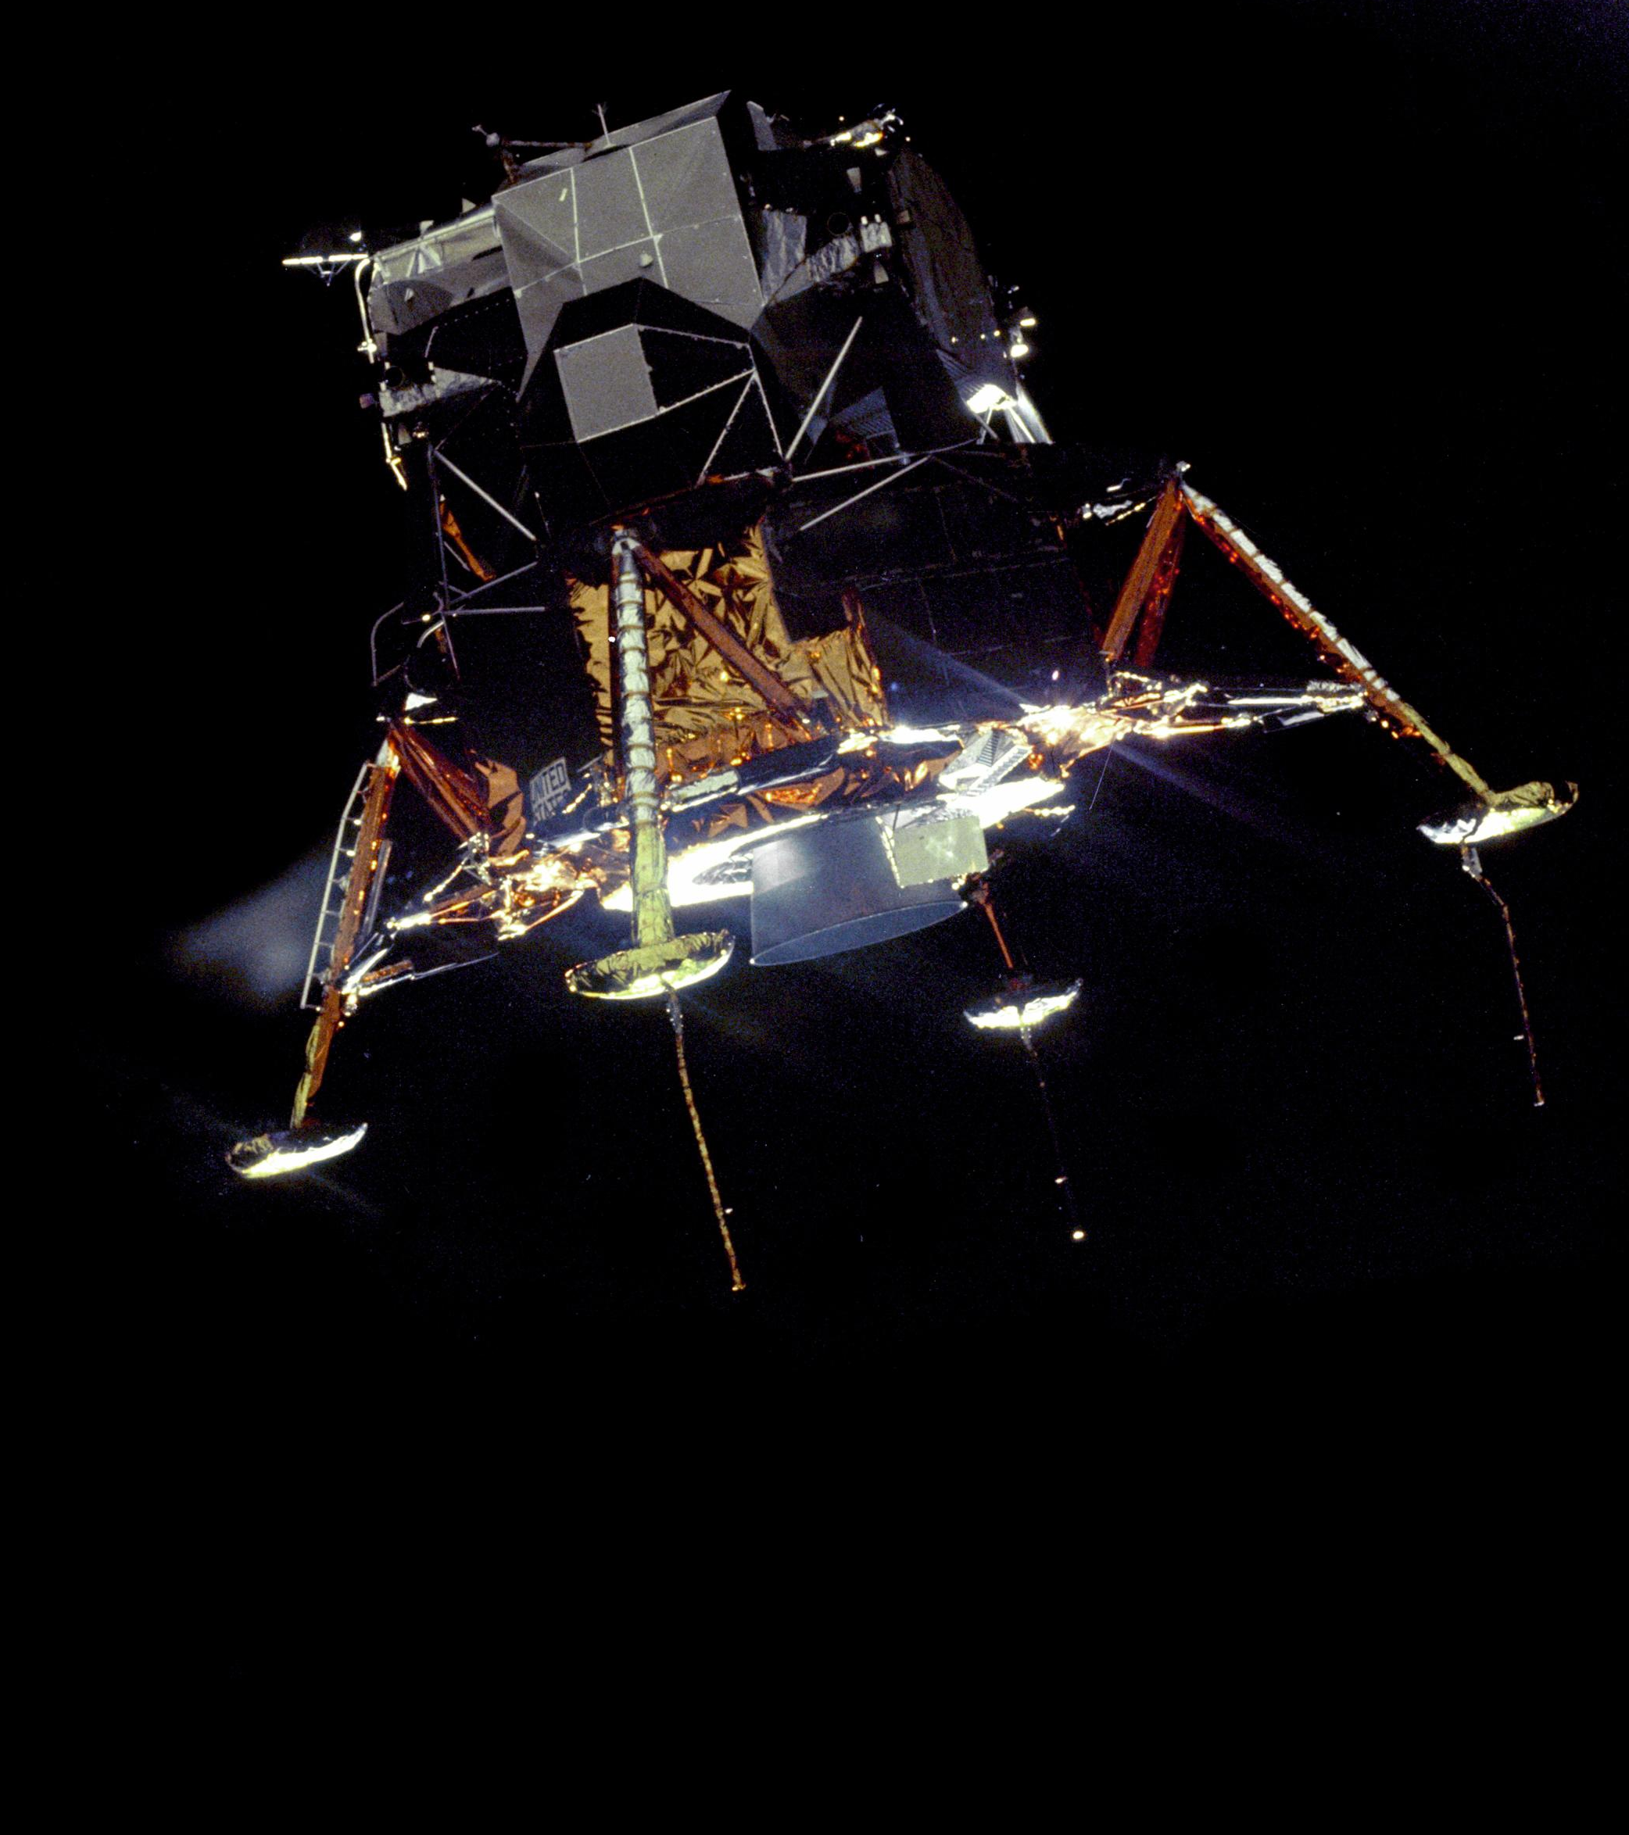
The NASA History Publication “CHARIOTS FOR APOLLO” states:
“The Lunar Module Descent Engine was the biggest challenge, and the most outstanding technical development of Apollo.”

