Slide 1
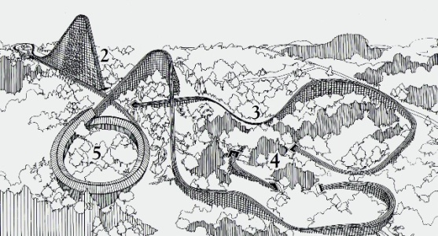
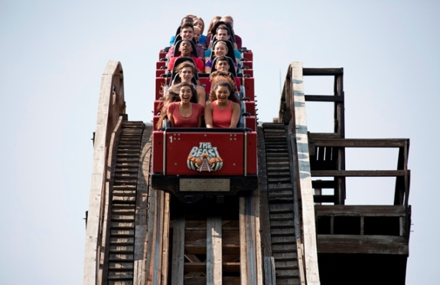
Cincinnati
Dinner Meeting
30 September 2016
All Welcome!
Time
6:00 PM Social
6:30 PM Dinner / Presentation
7:30 PM Tour
Location
Kings Island
International Restaurant
6300 Kings Island Drive
Kings Island, OH 45034
Reservations
RSVP by Sep 24th to
Marc Polanka Marc.Polanka@afit.edu
Dinner Menu
Montgomery Inn Ribs
with
House Salad, Mashed Potatoes,
Broccoli and Garlic Bread
with
Graeter’s Ice Cream
$25.00 Professionals
$10.00 Students
Guest Speaker:
Jeff Gramke
The BEAST
Abstract
It is still growling and prowling after all these years. A legend in its own time, it is the holy grail of wooden roller coasters.
When The Beast opened to the public April 14, 1979, it was acclaimed America’s ultimate roller coaster. It broke all existing records as the longest and fastest ride in the world. It is still listed in the prestigious “Guinness Book of World Records” as the longest wooden roller coaster in the world at 7,359 feet.
The record-breaking features of The Beast included:
• A 7,359-foot long track (1.4 miles) and ride time of four minutes, 10 seconds
• Vertical drops of 135 feet (at a 45-degree angle) and 141 feet (at an 18-degree angle)
• A 125-foot long underground tunnel at the bottom of the 135-foot drop
• Eight banked turns, some to 45 degrees
• A massive, 540-degree helix tunnel near the end
• Speeds up to 64.77 miles per hour
Come out and learn the history of the Beast and join us on a behind the scenes tour of the ride!
Background
Jeff Gramke was an Assistant Engineer at Kings Island during the construction of the BEAST. He was one of the maiden riders of the ride on April 13, 1979. He continues to serve as an engineer for the ride providing tours and talking about the history and the present of the BEAST.
We will refund the cost of admission to the park if you do not have a pass!

Slide 2
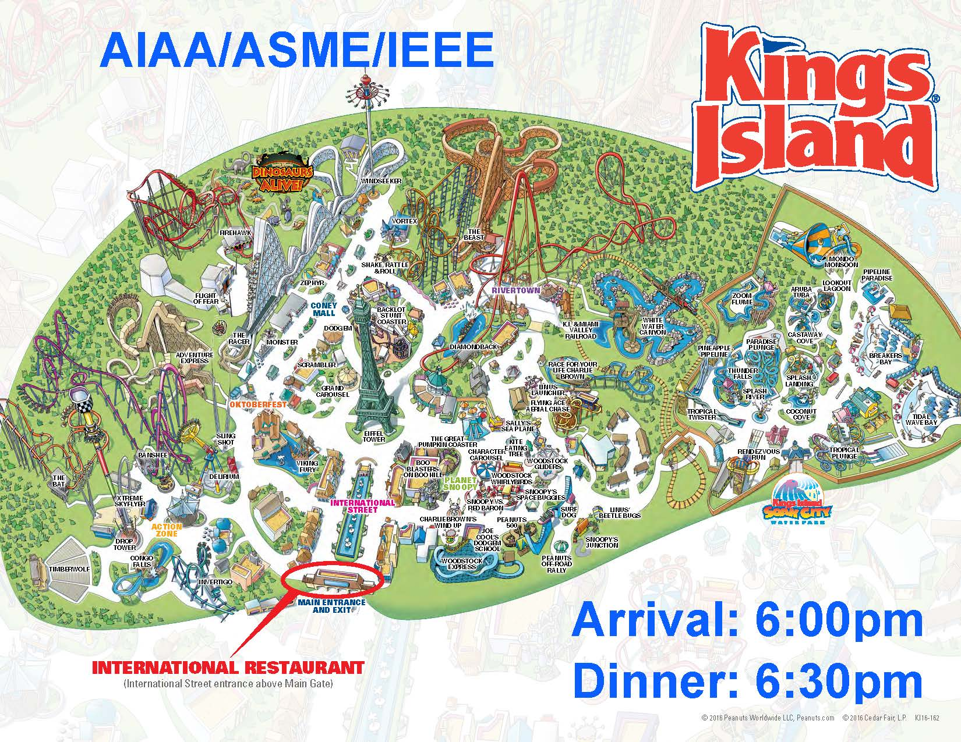
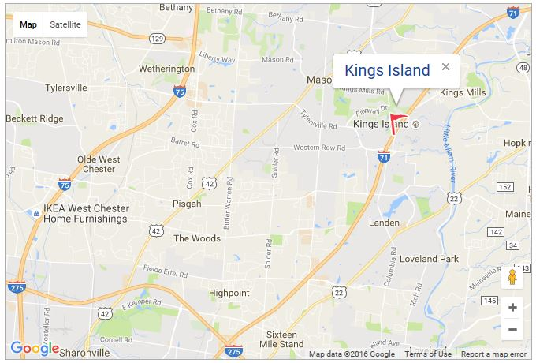
Enter through main gate: then proceed to restaurant

