Slide 1
MANNED SPACEFLIGHT-PAST AND FUTURE
AIAA Orange County
ASAT Conference
May 20, 2023
Chuck Lowry---Alumnus
Apollo, Space Shuttle,
Artemis-- Consultant

Slide 2
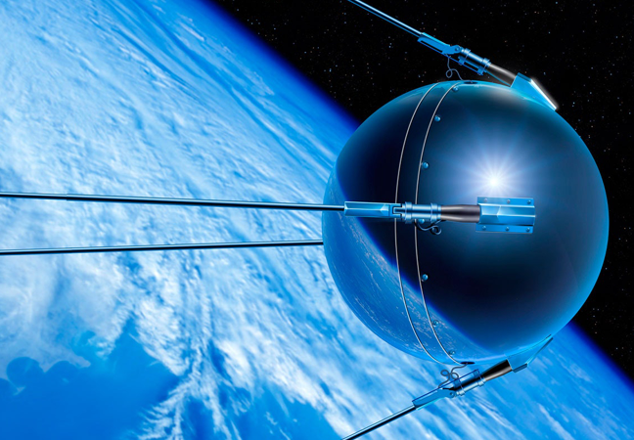
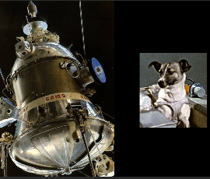
It all Started with the USSR
Sputnik 1
Oct 4, 1957
184 lb
Sputnik 2
Nov 3, 1957
Laika
1100 lb
Big Booster!!

Slide 3
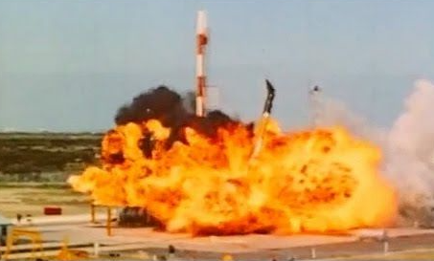
USA
meanwhile
Vanguard TV-3
Dec 6, 1957
Failed
Explorer 1
Feb 1, 1958
Successful
31 lb
Vanguard 1
May 17, 1958
Successful
3-4 lb

Slide 4
USSR
1st Man in Space
Yuri Gagarin
Vostok 1
Apr 12, 1961
1 Orbit

Slide 5
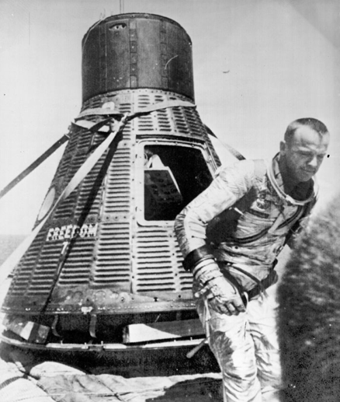
USA
1st USA Man in Space
Alan Shepard
15 Min Suborbital Lob
First Flt May 5, 1961
6 Crewed Flights

Slide 6
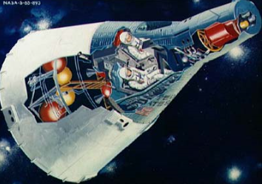
Gemini
2 Man
Enhanced Propulsion
EVA
Longer Flights
1st Flt Mar 23, 1965
10 Crewed Flights

Slide 7
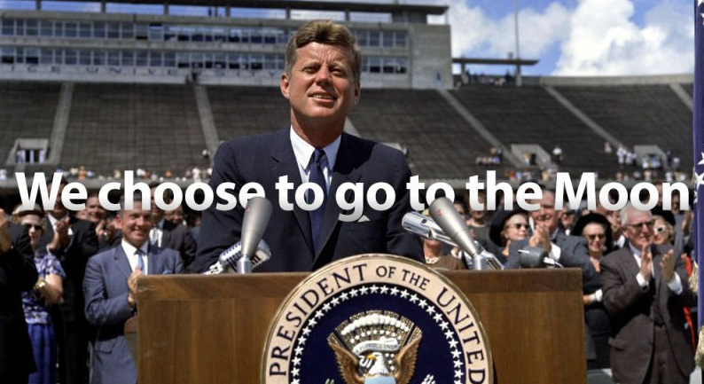
Sept. 12, 1962------

Slide 8
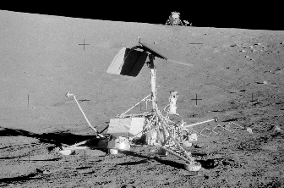
Surveyor 1----Landed May 30, 1966

Slide 10
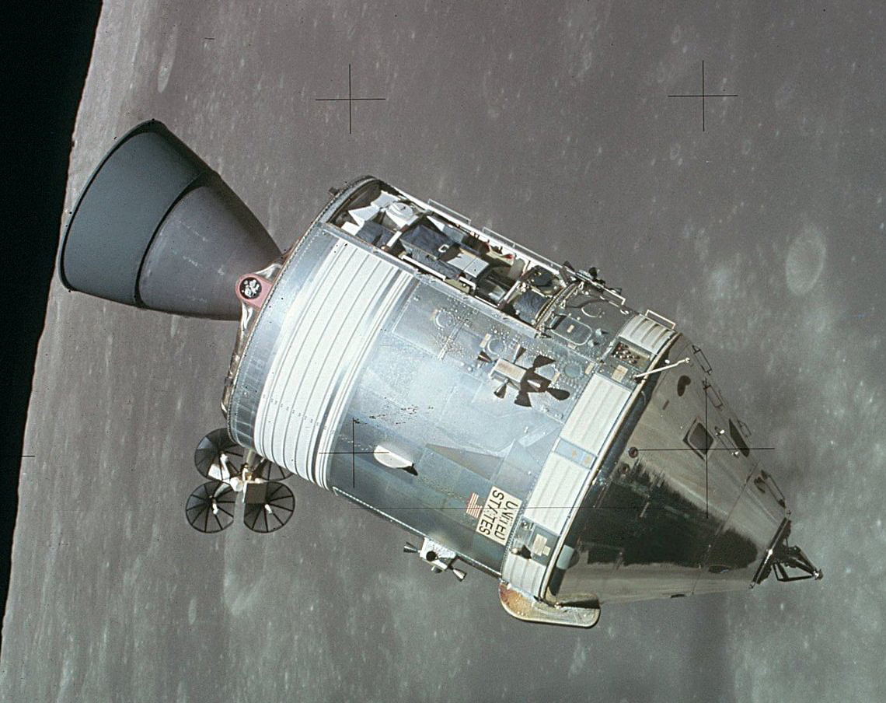
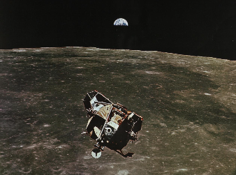
CSM
LM

Slide 11
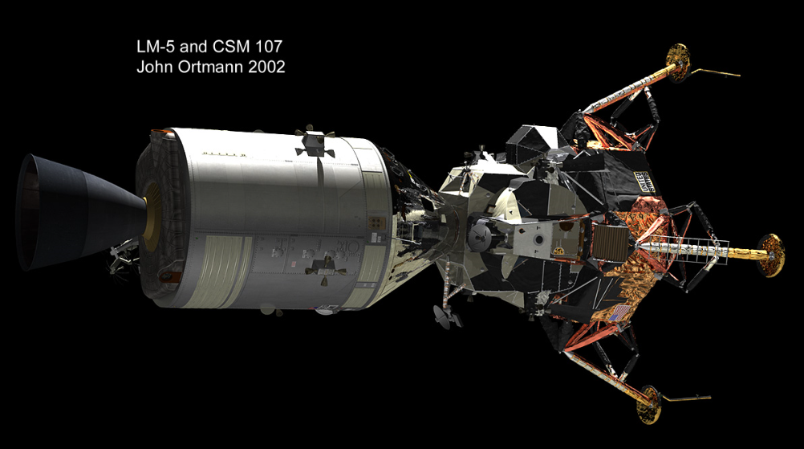
CSM/LM Docked---Trans Lunar

Slide 12
KSC Launch Complex

Slide 13
Crawler

Slide 14
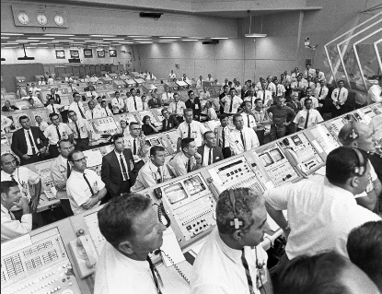
Ground Support
Mission Support
Mission Analysis
Mission Planners
Astronauts/Training
Assembly/Checkout
Army of Support

Slide 15
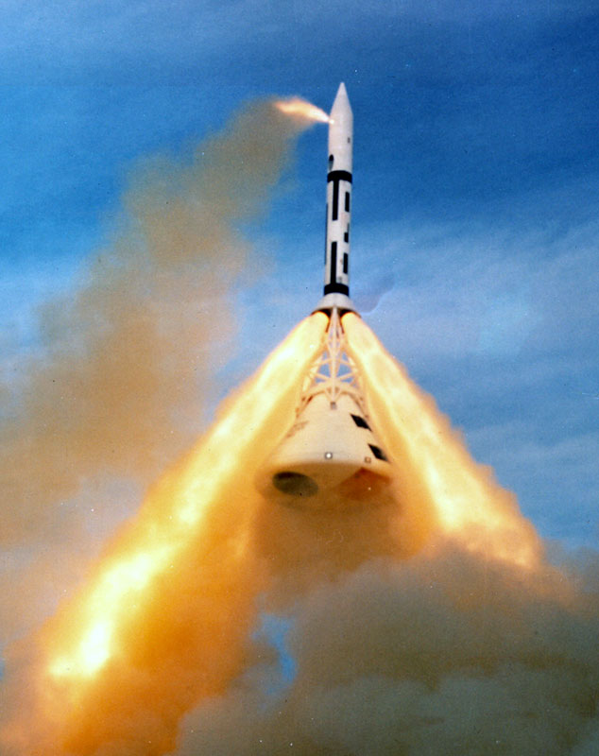
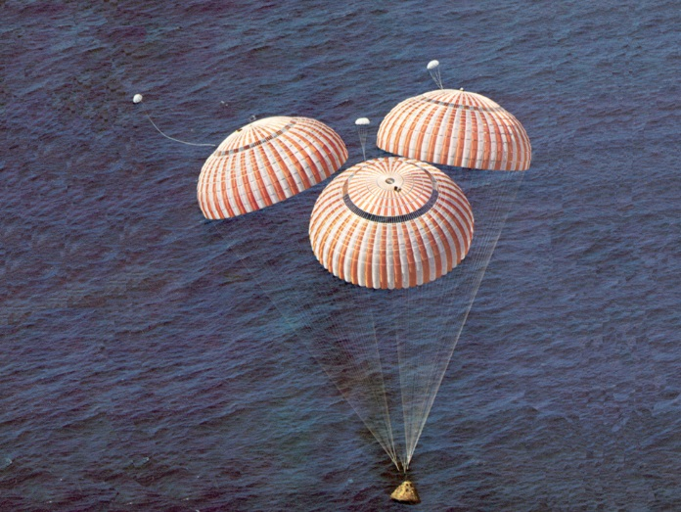
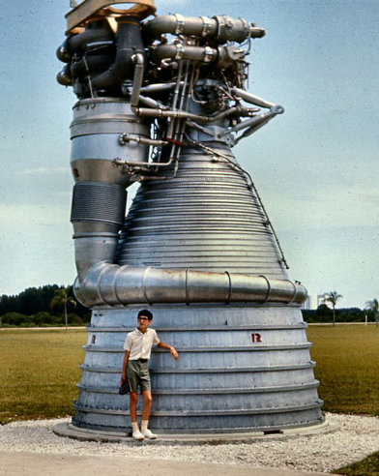

Slide 16
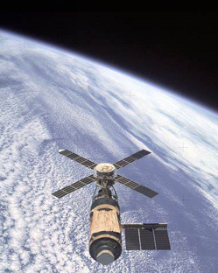
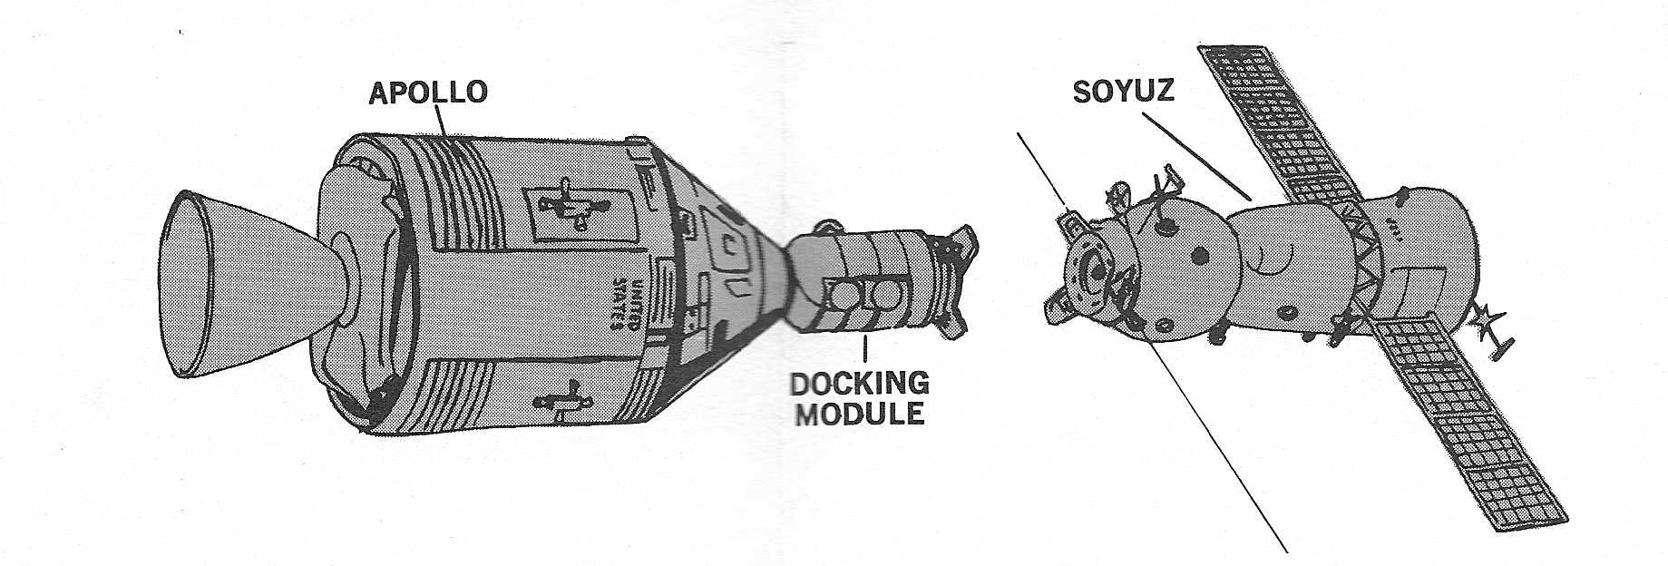
Skylab
ASTP

Slide 17
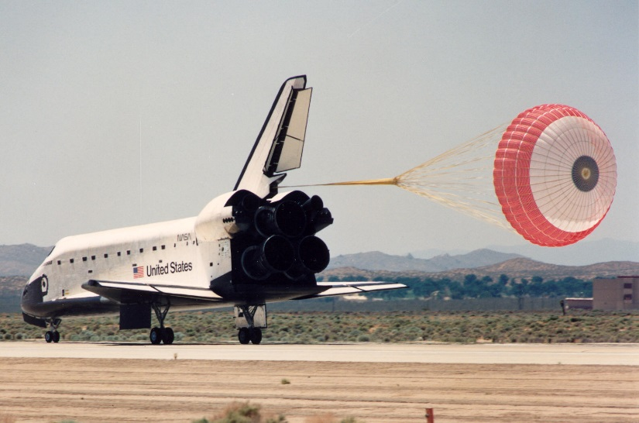
The Space Shuttle Age
4/12/81 Space Shuttle-1st Flight

Slide 18
ISS Age
11/02/00 ISS--1st Habitation

Slide 19
What was it all about?
Orbit a Satellite to Show Science Leadership
Mercury—Man in Space
Gemini—2 Man Crew19
Used to Develop Rendezvous/Docking, EVA, Longer Missions for Apollo
Apollo— Space Supremacy, Man on Moon and Return
Moon Science
Also Skylab Space Station, ASTP Joint Mission with USSR
Space Shuttle—Science/Truck/Work Horse
Satellite Delivery
On-Board Experiments
Construct and Support ISS
ISS—Science/Long Term Space Presence

Slide 20
WHAT’S GOING ON AND WHAT’S NEW IN MANNED SPACEFLIGHT?

Slide 21
What’s Going On Now? LOTS
ISS Continues to 2030
NASA Artemis. Like Big Apollo With Huge SLS Booster
1st Unmanned Lunar Orbit Good. 2nd Repeat Crewed 2024, 3rd Lunar Landing
Mars Capable
SpaceX—Delivering Crews to ISS.
Huge Starship/Falcon Heavy Mars Capable. 1st Flight Recent
Boeing CST-100 Starliner—1st Crewed Mission to ISS Soon
Blue Origin—Done 6 Crewed Suborbital Tourist Flights
Next-Later This Year
Gateway, Mars Prep Work
Other Countries—

Slide 22
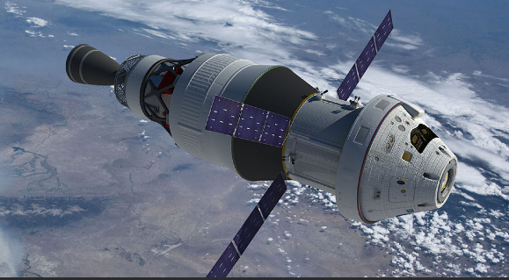
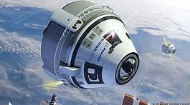
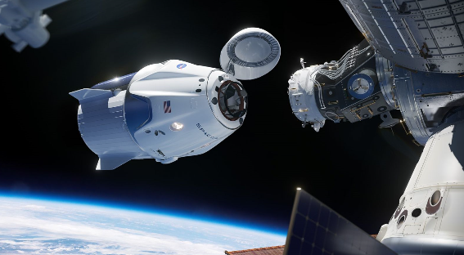
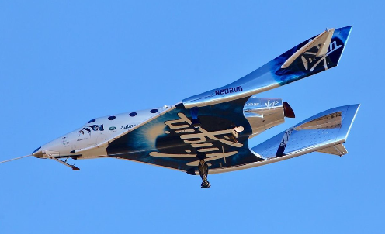
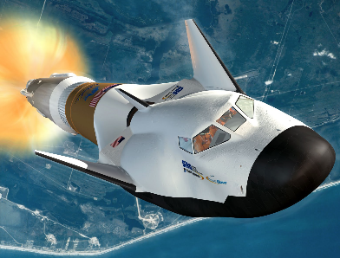
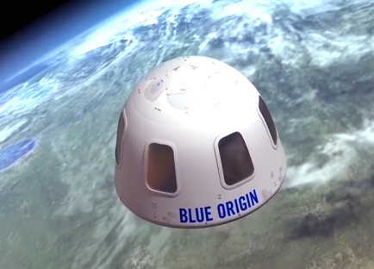
NASA Orion
Boeing
Starliner
Space-X
Dragon
Virgin Galactic
Unity
Sierra Nevada
Dreamchaser
Blue Origin
New Shepard

Slide 23
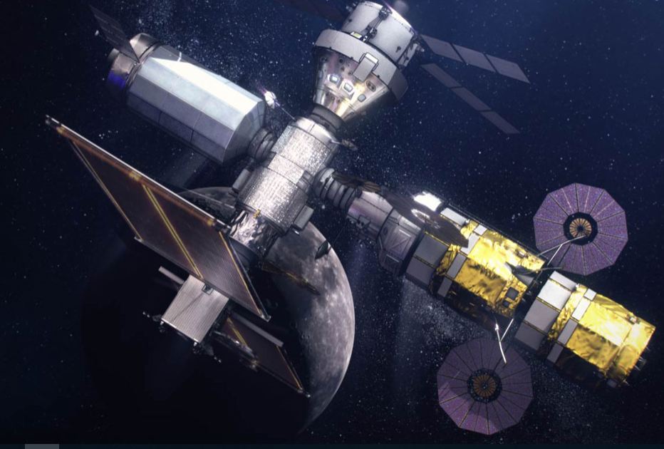
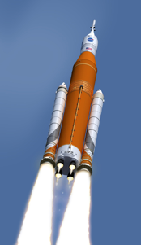
SLS
GATEWAY

Slide 24
Why Would Anyone Want to go to Mars?
Take Your Pick
Exploration/Adventure/Inspire National Goals, Unity
Advance Science (Pour Money Into Science, Which Benefits All)
Develop Cheap/Routine Access to Space
Facilitate Capturing Resources From Solar System
Create New Industries
Colonization
Job Creation
Youth Inspiration
Spur New Technologies Like Space Power Generation
Add Yours Here

Slide 25
Let’s Get Started
Wanna go to Mars?
First Obstacle is Politics
GHW Bush proposed Space Exploration Initiative—cut for costs
Bush 41 Set End of Space Shuttle, Initiated Constellation—cut for Costs
Retained Orion and SLS
Obama Proposed Asteroid Capture—cut for Lack of Interest
Trump/Pence Initiated Plan (with Commercial & International Partners)
Deep Space Gateway
Lunar Landings
Lunar Base
Then Mars
Second is Costs—International?
Third--Technology in General Not a Big Problem
EXCEPT--Radiation is a Big One
But Mars is our Focus

Slide 26
Americans on Mars by the 2030s???

