Slide 1
Psyche: Journal to a Metal World
William Hart,
California Institute of Technology, Jet Propulsion Laboratory
19 December 2023
2023 AIAA SGV Technical Gathering
Reference herein to any specific commercial product, process or service by trade name, trademark, manufacturer, or otherwise, does not constitute or imply its endorsement by the United States Government or the Jet Propulsion Laboratory, California Institute of Technology.
© 2023 California Institute of Technology. Government sponsorship acknowledged.

Slide 2
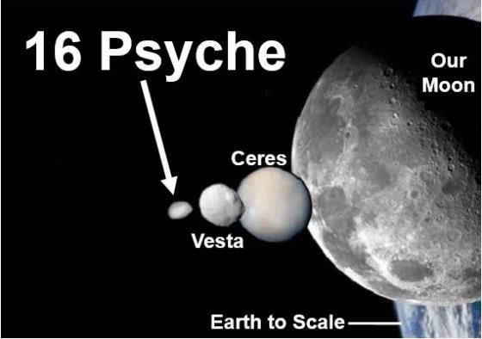
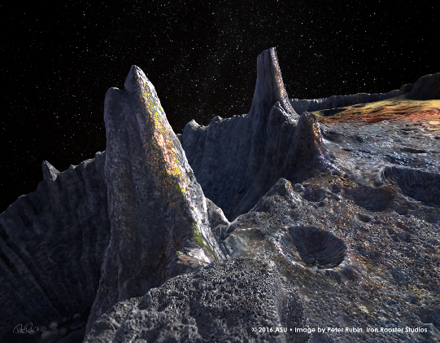
What is (16) Psyche?
Discovered in 1852 (Naples)
10th largest asteroid (largest M-type)
a = 2.92 AU, e = 0.140, i = 3.09 deg
Relatively easy access with solar electric propulsion (SEP)
Rotation period: 4.2 hours
High radar albedo
High density
High thermal inertia (120 tiu)
Spectra: 10% silicate, 90% metal
Strong testable hypothesis
“Is (16) Psyche the exposed core of larger differentiated body?”
“Was (16) Psyche created by a slow accretion of metal-rich material?”
Image Credit: Peter Rubin/ASU
Whatever hypothesis is determined, results would be scientifically significant
All material and information herein is subject to the statements at the bottom of the title page of this presentation.
Notes:
Discovered in 1852, at the observatory in Naples.
Tenth largest known asteroid, roughly the size of the state of Massachusetts.
Rotation period of a little over four hours.
It is relatively easy to get to; low inclination and eccentricity make it an opportune target for a mission, provided sufficient delta-V, which is enabled by solar electric propulsion.
There are a lot of reasons:
It is the largest metal asteroids; out of 19 M-type asteroids, only 7 have been shown to have high, homogeneous metal content. Psyche is the largest, by almost an order of magnitude.
Very high radar albedo, which is a strong indication of unusually high metal content.
It has a high density; current estimates are 2-3x Ceres and Vesta.
High thermal inertia; 120 tiu. Previous targets, such as Ceres and Vesta, range from 5 to 30.
Improbable body – not just unique, but improbable – take several hit-and-runs to clean off the rocky exterior…cores larger than this should not survive in the solar system

Slide 3
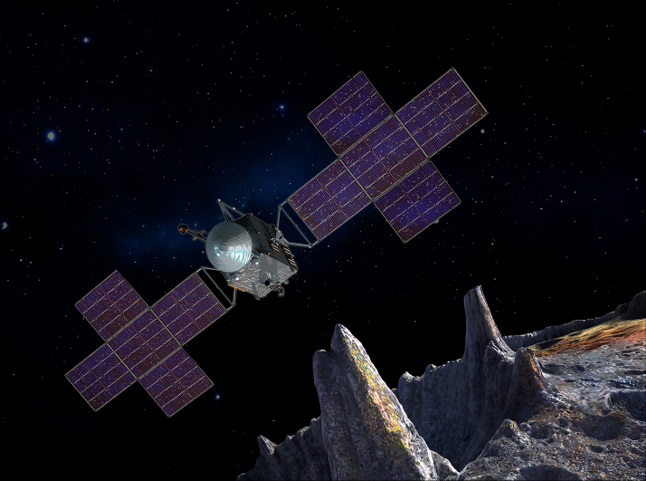
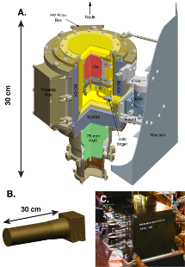
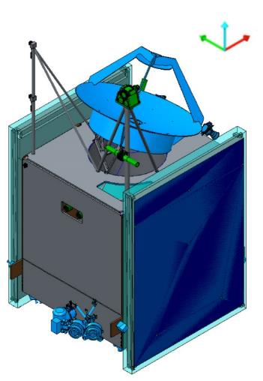
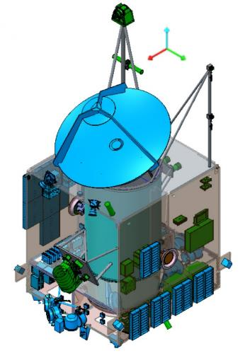
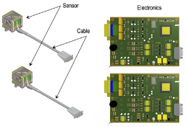
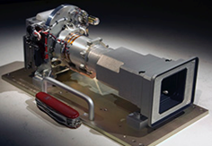
Psyche Mission Concept
Three instruments, one technology demonstration
Spacecraft bus fusion of two partners:
Space Systems/Loral (SSL)
Jet Propulsion Laboratory (JPL)
Leverages key strengths of each partner
Electric propulsion, high power S/C (SSL)
Deep space communications, autonomy (JPL)
Gamma Ray and Neutron Spectrometer
Magnetometer
Sensors
+Z
+Z
+Y
+X
+X
+Y
3.1m
Imagers
Deep Space Optical Communications
2.4m
2.4 m
All material and information herein is subject to the statements at the bottom of the title page of this presentation.
Notes:
Three instruments:
Magnetometer, located on a boom, provided by MIT. Used to measure the magnetic field.
Gamma Ray and Neutron Spectrometer, located on alternate boom, provided by APL, heritage from MESSENGER. Used to evaluate material compositions.
Imager, provided by ASU, built by Malin Space Sciences, and based on MSL Mastcam.
Also carries a technology demonstration, in the form of the Deep Space Optical Communications payload; completely separate from science. Will test capabilities of optical communications at various distances from the Earth during the Cruise Phase.
We have selected SSL’s SEP chassis, which is a subset of their standard bus, to minimize modifications and maximize economy.

Slide 4
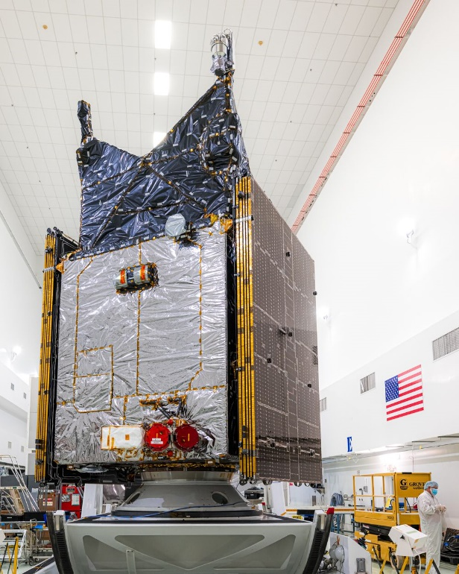
Project Timeline
2013:
Initial concept studies, JPL A-Team
2014:
Discovery #14 AO announced
More detailed studies, initial RFIs
2015/2016:
Psyche one of five projects downselected per Step 1
Step 2 Proposal efforts, refinement of design, RFPs
2017:
Psyche, Lucy selected as part of Step 2
2018/2019:
Phase B/C
Project PDR
2020:
Project CDR, subsystem construction and testing
2021-2023:
Project SIR
Phase D, system assembly, integration and testing
2023:
Final testing at launch base, launch operations
All material and information herein is subject to the statements at the bottom of the title page of this presentation.

Slide 5
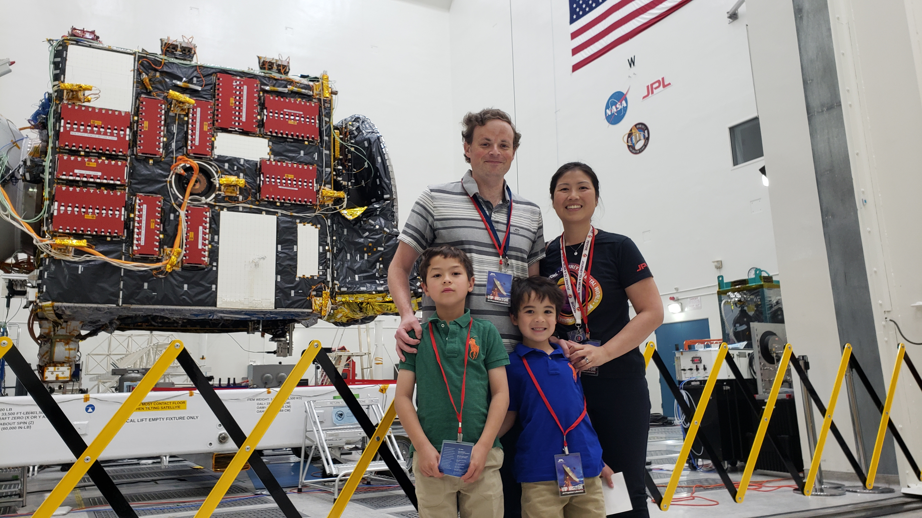
Under construction
All material and information herein is subject to the statements at the bottom of the title page of this presentation.

Slide 6
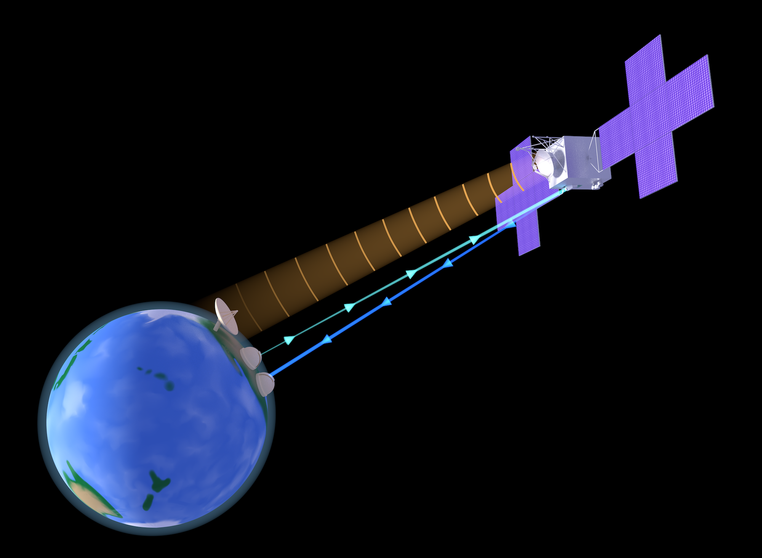
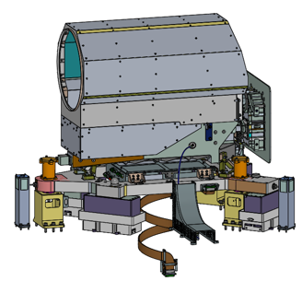
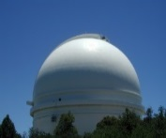
Deep Space Optical Communications (DSOC)
DSOC is a technology demonstration provided as GFE to Psyche
DSOC is its own project, with separate NASA funding sponsors
Psyche mission success does not rely on the success of the DSOC demonstration
Psyche schedules regular opportunities to point DSOC at Earth for communications
Psyche
Spacecraft
Flight Laser Transceiver (FLT)
Range (au from Earth) | Time Period | Cadence (approx.)
0.0 – 1.5 | Oct 2023 – Feb 2024 | 1 / week
1.5 – 3.1 | Mar 2024 – Jul 2024 | 1 / week
2.6 – 1.5 | Dec 2024 – Sep 2025 | 1 / week
Ground Laser Transmitter (GLT)
Table Mountain, CA
1m-OCTL Telescope (5 kW)
Ground Laser Receiver (GLR)
Palomar Mountain, CA
5m-dia. Hale Telescope
All material and information herein is subject to the statements at the bottom of the title page of this presentation.

Slide 7
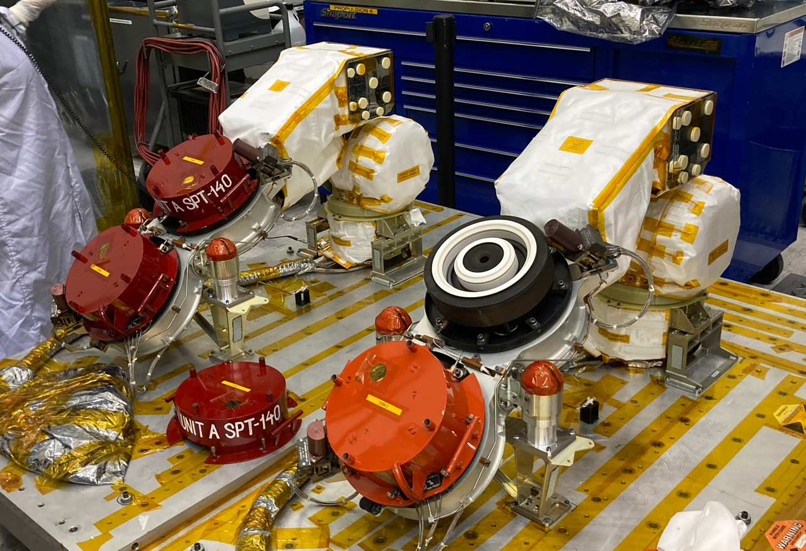
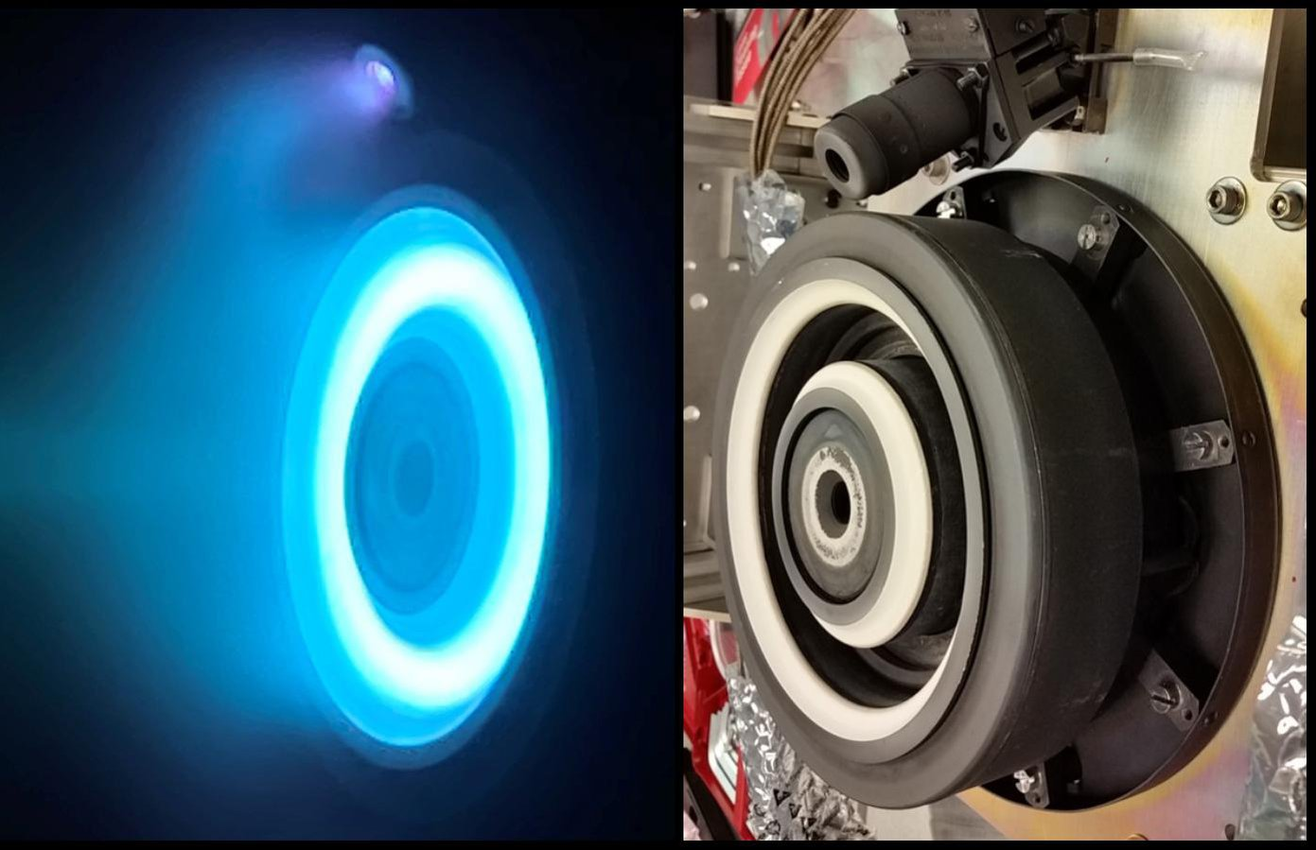
Electric Propulsion: High efficiency, low thrust
All material and information herein is subject to the statements at the bottom of the title page of this presentation.

Slide 8
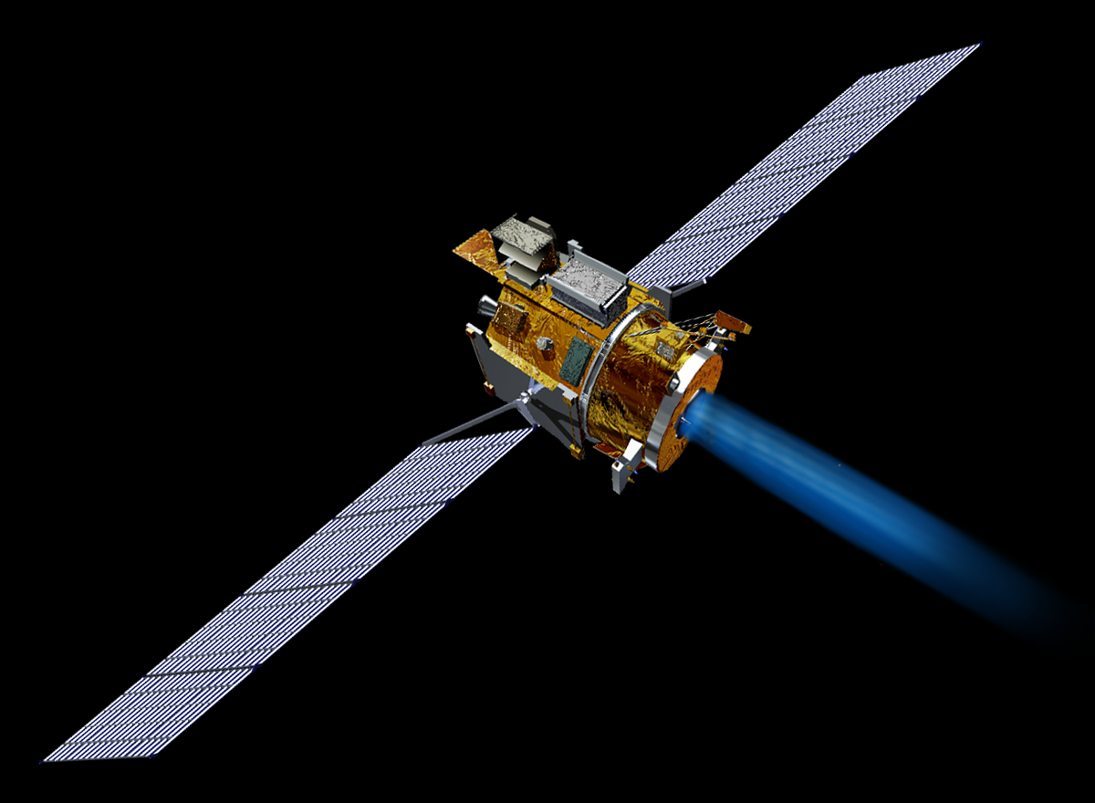
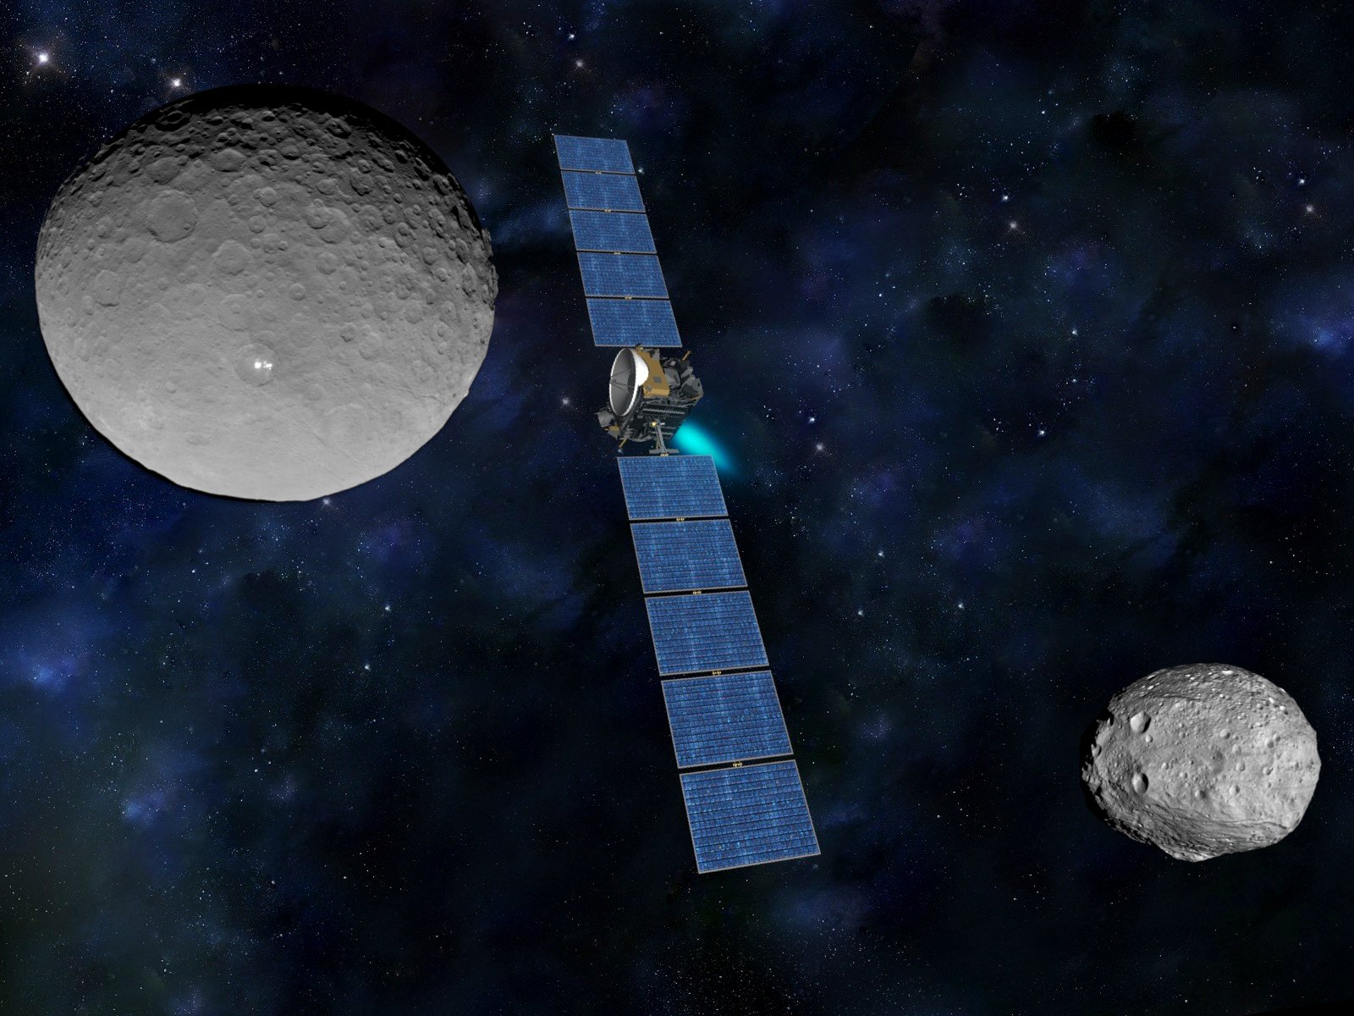
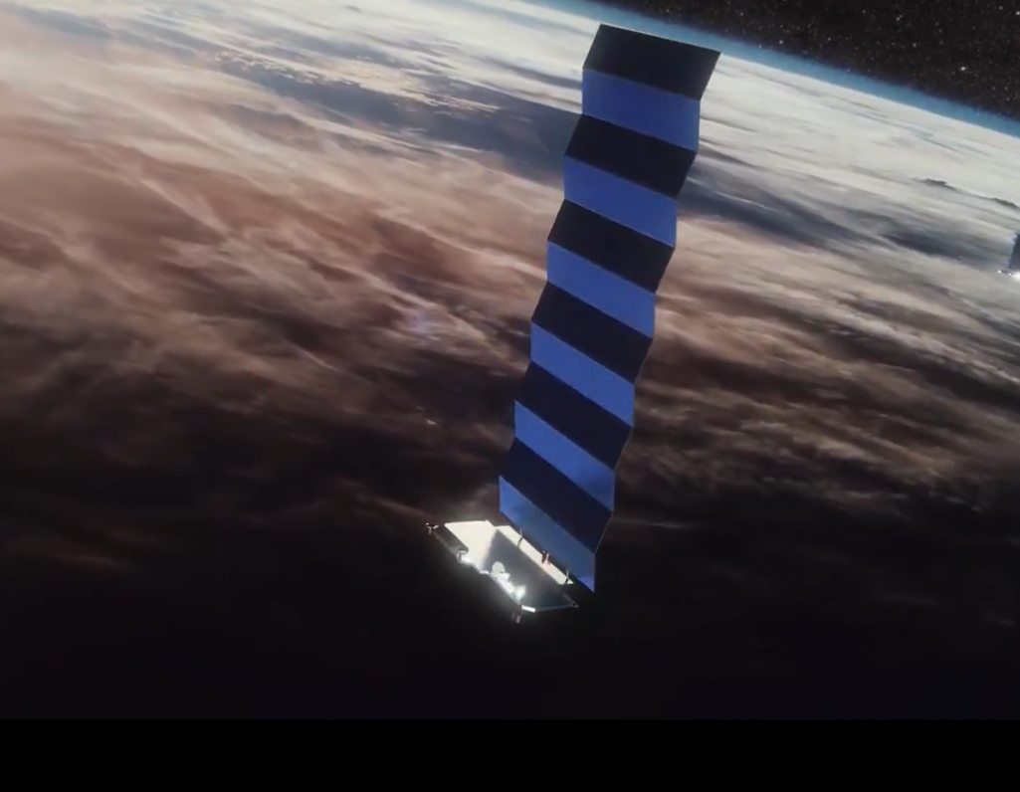
The rise of electric propulsion (and Hall thrusters!)
Majority of deep space missions use chemical propulsion
Electric propulsion deep space missions started in 1999 (DS1)
Propulsive maneuvers much longer
Thrust times become significantly longer
Strong mass/power relationship; thrust now dependent upon power
With development of LEO constellations (Starlink, Project Kuiper), electric propulsion use increased dramatically
Over 7,700 satellites in Earth orbit, and about two-thirds utilize electric propulsion
Most of those satellites utilize Hall effect thrusters, similar to Psyche’s
Deep Space 1
Dawn
Starlink (cred: SpaceX)

Slide 9
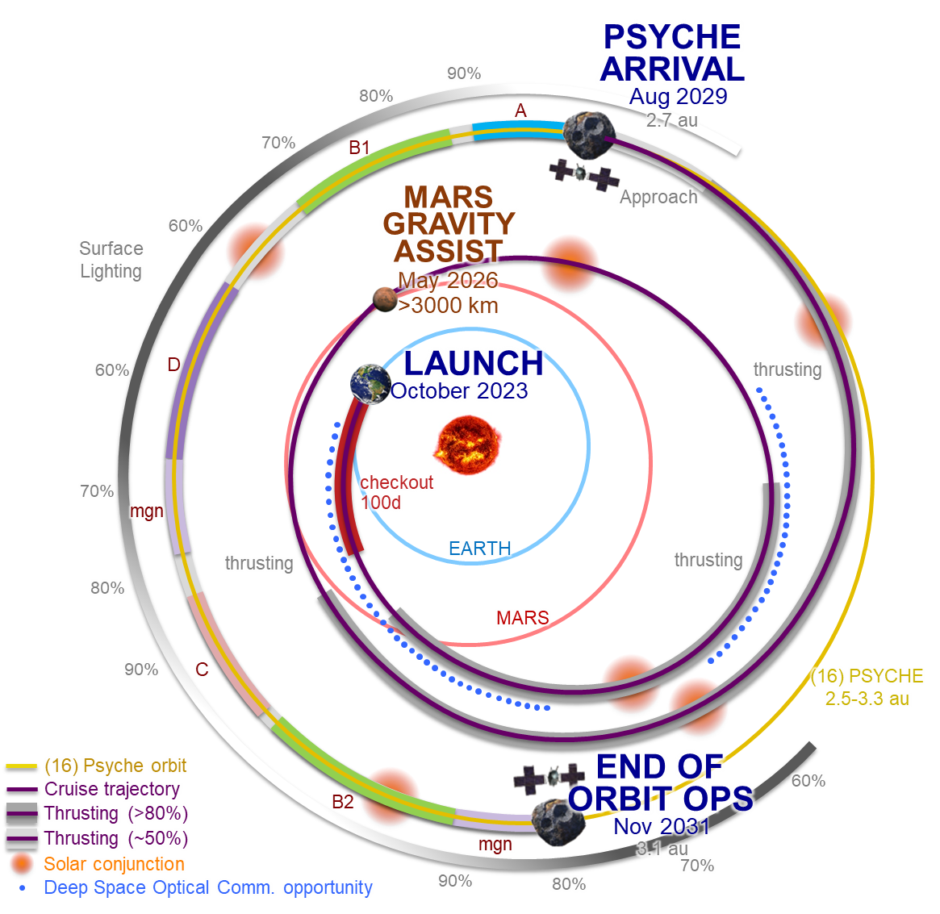
Baseline Mission Design
Dawn-like mission design
Launch from KSC
Mars Flyby (500 km)
Min Solar Range: 1.0 AU
Max Solar Range: 3.33 AU
Cruise: 5.9 Years (70 months)
Orbital Operations: 27 months
All material and information herein is subject to the statements at the bottom of the title page of this presentation.
Notes:
Baseline mission design:
Leveraging experience on Dawn, another SEP mission.
Launch from KSC, similar trajectory to Mars missions.
Point out red, gray arcs and what they mean.
However, flyby Mars, arrive at Psyche after a cruise, 27 months at Psyche.

Slide 10
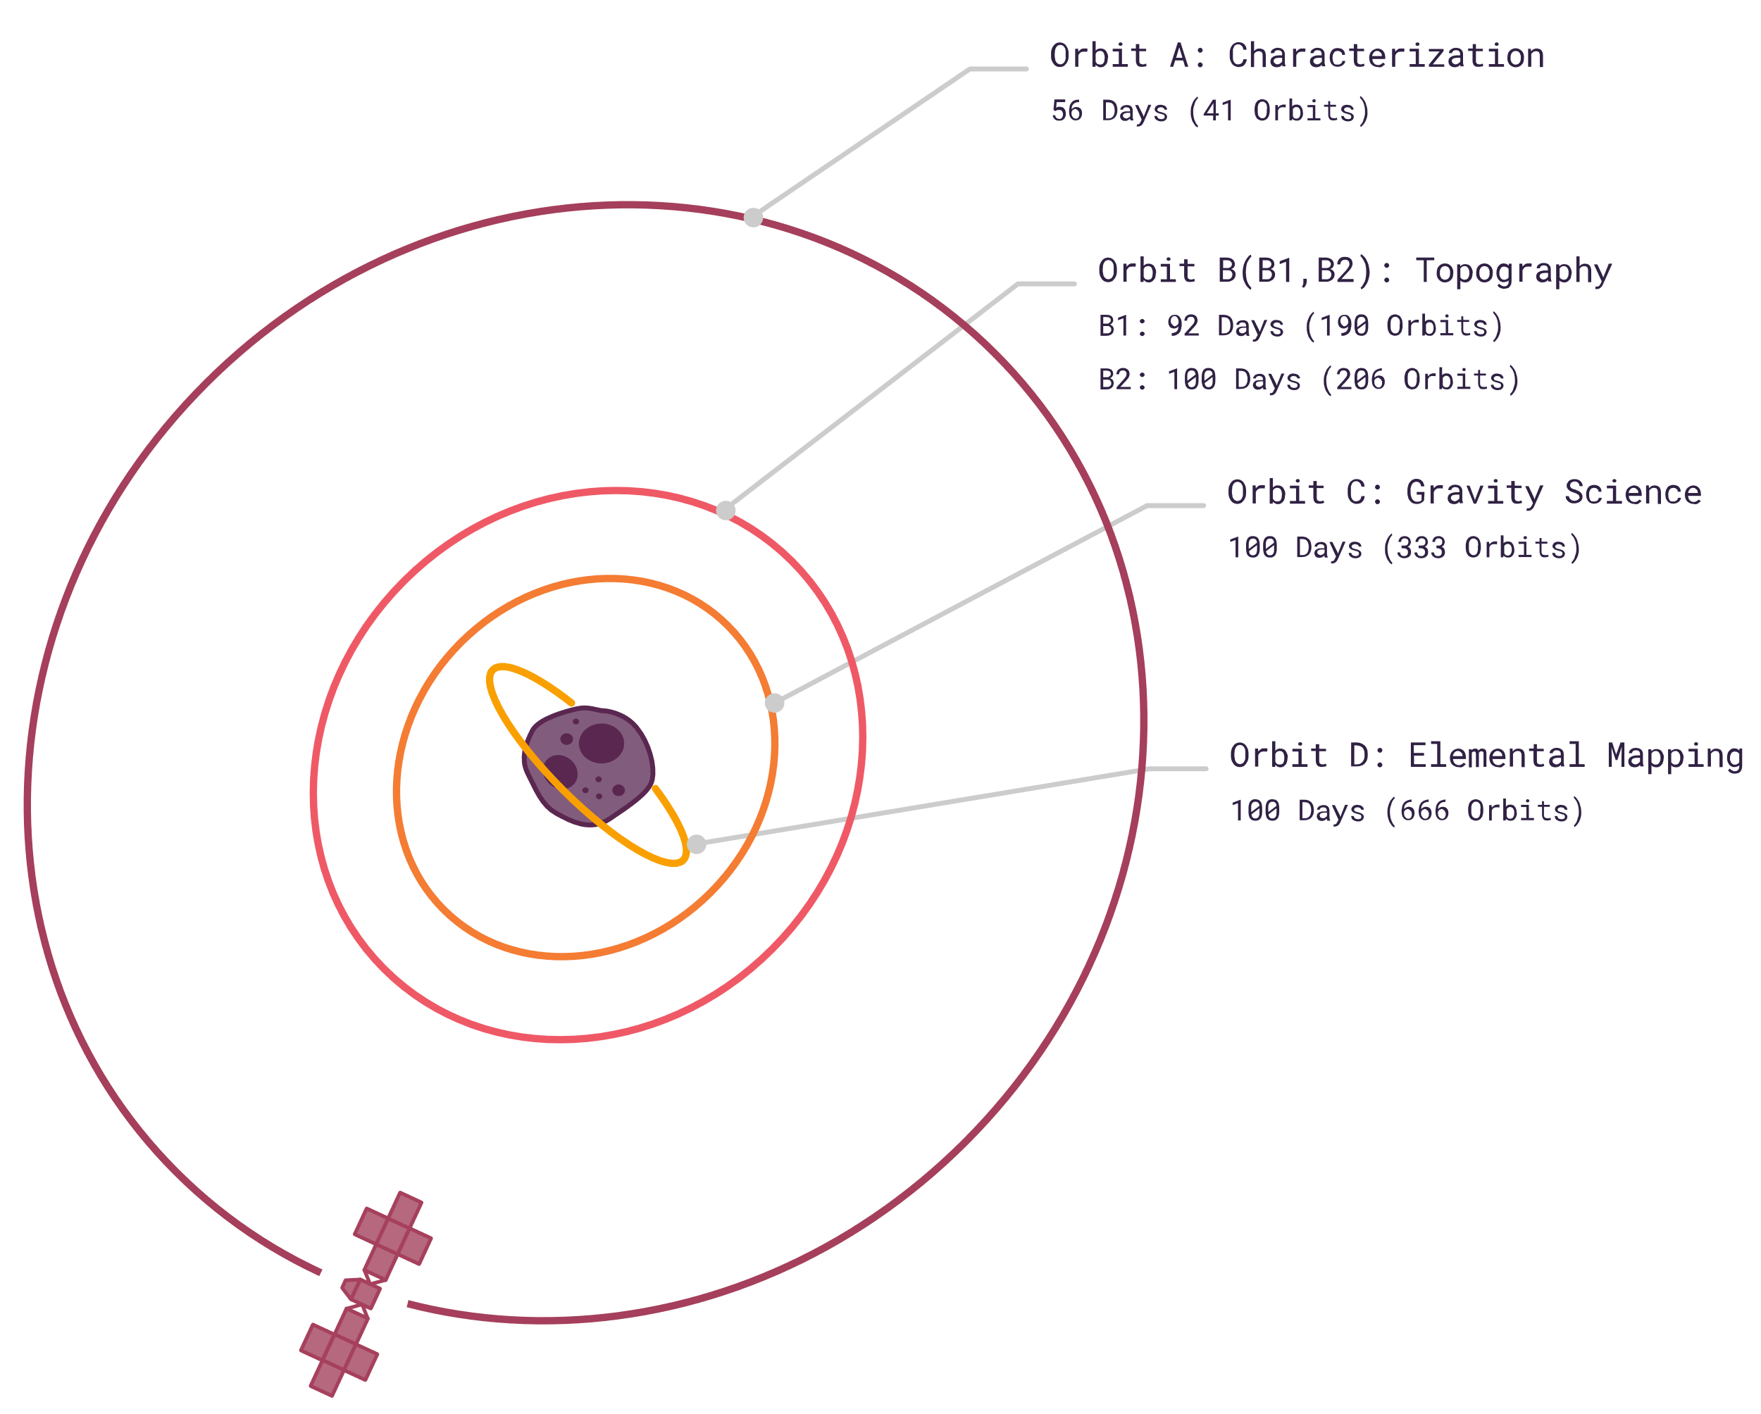
Baseline Mission Design
Orbital operations consists of four orbits
Parameters designated to fit L1 science requirements
Orbit sequence determined by lighting of 16 Psyche
Orbit | Alt (km) | Inc (deg)
A | 709 | 90
B1/B2 | 303 | 90
C | 190 | 90
D | 75 | 160
All material and information herein is subject to the statements at the bottom of the title page of this presentation.
Notes:
Four orbits during the mission; each defined to meet the requirements of a certain instrument.

Slide 11
Orbital Ops Phase: Trajectory View
All material and information herein is subject to the statements at the bottom of the title page of this presentation.

Slide 12
October 13, 2023: Launch!
All material and information herein is subject to the statements at the bottom of the title page of this presentation.

Slide 13
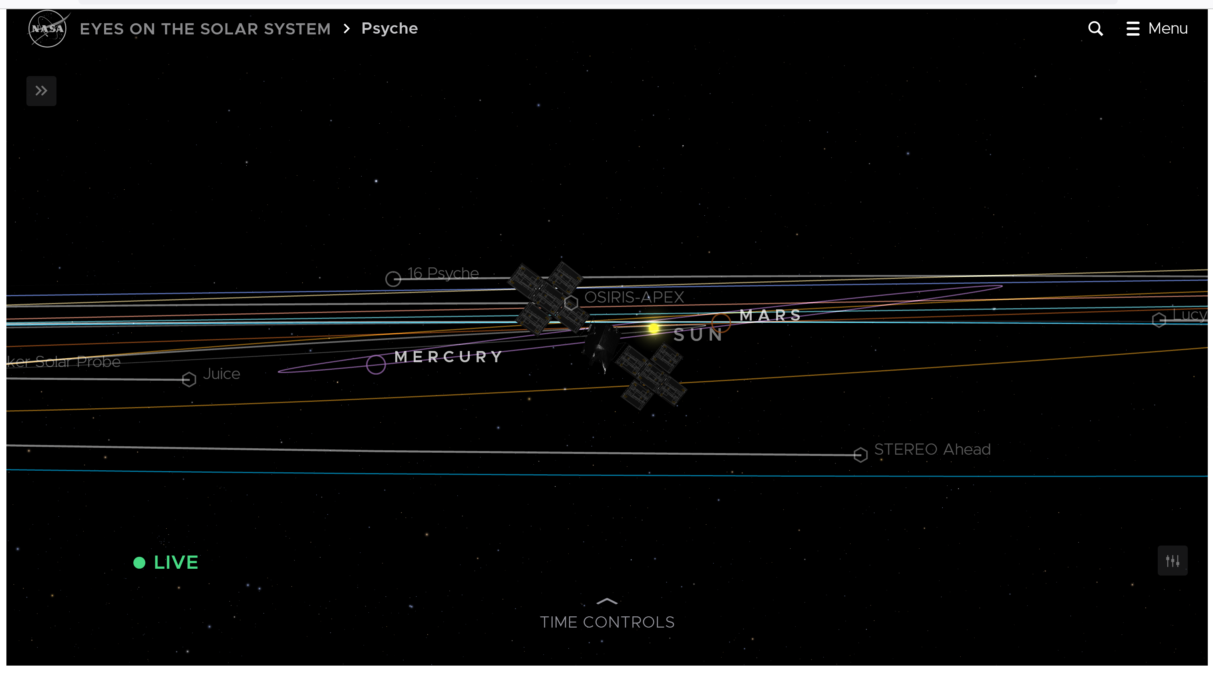
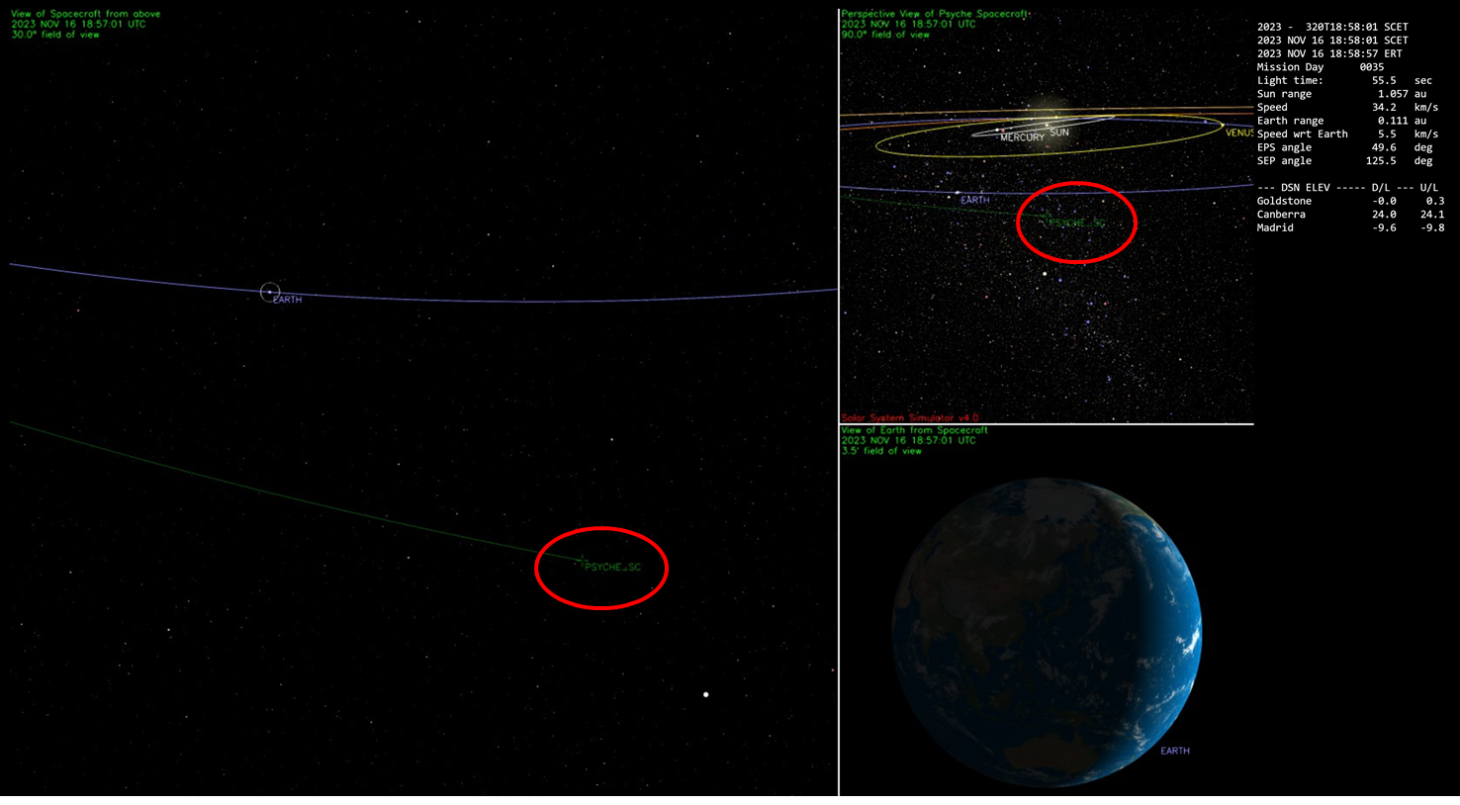
Where is Psyche now?
Two ways to keep track of Psyche’s progress visually:
NASA’s Eyes on the Solar System (eyes.nasa.gov)
JPL’s Solar System Simulator (space.jpl.nasa.gov/psyche_now/)
Psyche mission website
https://science.nasa.gov/mission/psyche/
Psyche mission blog
https://medium.com/the-nasa-psyche-mission-journey-to-a-metal-world
All material and information herein is subject to the statements at the bottom of the title page of this presentation.

Slide 14
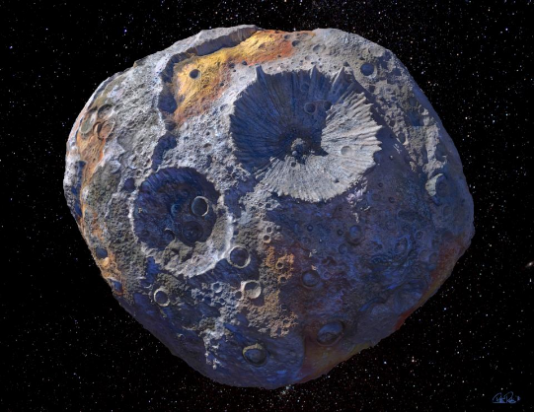
What’s happened/What’s next
Already achieved a couple of firsts
First firing of Hall Effect thrusters beyond Earth’s SOI
First use of optical comm beyond Earth orbit (DSOC)
Cruise Phase begins Jan 2024
Periodic calibrations, DSOC comm testing through 2024, 2025
Mars flyby in 2026
Arrival, orbital operations in 2029
All material and information herein is subject to the statements at the bottom of the title page of this presentation.

Slide 15
Questions?
All material and information herein is subject to the statements at the bottom of the title page of this presentation.
Notes:
Conclusions
Acknowledgements
Open the floor to questions.

