Slide 1
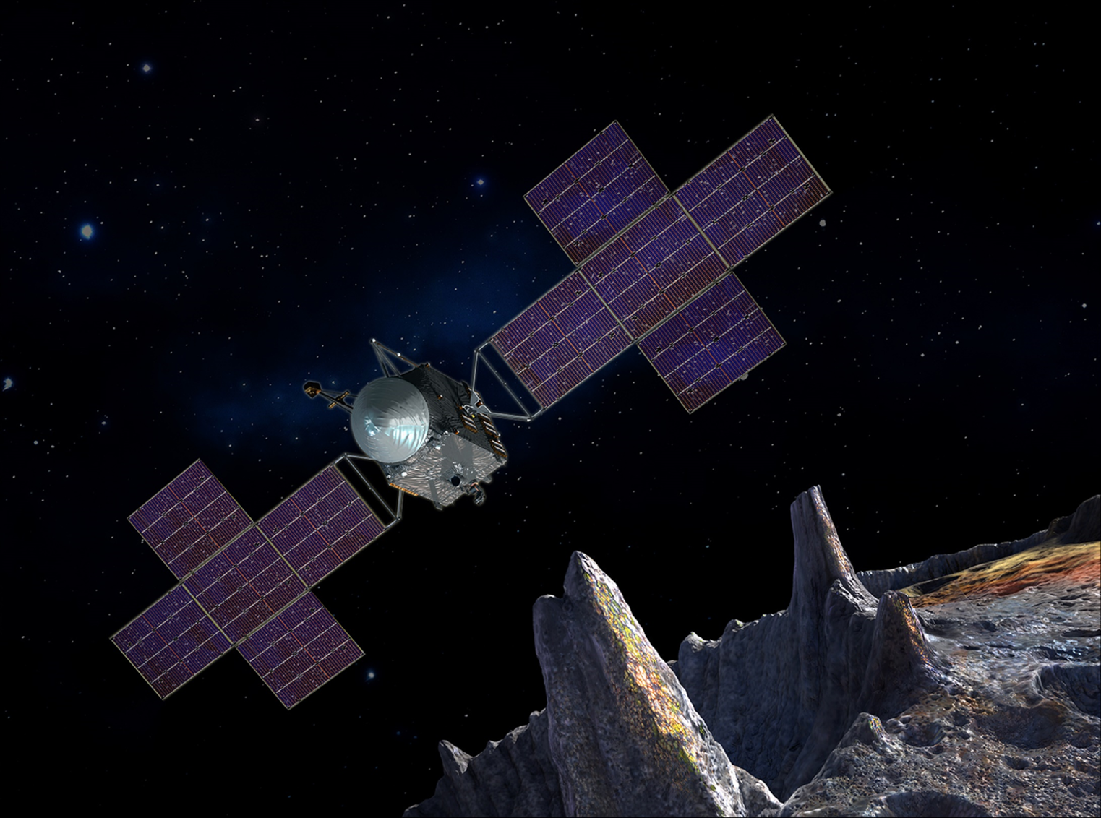
AIAA San Gabriel Valley Seminar
December 19, 2024 at 2pm PST
RSVP online: https://tinyurl.com/aiaa-psyche
Psyche: Journey to a Metal World
Abstract: “Psyche: Journey to a Metal World”, launched on October 13, 2023, was selected in 2017 as the 14th mission in NASA’s Discovery program. The mission uses an electric propulsion (EP) system to rendezvous with and orbit the large metal asteroid (16) Psyche. The spacecraft design is a hybrid approach with deep-space avionics provided by the Jet Propulsion Laboratory (JPL) and a solar electric propulsion chassis based on Maxar’s 1300-series GEO communications satellites. This presentation will go over the design and development of Psyche, its current status, and upcoming milestones in its historic mission.
William Hart is a member of the Project Systems Engineering and Formulation section at NASA's Jet Propulsion Laboratory. Prior to JPL, he served a variety of roles at Space Systems Loral (SSL), leading electric propulsion and bus design efforts for a variety of commercial and government new business proposals. He is an Associate Fellow in the AIAA, he received his B.S. in Mechanical Engineering from the University of Notre Dame and his M.S. and Ph.D. in Aeronautics and Astronautics from Stanford University.

