Slide 1
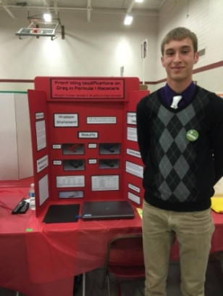
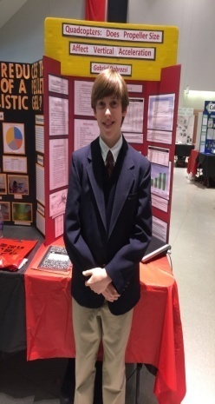
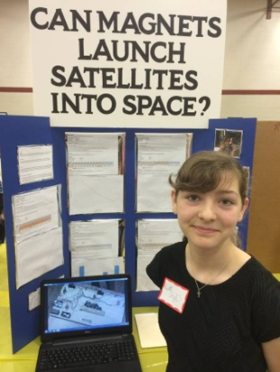
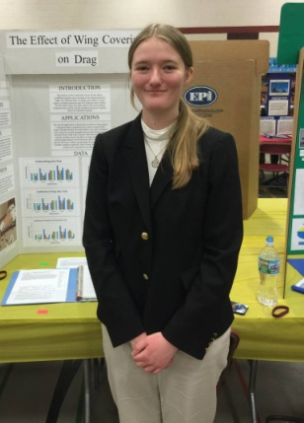
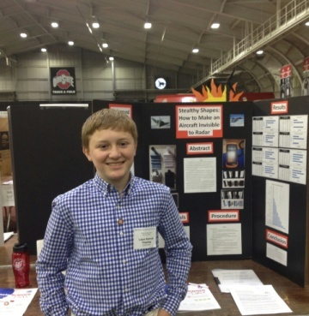
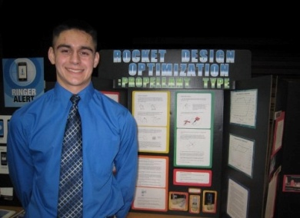
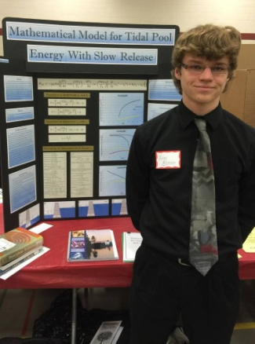
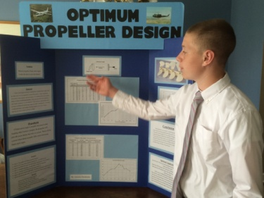
AIAA DAYTON-CINCINNATI / ASME DAYTON
ANNUAL HONORS & AWARDS PROGRAM
Science Fair
Award Winners
University of Dayton May 21, 2015

Slide 2
ASME Dayton Section
2014-2015 Executive Board
Tim Leger Chair & Webmaster
Vince Miller Treasurer
Tommy Baudendistel Honors and Awards
Science Fair Awards
Sivaram Gogineni Executive Director
General Board Member: Joe Miller
Cedarville University: Darren Holland
Wright State University: Ha-Rok Bae
University of Dayton: David Myszka
Thank you for your dedication!

Slide 3
ASME Dayton Section
2014-2015 Activities
October 2014
10 ^{th} DESS
March 2015
Support of 40th DCASS
Ohio West District Science Day
April 2015
Student Impromptu Design
Competition
2014-2015 Financial Support
TechFest
FIRST Lego League
Student sections (UD, WSU, Cedarville)
Engineers’ Week Activities at Valley
View middle school
Valley View Science Fair
Solar Splash
MWPG

Slide 4
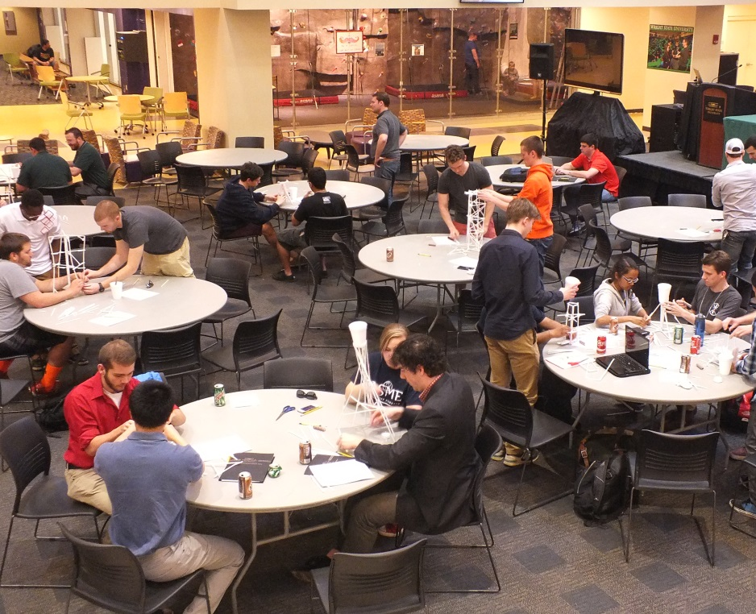
ASME Impromptu
Student Design Competition
Held 17 April at Wright State University
In conjunction with
AIAA Regional III Student Conference
25 Students & 7 Professional members attended
Students from Wright State University, Cedarville University, University of Illinois, and Cleveland State University
2 Challenges: Straw Tower & Parachute

Slide 5
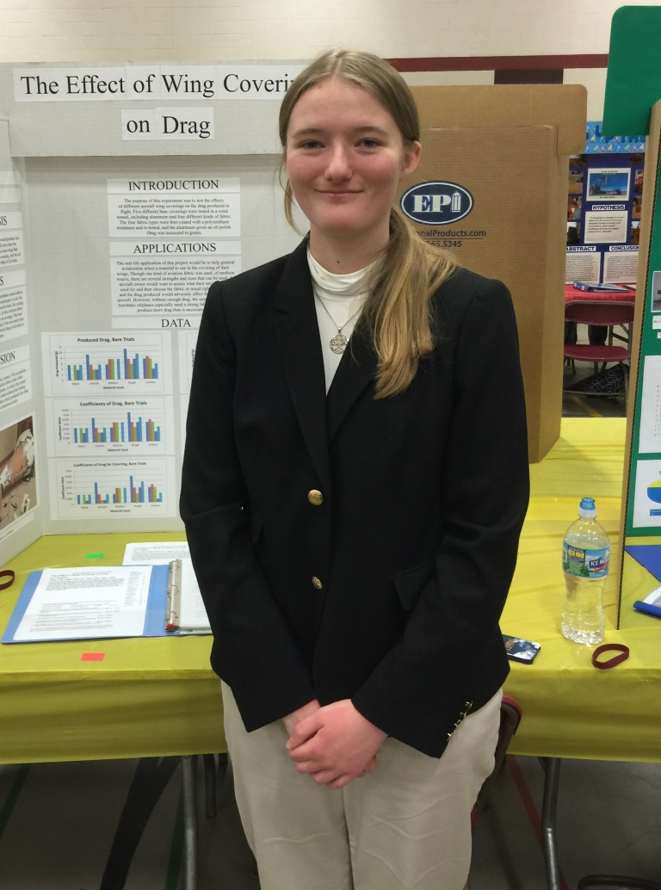
ASME Dayton Section
Science Fair Awards
Erin Rogers
“The Effect of Wing Covering on Drag”
Congratulations!!

Slide 6
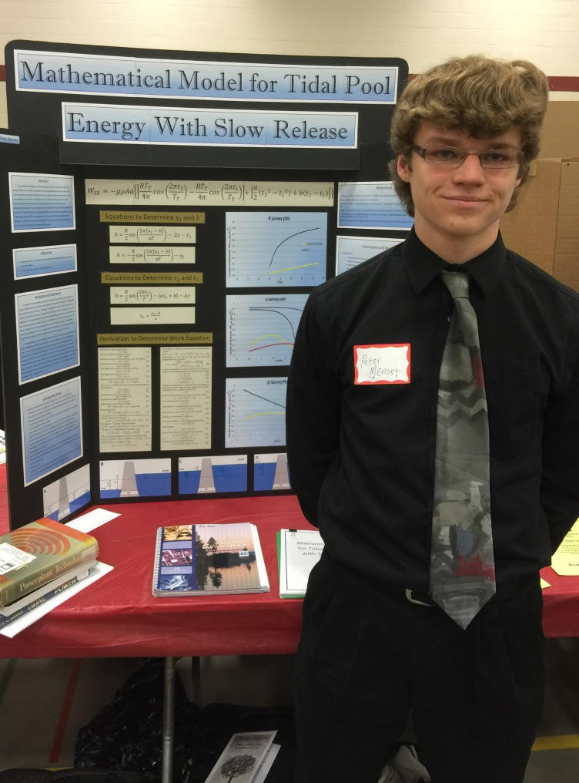
ASME Dayton Section
Science Fair Awards
Peter Menart
“Mathematical Model for
Tidal Pool Energy with
Slow Release”
Congratulations!!

Slide 7
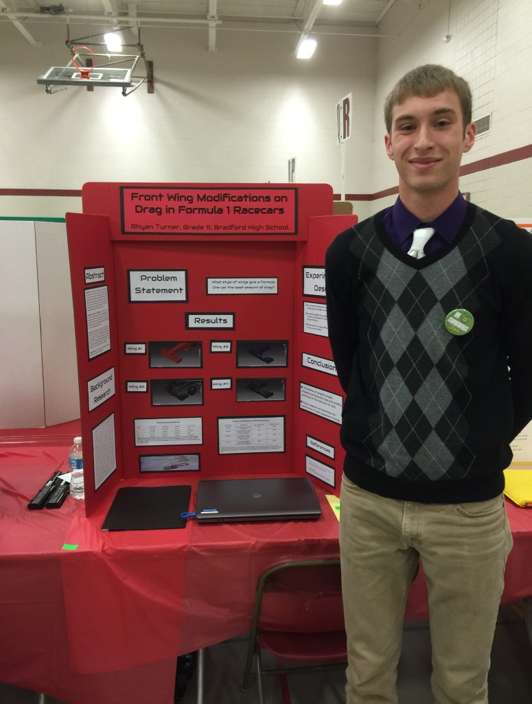
ASME Dayton Section
Science Fair Awards
Rhyan Turner
“Front Wing Modifications
on Drag in F1 Racecars”
Congratulations!!

Slide 8
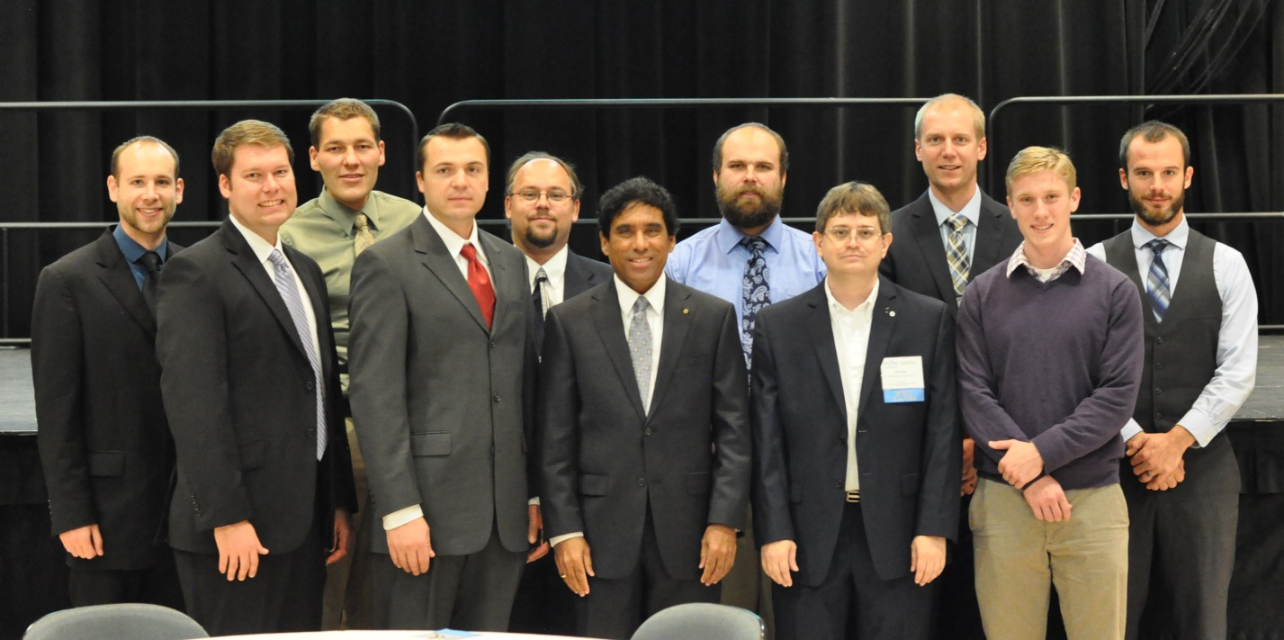
Tenth Annual DESS
Organizing Committee
Chair:
Sivaram Gogineni
Co-chair:
Drew Caswell
Marcus Bracey
Ryan Schmit Darren Holland Joe Miller Ben Halls Daniel Richardson Jake Schmidt Tim Leger
Vince Miller
Carl Tilmann
Keynote Address: Dr. Ian Clark
“Towards the Next 40 Years of Planetary Exploration: Advancing Aerodynamic
Decelators for the Future”
Thank you for your dedication!

Slide 9
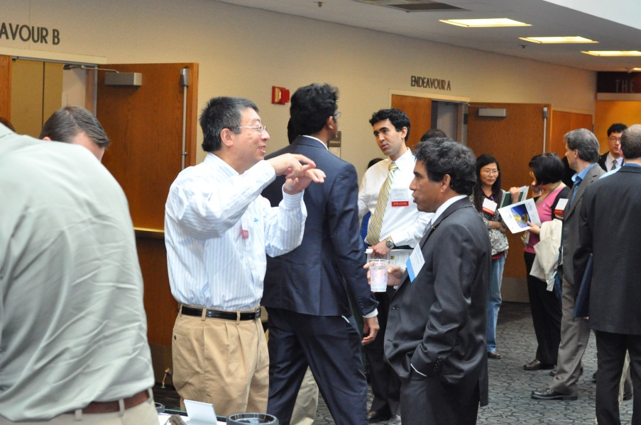
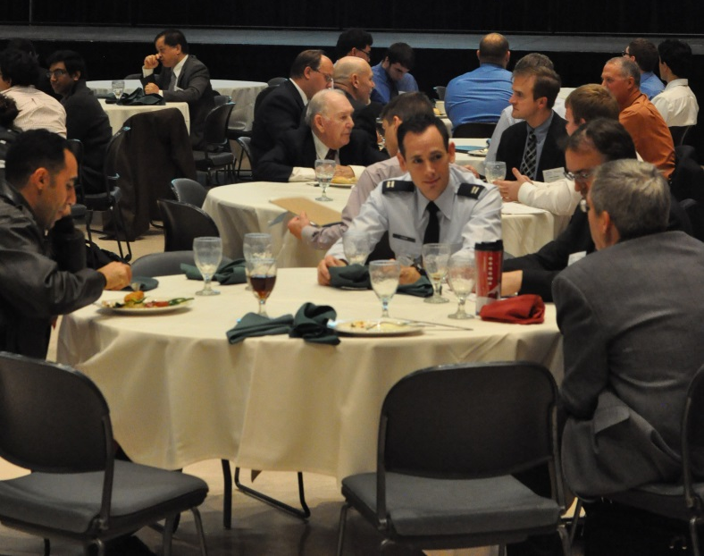
Tenth Annual DESS
Event Highlights
More than 150 participants
Keynote address given by Dr. Ian Clark
Systems Engineer at NASA’s
Jet Propulsion Laboratory
Over 100 Oral & Poster presentations
11th DESS scheduled for November 2, 2015 Wright State University Student Union
For further details: http://www.asmedayton.org/DESS

Slide 10
Tenth Annual DESS
Sponsors
Gold Sponsors
Silver Sponsors
Supporting Organizations
Thank you for your support!

Slide 11
ASME Dayton Engineering Sciences Symposium
Best Presentation Awards
Engineering Measurements: Daniel Clark
Additive Manufacturing: Kyle Harned,
Benjamin Raabe, Alexander Cozier,
Margaret Riley
Poster Session, College: Adam Hehr,
Marcelo Dapino, Paul Wolcott,
Matt Scheidt
Structures and Fatigue: Emily Henry Design & Optimization: Nidal Jodeh Materials: Abishek Kamaraj
Thermal Sciences: Mouleeswaran Palaniappan
Congratulations!!

Slide 12
ASME Dayton Engineering Sciences Symposium
Best Presentation Awards
Undergraduate Research: Adam Katterheinrich,
Nicholas Nielsen, Tyler Parcell
Renewable and Clean Energy: Rob Lafleur
Microstructures: Gregory Loughnane Fluid Dynamics & CFD: Arvind Mohan Engineering Education: Vidur Prasad Sensors: Jacob Singleton
Biomedical: Senia Smoot Light-Matter Interaction: William Vance Poster Session, High School: Ryan Wood
Congratulations!!

Slide 13
ASME Member Longevity
25 Years
William Andes
Paul Brown Thomas Eason Joseph Fulford Brent Hughes Mark Jenks
Christopher Murawski Christopher Murphy
Andrew Murray Timothy Norman Daniel Papay Richard Rivir
50 Years
Bill Elrod Roger Panton Reuben Wasserman
Congratulations!!

Slide 14
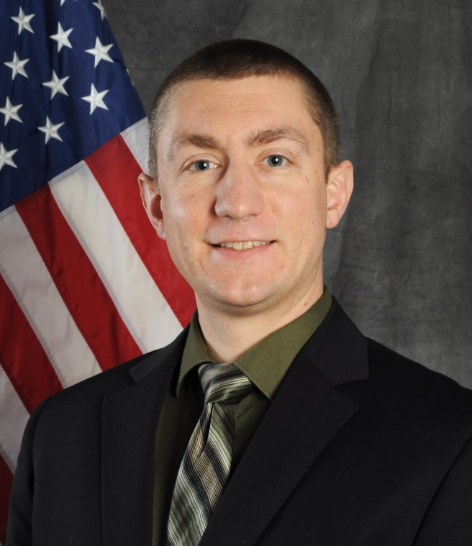
ASME Dayton Section
Young Engineer of the Year Award
Dr. Caleb Barnes
AFRL/RQVA
“Caleb Barnes is recognized for advancing the understanding of streamwise vortex-wing interaction.”
Congratulations!!

Slide 15
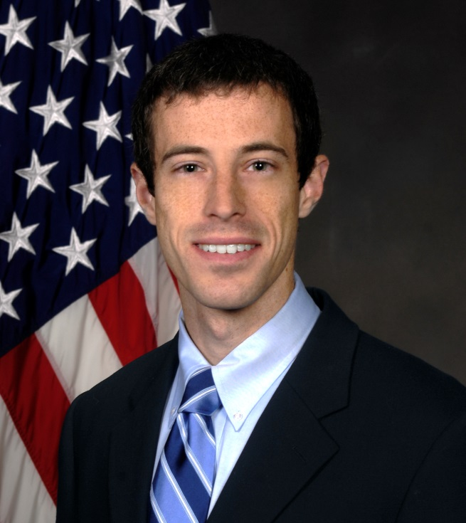
ASME Dayton Section
Young Engineer of the Year Award
Michael Ooten
AFRL/RQTT
“Michael Ooten is recognized
for significant contributions to
the design and development of advanced turbine components.”
Congratulations!!

Slide 16
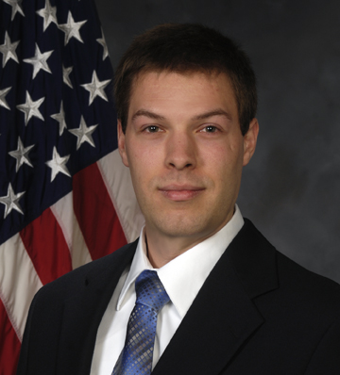
ASME Dayton Section
Outstanding Contribution Award
Dr. Michael List
AFRL/RQTT
“For contributions towards the advancement of reduced order modeling of advanced turbo-machinery engine inlets.”
Congratulations!!

Slide 17
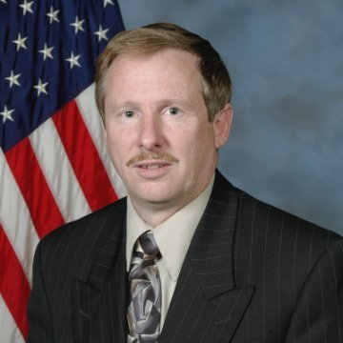
ASME Dayton Section
Lifetime Achievement Award
Dr. william Copenhaver
AFRL/RQTT
“In recognition of technical accomplishments in the areas of turbomachinery compressors
and flow control, along with sustained and distinguished service to both ASME and AIAA.”
Congratulations!!

Slide 18
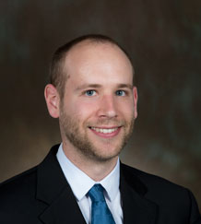
ASME Dayton Section
Chair’s Special Service Awards
Joe Miller
Darren Holland
“For outstanding service to the
ASME Dayton Section”
Congratulations!!

Slide 19
AMERICAN INSTITUTE OF AERONAUTICS AND ASTRONAUTICS
Dinner Meetings (2)
Lunch ‘n Learns (11)
STEM (Science Fairs; Women In Engineering Camp; Booths at Techfest, Air Show, SpaceFest, WACO Fly-In)
DCASS with Keynote Michael Drake
Tour of Hawthorn Hill with Stephen Wright
Tour of Mach 3 & 6 Wind Tunnels
Tour of Champaign Aviation Museum
Public Policy Meeting with Congressman Turner
Student Sponsorship at Air Camp
Others (Tours, SequestFest, π Day, CVD, NMUSAF Hollywood)
Hosted over 40 programs and events!

Slide 20
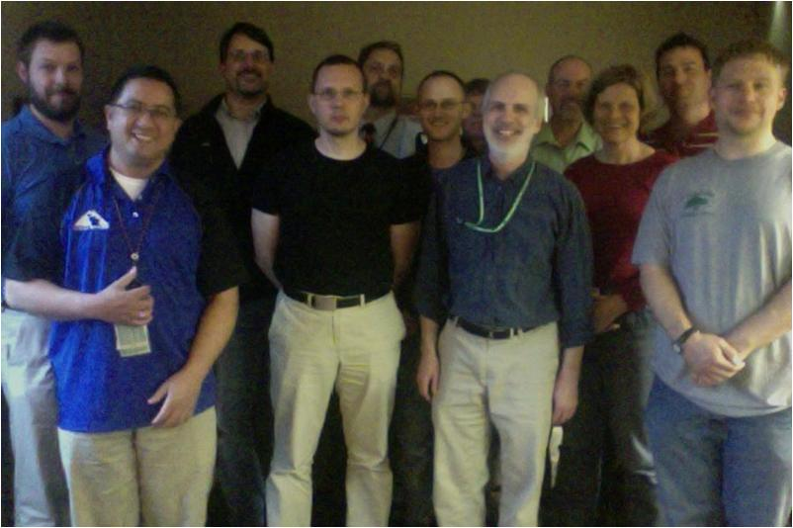
AIAA Dayton - Cincinnati Section
2014-2015 Executive Board
Lance Chenault Chair
Michael List Vice-Chair
Michael List Secretary
Jon Poggie Treasurer
Tim Cleaver Membership Chair
Oliver Leembruggen College Outreach
Carl Tilmann Pre College Outreach
Margo Ratcliff Webmaster
Eric Swenson Symposium Chair
Rob Mitchell Young Professionals
Mike White Public Policy
Darius Sanders Career & Workforce Development
Sivaram Gogineni Regional Representative
Marc Polanka Honors and Awards
Thank you for your dedication to our members!

Slide 21
TechFest
Science Fairs
iSPACE
Air Show
Great Wright Carnival
AIAA k-12 STEM Volunteers
Neil Bechmann
José Camberos
Darrell Crowe
Anang Dadhich
Chad Geesman
Sid Gunasekaran
McKenzie Kinzbach
Oliver Leembruggen
David Liu
Wayne Lundberg
Doris Lundberg
Mark Mears
Rob Mitchell
Marc Polanka
Rory Roberts
Dhuree Seth
Rachel Sharp
Josh Shepard
Andrew Stubblebine
Carl Tilmann
Sam Tilmann
Mike White
Rick Wills
Cale Zeune
UD D/B/F Team
UD Student Branch
UC Student Branch
WSU Stud. Branch
Air Force Institute of Technology
Dayton Affiliated Societies Council
National Museum of the USAF
WACO Fly-in
ScopeOut
Engineers Week
Thank You!!!
Wright-Dunbar Urban Nights
STEMulate your Mind
SpaceFest

Slide 22
Montgomery County Science Fair
“Can Magnets Launch Satellites into Space?”
1st Place – Curtis Mackey
Congratulations!!

Slide 23
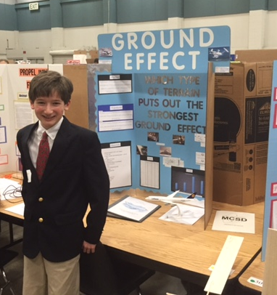
Montgomery County Science Fair
“Ground Effect”
2nd Place – Nicolas Pitrof
Congratulations!!

Slide 24
Montgomery County Science Fair
“Optimum Propeller Design”
3rd Place – Julianna Huber
Congratulations!!

Slide 25
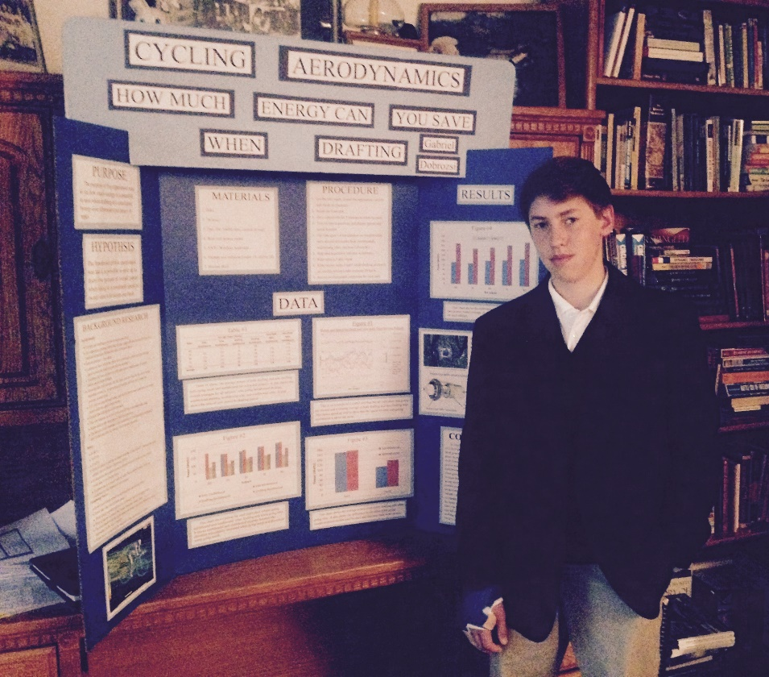
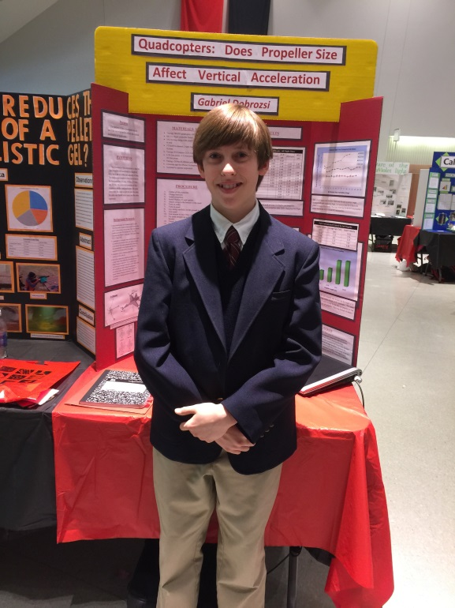
Southwest Ohio Science and Engineering Expo
“Cycling Aerodynamics”
1st Place – Gabriel Dobrozsi
Congratulations!!

Slide 26
Southwest Ohio Science and Engineering Expo
“The Effects of Different Angled Winglets in a Turbulent Flow”
2nd Place
Adam Smith
Congratulations!!

Slide 27
Southwest Ohio Science and Engineering Expo
“Stealthy Shapes: How to Make an Aircraft Invisible to Radar”
3rd Place
Kevin Wedig
Congratulations!!

Slide 28
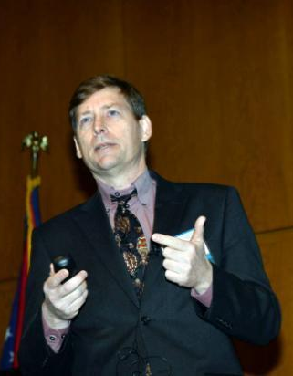
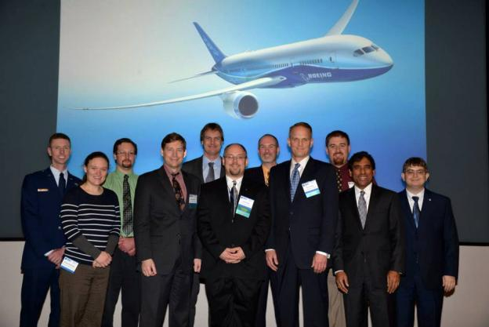
AMERICAN INSTITUTE OF
AERONAUTICS AND ASTRONAUTICS
40th Annual
Dayton-Cincinnati
Aerospace Sciences Symposium
4 March 2015
Sinclair
Conference
Center
Dayton, Ohio
2015 DCASS Organizing Committee
2015 DCASS Keynote Speaker
Mr. Michael Drake

Slide 29
Symposium Planning Team
Executive Co-Chairs Eric Swenson & Ryan Schmit
Technical Program Ryan Schmit & Mike Brown
Aide Markus Rumpfkeil
Art-in-Science Levi Elston
Corporate Sponsorship Sivaram Gogineni, Cindy Obringer
Exhibits Mike Brown
Keynote Lance Chenault
Publications Travis Michalak
Registration Amy Lynch & Tim Leger
Government Approval Eric Swenson & Ryan Schmit
Venue and Gifts Beth Huelskamp
Web Site Tim Leger

Slide 30
40th Dayton-Cincinnati
Aerospace Sciences Symposium
Recognizes the Following
CO-SPONSORS
American Institute of Aeronautics and Astronautics
Illinois Section
AFIT Student Section
ONU Student Section
UC Student Section
UD Student Section
UK Student Section
WSU Student Section
American Society of Mechanical Engineers
Dayton Section
Cedarville Student Section
UD Student Section
WSU Student Section
American Chemical
Society
Dayton Section
Association for Unmanned
Vehicle Systems International
Wright-Kettering Chapter
Human Factors and
Ergonomics Society
Southern Ohio Chapter
Institute of Environmental
Sciences and Technology
Greater Ohio Chapter
Society for the Advancement of
Materials and Process Engineering
Midwest Chapter
Society for
Applied Spectroscopy
Ohio Valley Section

Slide 31
39th Dayton-Cincinnati
Aerospace Sciences Symposium
Recognizes the Following
CORPORATE-SPONSORS
College of Engineering
and Applied Sciences
Platinum Level Sponsor
Gold Level Sponsor
Gold Level Sponsor
Gold Level Sponsor
Gold Level Sponsor
Gold Level Sponsor
Silver Level Sponsor
Silver Level Sponsor
Silver Level Sponsor

Slide 32
40th Dayton-Cincinnati
Aerospace Sciences Symposium
Recognizes the Following
CORPORATE-SPONSORS
Gold Level Sponsor
Gold Level Sponsor
Gold Level Sponsor
Silver Level Sponsor
Silver Level Sponsor
Silver Level Sponsor
Silver Level Sponsor

Slide 33
Art-in-Science Awards: First Place
Betty Quinton (AFRL)
“Silica Viper with Iron Particles”
Congratulations!!

Slide 34
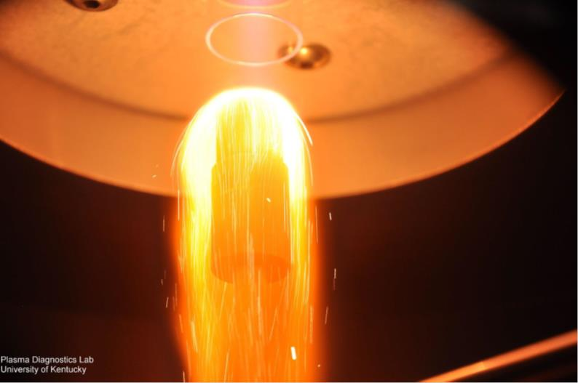
Art-in-Science Awards: Second Place
Helmut Koch (UK)
“1st vs 4th State of Matter"
Congratulations!!

Slide 35
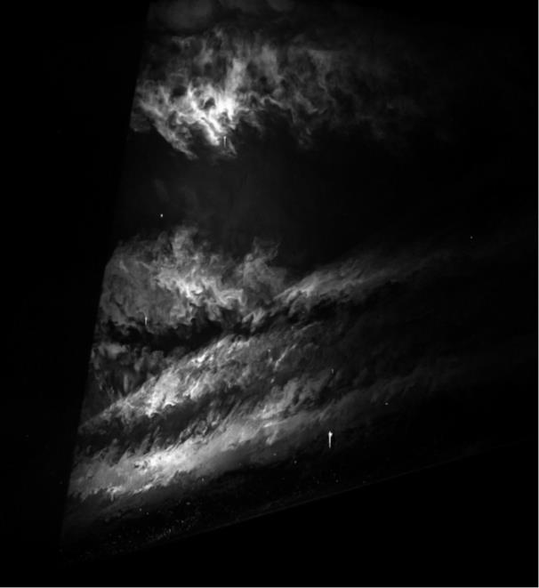
Art-in-Science Awards: Third Place
Paul Gulotta (AFIT)
“Supersonic Clouds”
Congratulations!!

Slide 36
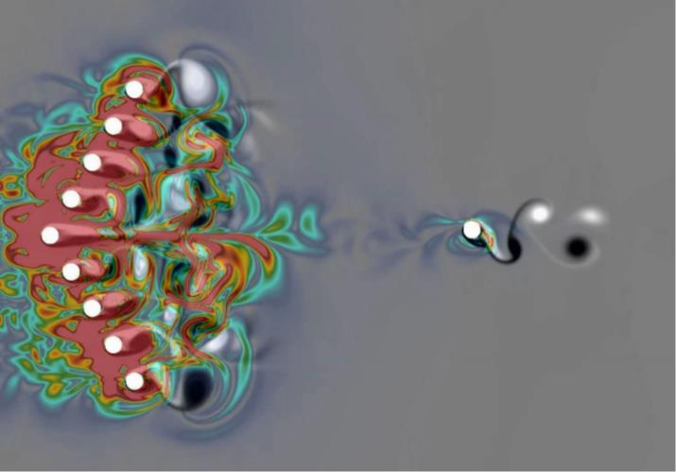
Video-in-Science Awards: First Place
Christopher Koehler (UTC)
“Goal Driven Flow Visualization of a Complex Vortical Flow”
Congratulations!!

Slide 37
Best Technical Presentation Awards
Joseph Ausserer Fuels AFIT
Tyler Dicks Space Cedarville
Christopher Fisher Optimization WSU
William Graves Materials AFIT
Kerianne Gross Space Dynamics AFRL
Benjamin Halls Combustion NRC
Joshuah Hess Space Dynamics AFIT
Adam Katterheinrich Facilities GoHypersonic
Joseph Miller Imaging & Diagnostics AFRL
Pablo Mora Experimental Applications UC
Mark Reeder Fluid Dynamics AFIT
Jim Tancred Hypersonics UD
Matthew Tufts Hypersonics OAI
Tim Vincent CFD UD
Connor Wiese Heat Transfer AFIT

Slide 38
Best Technical Presentation Award
Technical Category: Fuels
Joseph Ausserer – (AFIT)
Title: “Mapping of Fuel Anti-Knock Requirements for Small Remotely Piloted Aircraft Engines”
Congratulations!!

Slide 39
Best Technical Presentation Award
Technical Category: Space
Tyler Dicks – (Cedarville)
Title: “Versatile 3D Optical Measurement System for Satellite Deployables”
Congratulations!!

Slide 40
Best Technical Presentation Award
Technical Category: Optimization
Christopher Fisher – (WSU)
Title: “Multi-Fidelity Design Optimization: Trust Region Centric Low-Fidelity Correction Methodology”
Congratulations!!

Slide 41
Best Technical Presentation Award
Technical Category: Materials
William Graves – (AFIT)
Title: “Topology Optimization of a Penetrating Warhead”
Congratulations!!

Slide 42
Best Technical Presentation Award
Technical Category: Space Dynamics
Kerianne Gross – (AFRL)
Title: “Run Time Assurance Architecture and Formal Methods Analysis Applied to a 6U CubeSat Attitude Control Subsystem”
Congratulations!!

Slide 43
Best Technical Presentation Award
Technical Category: Experimental Methods
Benjamin Halls – (SE)
Title: “X-ray Diagnostics of Liquid Mass Distribution in Impinging Jet Sprays”
Congratulations!!

Slide 44
Best Technical Presentation Award
Technical Category: Space Dynamics
Joshuah Hess – (AFIT)
Title: “Alternate Numerical Solutions to Wahba's Problem for Satellite Attitude Determination”
Congratulations!!

Slide 45
Best Technical Presentation Award
Technical Category: Facilities
Adam Katterheinrich – (GoHypersonic)
Title: “Hypersonic Wind Tunnel Ceramic Core Storage Heater Design”
Congratulations!!

Slide 46
Best Technical Presentation Award
Technical Category: Imaging & Diagnostics
Joseph Miller – (AFRL)
Title: “High-Speed, Burst-Mode PIV for Space–Time Correlations in Turbulent Jets”
Congratulations!!

Slide 47
Best Technical Presentation Award
Technical Category: Experimental Applications
Pablo Mora – (UC)
Title: “Acoustic Field of a Rectangular Supersonic Jet Exhausting Over a Flat Surface”
Congratulations!!

Slide 48
Best Technical Presentation Award
Technical Category: Fluid Dynamics
Mark Reeder – (AFIT)
Title: “Flight Tests Conducted to Analyze a Store Experiencing Cavity Flow”
Congratulations!!

Slide 49
Best Technical Presentation Award
Technical Category: Hypersonics
Jim Tancred – (UD)
Title: “Aerodynamic Database Generation for a Hypersonic Vehicle using Variable-Fidelity Kriging and Control Elevon Deflection as an Independent Variable”
Congratulations!!

Slide 50
Best Technical Presentation Award
Technical Category: Hypersonics
Matthew Tufts – (OAI)
Title: “Calculation of Base State for Transition Prediction on Cones at Angle of Attack”
Congratulations!!

Slide 51
Best Technical Presentation Award
Technical Category: CFD
Tim Vincent – (UD)
Title: “A Simulation Tool for Aiding Qualification of Additively Manufactured Parts”
Congratulations!!

Slide 52
Best Technical Presentation Award
Technical Category: Heat Transfer
Connor Wiese – (AFIT)
Title: “Comparison of Adiabatic Effectiveness Measurements Obtained from Pressure Sensitive Paint and Infrared Thermography Techniques”
Congratulations!!

Slide 53
AIAA Member Longevity
25 Years
Aaron Altman Rick Graves Marc Polanka
Lynnette Blaney Frank Gulczinski Mark Reeder
Richard Cedar Robert Hancock Cynthia Robertson
Sean Coghlan Michael Ol R Kevin Rowe
40 Years
Eric Abell
Steward Cline
Keigh Davis
Dean Matz
William Smith
Congratulations!!

Slide 54
AIAA Member Longevity
50 Years
Awatef Hamed
Herbert Hickey
Joseph Martino
Charles Suchomel
60 Years
Congratulations!!

Slide 55
AIAA Associate Fellows
John Doty
Faure Joel Malo-Molina
Congratulations!!

Slide 56
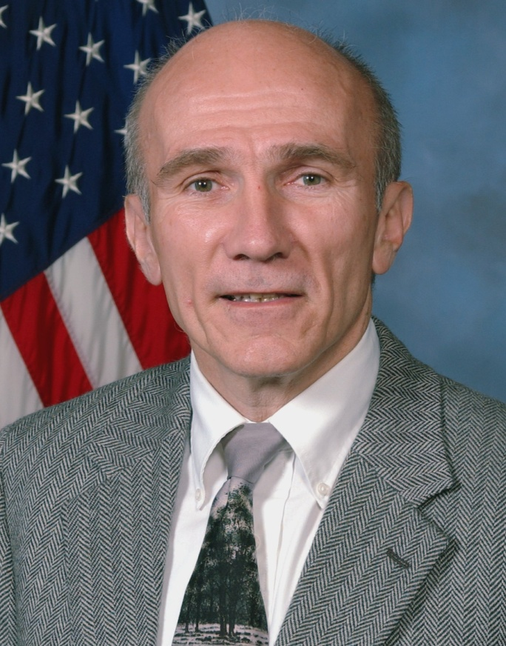
AIAA Fellow
Dr. Jim Gord (AFRL)
“For tireless work to enhance high tech leadership by the United States, in particular in the areas of optics and photonics, sensors, and directed energy.”
Congratulations!!

Slide 57
AIAA Fellow
Dr. Ajit Roy (AFRL)
“For tireless work to enhance high tech leadership by the United States, in particular in the areas of optics and photonics, sensors, and directed energy.”
Congratulations!!

Slide 58
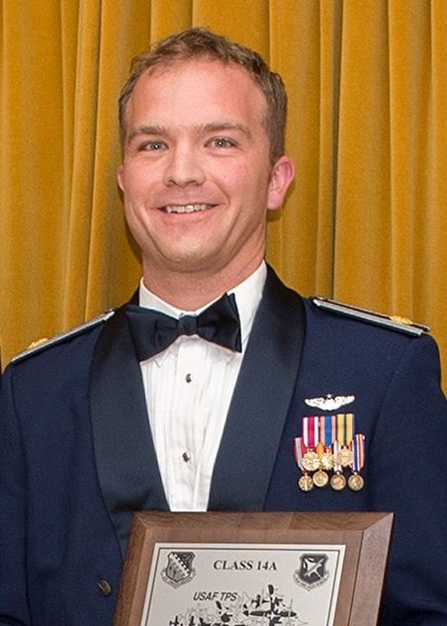
AFIT Graduate Student Award
for Service Excellence
Capt Joshua Shepard (AFIT)
For his master’s thesis entitled “Reverse Radio Frequency Fingerprinting for Remote Indoor Localization”
Congratulations!!

Slide 59
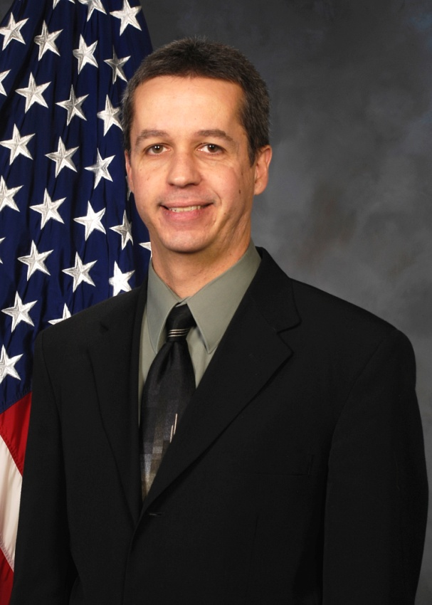
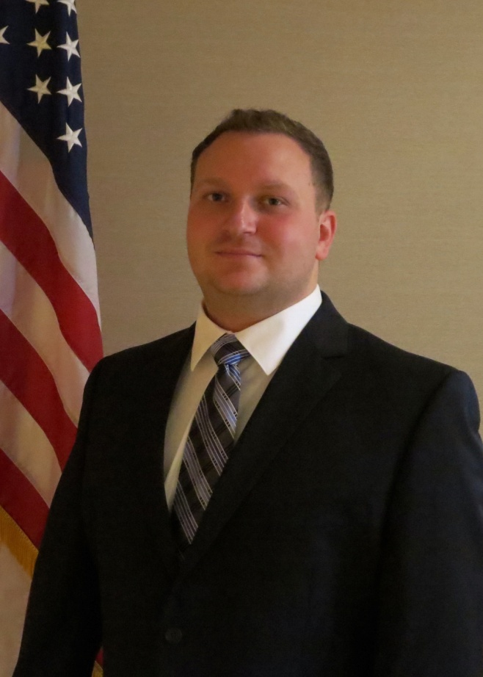
Outstanding Technical Contribution - Science
Dr. Stephen Clay (AFRL)
Mr. Philip Knoth (AFRL)
“For outstanding technical contributions and leadership in advancing the state of the art in progressive damage modeling for composite structures”
Congratulations!!

Slide 60
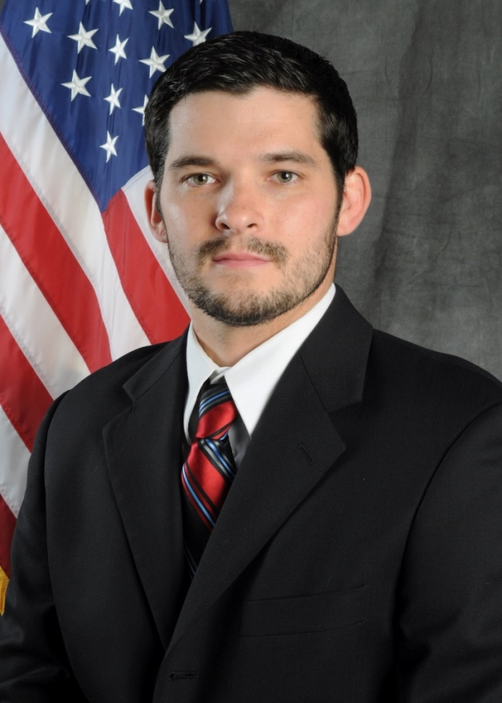
Outstanding Technical Contribution - Application
Mr. Doug Szczublewski (AFRL)
“For his exceptional work with small Unmanned Aircraft Systems (UAS) vehicle development leading to improved Intelligence, Surveillance and Recognizance (ISR) capability for the Department of Defense.”
Congratulations!!

Slide 61
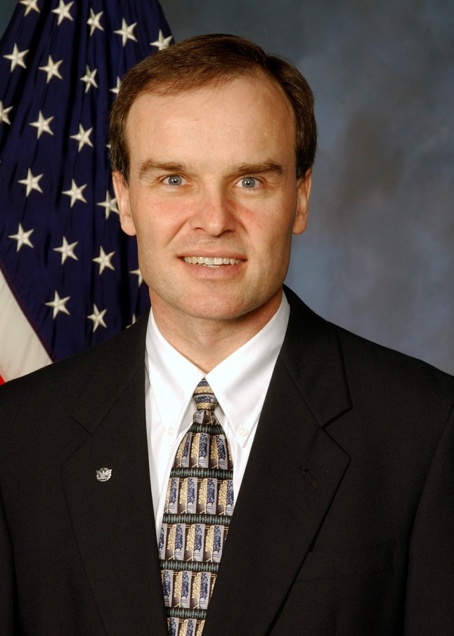
Outstanding Management Contribution Award
Dr. Robert Hancock (AFRL)
“For leading the RQT in-house High Impact Technologies (HIT) program at AFRL and managing the chief scientist innovative research funds, SBIR and STTR funds, and handling conference travel”
Congratulations!!

Slide 62
AIAA Chairman’s Award
Rich Snyder (AFRL)
“For his service to the organization over the past decade with particular emphasis on his efforts to obtain conference attendance approval for government employees desiring to attend DCASS”
Congratulations!!

Slide 63
AIAA Chairman’s Award
Michael White (OAI)
“For his service to the organization as the Section Public Policy Lead with particular emphasis on his efforts to organize a section meeting with Congressman Mike Turner and arrange a private tour of The Wright Brothers home "Hawthorn Hill"”
Congratulations!!

Slide 64
AIAA New Section Chair
Jayesh Mehta (Belcan)
Congratulations and Good Luck!!

