Slide 1
SciTech 2024 Conference Report
NDA TC Fall Meeting 20th October 2023

Slide 2
Conference Planning Timeline
Call for Papers Released: 28th March 2023
Abstract Submission Deadline: 25th May 2023
Abstract Reviews Completed: 22nd June 2023
Decision Deadline: 29th June 2023
Sessioning Deadline: 13th July 2023
Author Notifications: 25th August 2023
Upcoming Dates to Remember:
4th December 2023 20:00 hrs. ET: Deadline to submit final manuscript*
18th December 2023: Early bird registration
8th - 12th January 2024: In-Person SciTech 2024 in Orlando, Florida
*ALL authors - No Paper, No Podium and No Podium, No Paper Policy

Slide 3
Abstract Submissions: Topics

Slide 4
Abstract Submissions: Summary
Scitech 2024 | No. Of Extended Abstracts
Technical Paper (Completed Research) | 13
Technical Paper (Work in Progress) | 14
Student Paper Competition | 6
Oral Presentation only (by invitation only) | 1
Total | 34

Slide 5
After Decisions
Topics | NDA Papers accepted | NDA Papers rejected*
Design Under Uncertainty (joint NDA/MDO) | 4 | 1
Model Order Reduction & Surrogate Modeling | 9
Physics-informed Machine Learning (joint NDA/MDO) | 1
Probabilistic Machine Learning for Uncertainty Quantification in Complex Systems (Joint NDA/MDO) | 5
Reliability and Risk Analysis Methods and Applications | 3 | 1
Uncertainty Quantification and Analysis of Complex Aerospace Systems (joint NDA/GNC) | 6
Uncertainty Quantification and Model Validation for ICME (joint MAT/NDA) | 3
Uncertainty Quantification for Acoustics and Structural Dynamics (Joint NDA/SD) | 1
Total | 32
*Based on reviewers' recommendation

Slide 6
NDA Through the Years
Note:
For 1999-2022, counts for NDA only, Joint, Special (oral-only, etc.) were not available
Year 2023 & 2024 does not include withdrawals

Slide 7
Session Information
Please accept/decline session chair requests ASAP.
If you are unavailable/available to chair, please let me know.

Slide 8
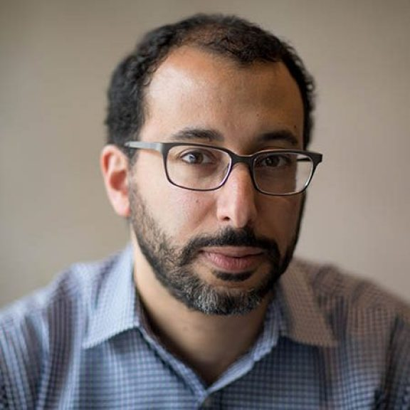
NDA Lecture
Prof. Youssef M. Marzouk (MIT)
Title: TBD
Monday January 8th, 9:30-10:45 am at Orlando Ballroom N
Bio: Youssef Marzouk is a professor in the Department of Aeronautics and Astronautics at MIT and co-director of the MIT Center for Computational Science and Engineering. He is also a core member of MIT’s Statistics and Data Science Center and director of MIT’s Aerospace Computational Design Laboratory. His research interests lie at the intersection of computation and statistical inference with physical modeling. He develops new methodologies for uncertainty quantification, Bayesian modeling and computation, data assimilation, experimental design, and machine learning in complex physical systems. His methodological work is motivated by a wide variety of engineering and environmental applications. He is an avid coffee drinker and occasional classical pianist.
Abstract: TBD

Slide 9
Thank you for your attention !
9

Slide 10
Backup

Slide 11
2024 NDA Conference CFP
Non-Deterministic Approaches Technical Discipline Description
Non-Deterministic Approaches are technologies aimed at understanding and managing the variations and uncertainties inherent in the design, production, and operation of physical systems. These technologies include computational and experimental methods to quantify uncertainty, propagate uncertainty in complex physical systems, design systems under uncertainty, and estimate the reliability and performance of these systems for confident decision making. The NDA conference is a forum to discuss both the development of new methods for solving these problems and the application of non-deterministic approaches to problems of interest to the aerospace community. Student submissions are welcome and encouraged for competition for the The Southwest Research Institute Student Paper Award in Non-Deterministic Approaches.
Design Under Uncertainty (joint NDA/MDO)
Mesh Quality, Adaptive Meshing, Error Estimation, and Uncertainty Quantification (joint MVCE/NDA)
Model Order Reduction & Surrogate Modeling
Physics-informed Machine Learning (joint NDA/MDO)
Probabilistic Machine Learning for Uncertainty Quantification in Complex Systems (Joint NDA/MDO)
Reliability and Risk Analysis Methods and Applications
Uncertainty Analysis Advancements for Wind Energy Applications (joint NDA/WE)
Uncertainty Quantification and Analysis of Complex Aerospace Systems (joint NDA/GNC)
Uncertainty Quantification and Model Validation for ICME (joint MAT/NDA)
Uncertainty Quantification for Acoustics and Structural Dynamics (Joint NDA/SD)

Slide 12
ADS 2022-2023
Will be updated in Dec. 2023
 | 2022 |  |  |  |  |  | 2023
 | Submitted | Rejected | Accept % | Withdrawn | Withdraw % | Scheduled | Submitted | Rejected | Accept % | Scheduled
Adaptive Structures (AS) | 48 | 1 | 98% | 5 | 11% | 42 | 44 | 3 | 93% | 41
Design Engineering (DE) | 20 | 4 | 80% | 3 | 19% | 13 | 24 | 2 | 92% | 22
Dynamic Specialists | 65 | 1 | 98% | 5 | 8% | 59
Materials (MAT) | 90 | 21 | 77% | 8 | 12% | 61 | 107 | 18 | 83% | 89
MDO | 99 | 7 | 93% | 28 | 30% | 64 | 116 | 12 | 90% | 104
NDA | 48 | 4 | 92% | 8 | 18% | 36 | 39 | 3 | 92% | 36
Spacecraft Structures (SCS) | 41 | 4 | 90% | 3 | 8% | 34 | 60 | 8 | 87% | 52
Structural Dynamics (SD) | 83 | 10 | 88% | 16 | 22% | 57 | 136 | 20 | 85% | 116
Stuctures (STR) | 126 | 3 | 98% | 19 | 15% | 104 | 139 | 7 | 95% | 132
Survivability (SUR) | 20 | 8 | 60% | 4 | 33% | 8 | 7 | 2 | 71% | 5
System Engineeinrg (SE) | 25 | 0 | 100% | 5 | 20% | 20 | 31 | 4 | 87% | 27
Complexity in Aerospace (CASE) |  |  |  |  |  |  | 8 | 1 | 88% | 7
Total | 665 | 63 | 91% | 104 | 17% | 498 | 711 | 80 | 89% | 631
Notes:
For NDA, 39 submitted (instead of 40 as on slide 3) due to one paper being moved to APA.

