Slide 1
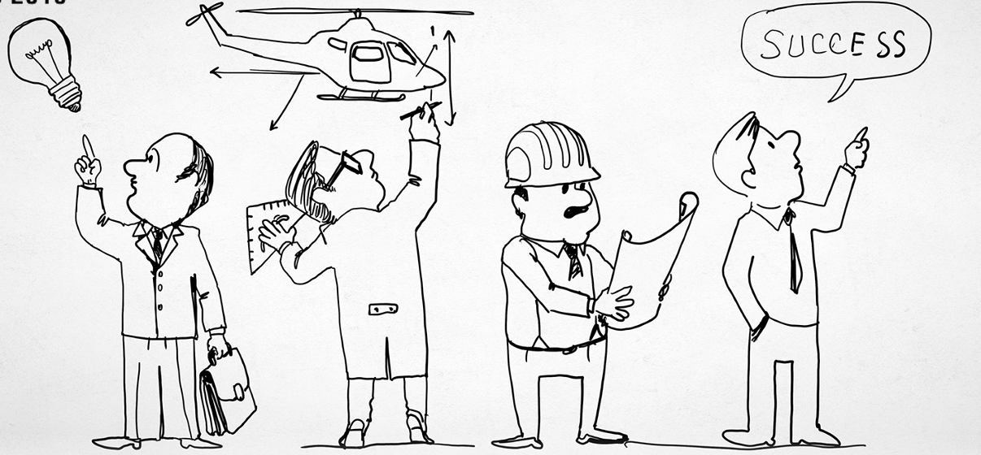
AIAA San Gabriel Valley Seminar
February 13 at 11 am, PST
RSVP online: https://tinyurl.com/ExtremeEng
Insert relevant image here
Extreme Engineering: Adventures in Deep Space
Abstract: Our speaker will discuss the design challenge of highly unique, high risk, missions of space exploration-- where mission success requires what could be termed “Extreme Engineering.”
About the Speaker:
David Oberhettinger is the founder of Deep Space Engineering Technology, a firm that consults in the engineering of spaceflight systems destined for operation in deep space.
In 2020 he was appointed by the U.S. Department of State to the U.S. Permanent Mission to the International Atomic Energy Agency, the UN’s nuclear watchdog. Following retirement from the NASA/Caltech Jet Propulsion Laboratory (JPL) in Pasadena, California (in 2020), he remains JPL’s Chief Knowledge Officer Emeritus. JPL is this world’s leading spacecraft design and operations center for the robotic exploration of deep space; we have visited all the planets (and discovered 28 Earth-like exoplanets), placed five rovers on Mars, landed by a methane lake on Titan, and both Voyager spacecraft have left the solar system and are operating in interstellar space.
Beyond serving as JPL’s first Chief Knowledge Officer, additional responsibilities within the JPL Office of the Chief Engineer included assuring engineering excellence in the design, test, and operation of robotic interplanetary spacecraft and planetary probes. This has included managing the JPL Engineering Standards Office and the JPL Spaceflight Engineering Research Program, chairing the JPL Lessons Learned Committee, and serving as a member of the JPL Engineering Board.
His primary technical expertise is in spacecraft design, spaceflight risk management, and failure modes for deep space systems. He studied space environmental physics under Dr. Henry Garrett.
Prior to work at JPL, as manager of Northrop Grumman’s Spacecraft Engineering Technology Department, he oversaw all Northrop Grumman work related to the design or test of spacecraft systems. Before that, he served as a public interest lobbyist in Washington, D.C. A past General Chair, he was appointed by the president of AIAA to the Board of Directors of the 66th annual Reliability & Maintainability Symposium.
Lt Col Oberhettinger, USAF Auxiliary, also serves as pilot or aircrew on USAF-assigned benevolent missions. In his spare time, he flies a Cardinal (tail number N13HK) to captivating places like Santa Barbara or Santa Ynez. He is a frequent speaker on the international conference circuit, having delivered keynote speeches in Canada, Europe, South America, Australia, and Africa-- plus a recent TED-type Talk.

